Slide 1
This is a hidden slide
Dear honorable teacher please follow the instructions that has given in the slide notes (under the every slide). It would be helpful to take a successful class. Thanks a lot. I wish you good luck.

Slide 2

Welcome
Notes:
Teacher can say it orally.

Slide 3
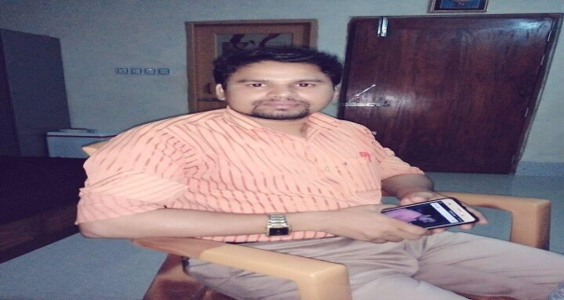

Identity
Md. Farid Uddin
Assit: Teacher (English)
Dupchanchia D.S Fazil Madrasah,Dupchanchia, Bogura.
English For Today
Class : 9+10
Unit : Six.
Notes:
Teacher can hide this slide.

Slide 4






Look at the Flags
Maldives
Sri Lanka
India
Nepal
Pakistan
Bhutan
These are our neighbor countries.
Do you know ,what are the countries names of these flags?
Notes:
T will try to elicit the ans: from ss if fail then T will give feedback by clicking .

Slide 5
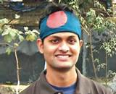
Do you know what is his great achievement ?
Do you know him ?
His great achievement is hasting BD flag on The Himalayes.
He is Musa Ibrahim.
Let enjoy a video clip
Notes:
T will try to elicit the ans: from ss if fail then T will give feedback by clicking .

Slide 6
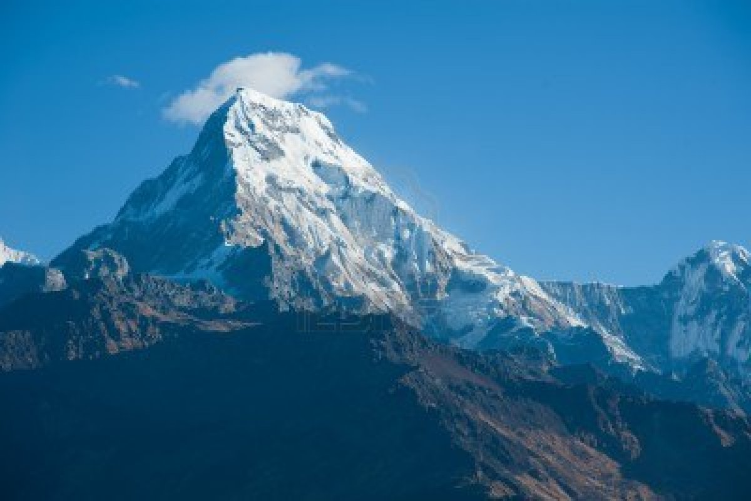
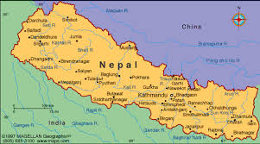

Lesson Declaration
Do you know what is the name of this peak?
Do you know where is Mount Everest?
Our Neighbors
Nepal, the land of Everest
Mount Everest is in Nepal.
Mount Everest

Slide 7
Learning Outcomes
After completing this lesson students will be able to ----
ask and answer questions.
read travel ads and talk about them.
write letters to friends describing places of interest.

Slide 8
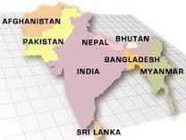

Look at the map, talk with your friend and find out where is NEPAL.
AFGHANISTAN
PAKISTAN
NEPAL
BHUTAN
BANGLADESH
INDIA
MYANMAR
To find out, click on country name.
SRI LANKA
Notes:
T will try to elicit the ans: from ss if fail then T will give feedback by clicking on the country name.

Slide 9
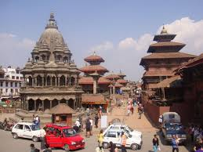
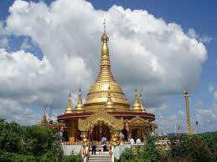

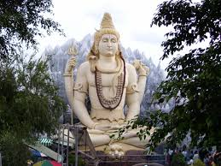
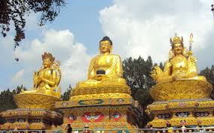
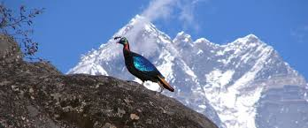
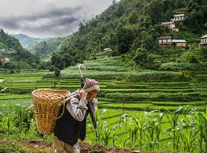
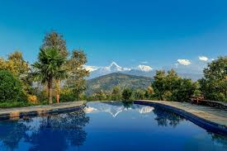
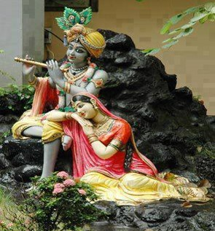
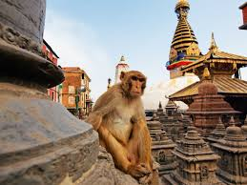
Look at the pictures and talk with your partner what about the pictures.
It is also known as the only Hindu Kingdom in the world.
Nepal known as the Land of Everest which is one of the most charming countries in Asia.
The kingdom of Nepal is a small land of sublime beauty.
It has some of the world`s best and very important temples.
It is a country that is rich in scenic beauty and culture heritage.
Notes:
After showing every picture T will try to elicit answer from the ss what about the picture, teacher can share with them then will show next picture.

Slide 10
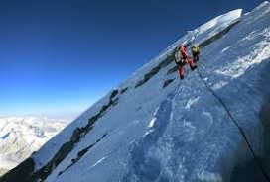
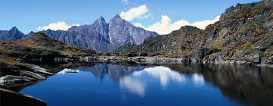
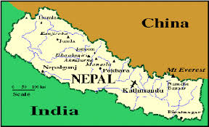


Look at the pictures and talk with your partner what about the pictures.
Pokhara
Here the temperatures reach up to ${40}^{0}c$ in April and May and monsoon rains drench this region from June to September.
Nepal lies between India and the Tibetan part of China.
North of that is the slope of the main section of the Himalayan range. This part of Nepal has some of the highest peaks of the world including Everest.
This small country has an area of 147,181 square kilometers. Southern Nepal is tropical low land known as the Tari Plain.
The central hill-lands including the Kathmandu and Pokhara valleys have a temperate climate and are also influenced by the monsoon.
Notes:
After showing every picture T will try to elicit answer from the ss what about the picture, teacher can share with them then will show next picture.

Slide 11

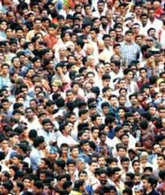
Population of Nepal
The population is primarily rural.
Kathmandu, the capital city, has less than one million inhabitants.
Nepal is home to nearly 29,000,000 people.
Notes:
After showing every picture T will try to elicit answer from the ss what about the picture, teacher can share with them then will show next picture.

Slide 12
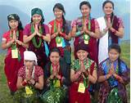
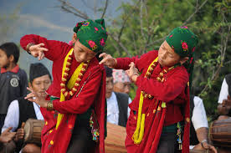
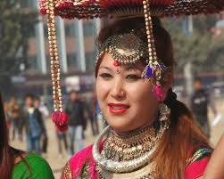
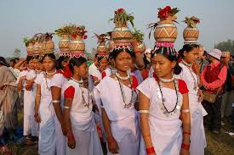
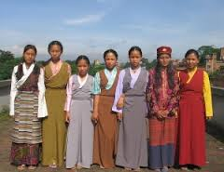
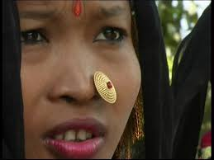
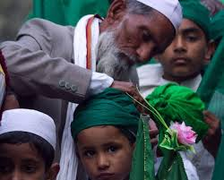
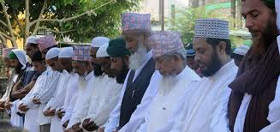
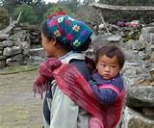
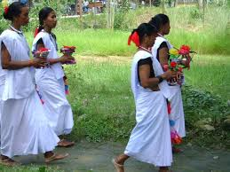
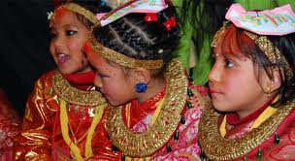
Ethnic groups in NEPAL
Tharu
Damai
Magur
Muslim
Chetri
Bahun
In total, there are 103 castes and ethnic groups living in this small country. The two largest of such groups are known as Chetri and Bahun.
About 48% of the people speak Nepali. Anong other languages spoken are Maithali, Bhojpuri, Tharu and Tamang.
Nepal demographic features are complicated not only by dozens of ethnic groups, but by different castes.
Notes:
After showing every picture T will try to elicit answer from the ss what about the picture, teacher can share with them then will show next picture.

Slide 13

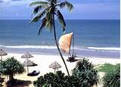
Charming
Key word
The scenery is very charming to look at.
Meaning
(Click here)
Any things, sceneries or countries that look very beautiful.
Notes:
At first teacher will show the words then ask his/her students to tell the meaning and making sentences. If they fail teacher will show the picture again. For feedback click on meaning button.

Slide 14
Sublime
Key word
The picture`s has a sublime beauty.
Meaning
(Click here)
Any things that look at the best or most excellent kind.
Notes:
At first teacher will show the words then ask his/her students to tell the meaning and making sentences. If they fail teacher will show the picture again. For feedback click on meaning button.

Slide 15
Temple
Key word
In Nepal has some of the world`s best and important temples.
A building used for the worship of a god or goddess.
Meaning
(Click here)
Notes:
At first teacher will show the words then ask his/her students to tell the meaning and making sentences. If they fail teacher will show the picture again. For feedback click on meaning button.

Slide 16
Monsoon
Key word
Monsoon rains falls in Nepal from June to September.
Meaning
(Click here)
A wind in South Asia, which blows from the south-East in summer.
Notes:
At first teacher will show the words then ask his/her students to tell the meaning and making sentences. If they fail teacher will show the picture again. For feedback click on meaning button.

Slide 17
Ethnic
Key word
In Bangladesh has also many ethnic groups such as Chakma, Monipuri etc.
Meaning
(Click here)
A nation, race or tribe that has a common cultural tradition.
Notes:
At first teacher will show the words then ask his/her students to tell the meaning and making sentences. If they fail teacher will show the picture again. For feedback click on meaning button.

Slide 18
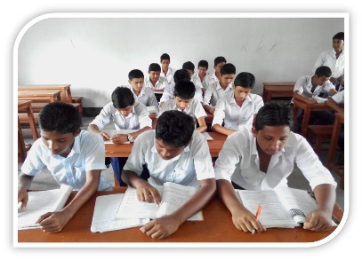
Read the text a, b, and c, silently then look at the picture and answer the following questions.
Where is Nepal situated ?
Write about the population, weather and culture of Nepal.
Notes:
Teacher can take it by written / orally.

Slide 19
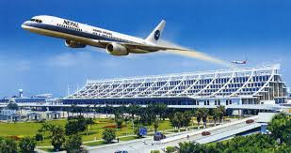
Pair works: Go to section ‘E’ and read the advertisement of a package tour to Nepal.
Now, discuss with your friend if the statements are true or false. If false give the correct information.
Notes:
SS will open their book, read the advertisement then give the answer.

Slide 20
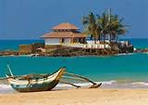
Home work
Write an e-mail to your friend highlighting the main attraction of Nepal.
Notes:
Teacher can give some instructions about the home work.

Slide 21
Acknowledgement
We would like to express our cordial gratitude to the Ministry of Education, Directorate of Secondary & Higher Education, NCTB, a2i
and
the panel of honorable editors ( Md. Jahangir Hasan, Associate Professor (English) TTC, Rangpur, Ranjit Poddar, Associate Professor (English) TTC, Dhaka, and Urmila Ahmed, Associate Professor (English) TTC, Dhaka, to enrich the contents.

Slide 22
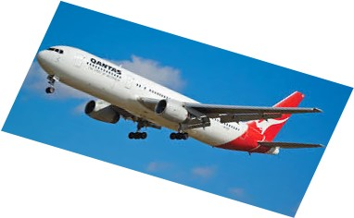
Thanks and goodbye.
Notes:
Teacher can use any other language.

