Slide 1
WELCOME
My dear students

Slide 2
Lilufa Begum
Assistant Teacher
Patanondi Government Primary School
Chouddagram, Cumilla.

Slide 3
Introducing Lesson
Class: 3
Subject: English
Unit: 25, Lesson: 1-3
Title: What sounds do they make
Time: 40 minutes

Slide 4
Learning Outcomes
Students will be able to:
Say words and sentence with proper pronunciation
Talk about animal’s sound and identify them

Slide 5
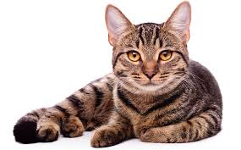
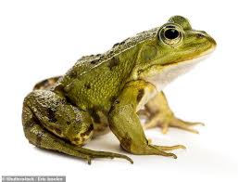
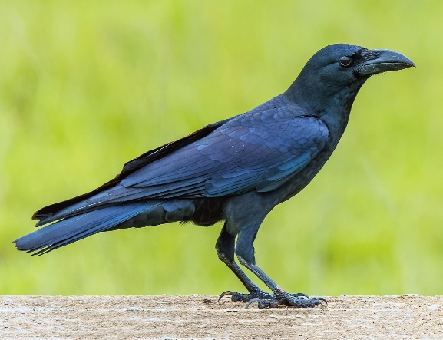
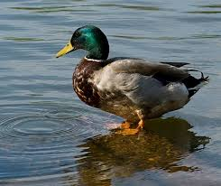
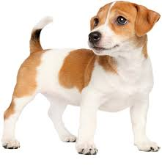
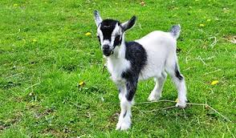
Look at the pictures

Slide 6
What sounds do
they make?

Slide 7
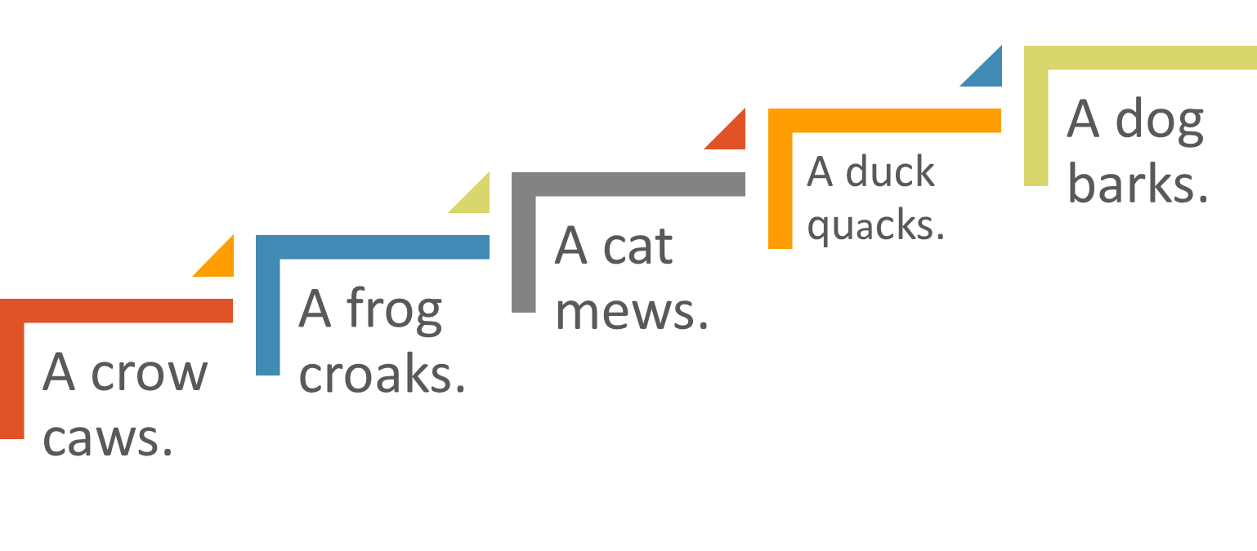


Look at the stairs and say what kinds of sound they make.
A goat bleats

Slide 8

B. Read and Match
Dog
Cat
Crow
Goat
Duck
frog
Caw
Bark
Quack
Croak
Bleat
mew

Slide 9
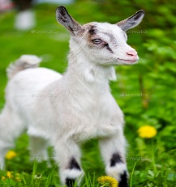
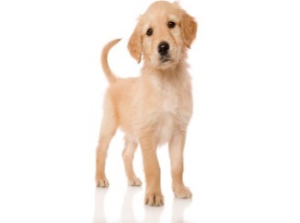
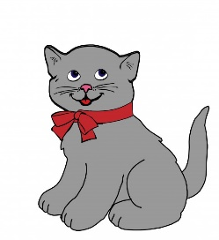
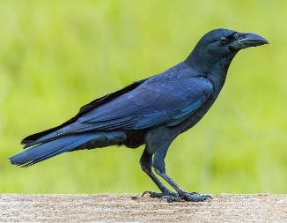
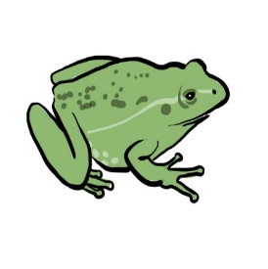
C. Read and write in your exercise book
One has been done for you
A goat bleats.
A dog barks.
A cat mews.
A frog croaks.
A crow caws.

Slide 10
Evaluation
To speak
To write

Slide 11
THANK YOU
Lilufa Begum
E-mail: lilufab8@gmail.com

