Slide 1
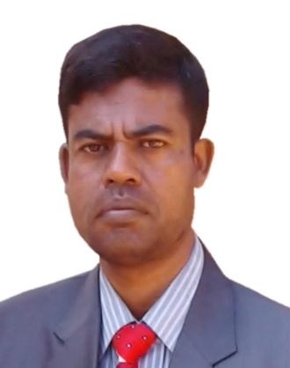
IDENTITY
MD. ABDUR RAZZAK
HEAD TEACHER
DHALAHARA WESTPARA
SECONDARY GIRLS’ SCHOOL
E-mail: abdurrazzakmtrt@gmail.com
Phone number: 01721588402

Slide 2
TOPIC
DIALOGUE WRITING
TITLE : LOAD SHEDDING
CLASS : ix & x
Time : 50 minutes

Slide 3
Acknowledgement
Muktopaath, NCTB , A2I respective officials & Prof. S. Yoffie
Note for the teachers:
Implementation of such model content depends on the class room situation and skills of the teachers. If the situation demands please edit it according to Ss’ demands.

Slide 4
LEARNING OUTCOMES
After the end of the lesson the Ss will be able to –
say the causes of load shedding.
write bad effect of load shedding.
explain solution of load shedding.
Write a dialogue on load shedding.

Slide 5
Warm up
5 min.
Dhalahara Westpara Secondary Girls’ School
WELCOME TO MULTIMEDIA CLASS
ENGLISH

Slide 6
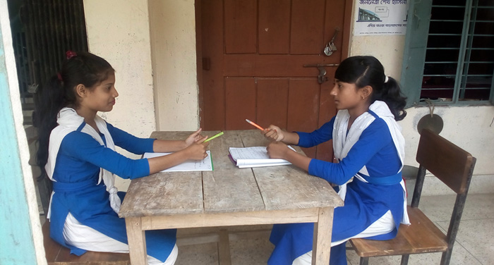
What are they doing?
Look at the picture.
They are making a dialogue.

Slide 7
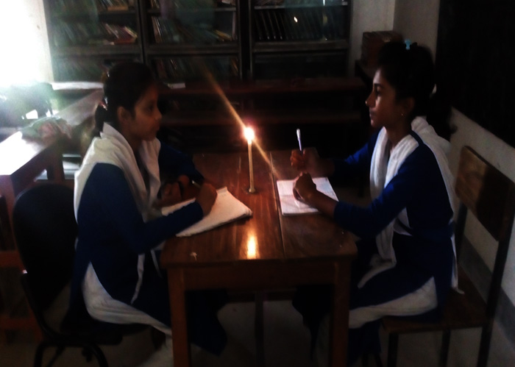
Why are they reading lighting candle ?
Because load shedding is going on.

Slide 8
So , What is today’s lesson?
WRITING DIALOGUE ABOUT LOAD SHEDDING

Slide 9
Could you remind what is dialogue?
Dialogue is a written or spoken conversation between two or more persons.

Slide 10
INDIVIDUAL WORK 10 MINUTES
by answering question
during the pic hour
When does it occur?
Electricity is in.
Load Shedding
BREAK

Slide 11
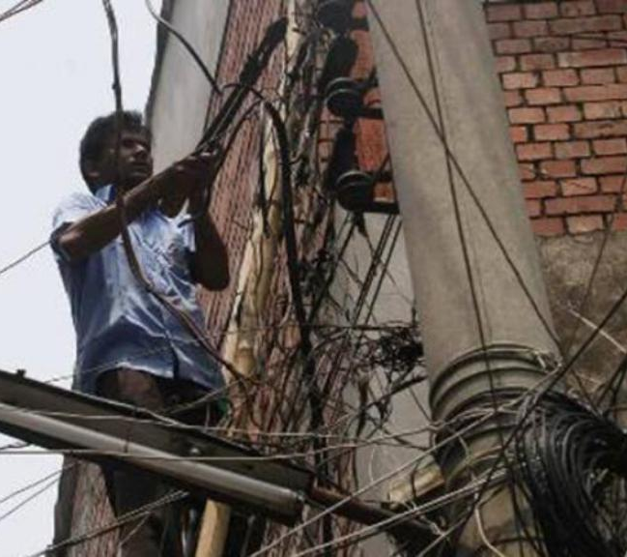
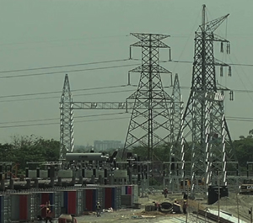
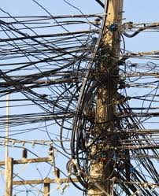
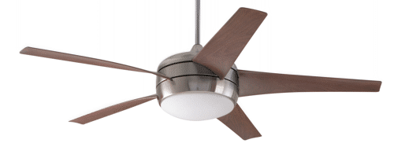
due to system loss
due to illegal connection
due to misuse
due to less production
Why does it occur?

Slide 12
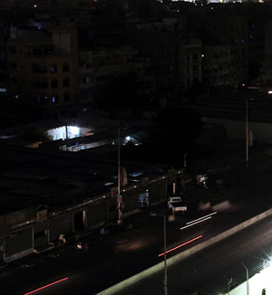
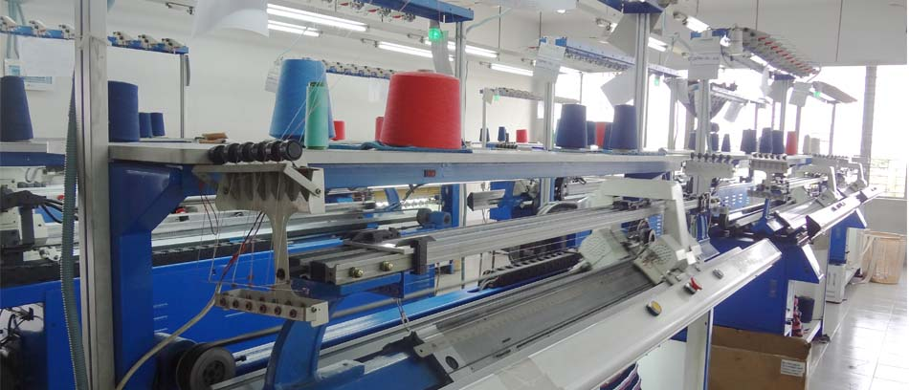
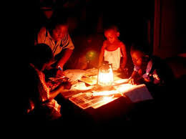
productions are stopped.
environment becomes dark.
students can’t read.
What are the bad effects?

Slide 13
Way of reducing load shedding.
By solving the causes of load shedding.

Slide 14
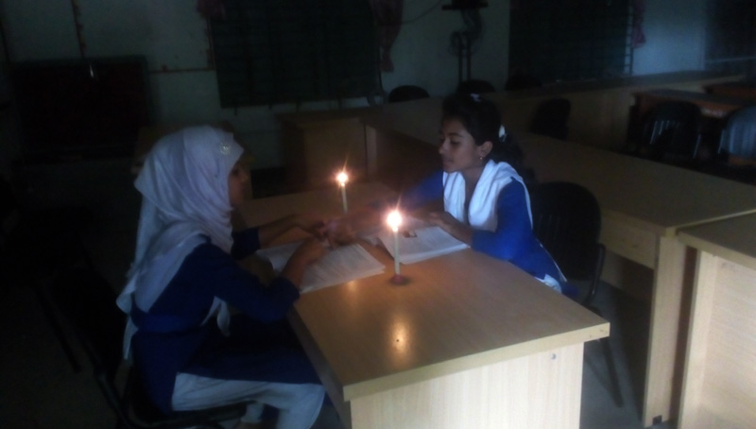
PAIR WORK 15 MIN.
Every single pair will make dialogue
Sumana : Hello Sharmin, how’re you?
Sharmin : Not so good.

Slide 15
Sumana : But why?
Sharmin : Don’t you see load shedding is going on ?

Slide 16
Sumana : What’s load shedding?
Sharmin : Load shedding is discontinuation of electricity supply.

Slide 17
Sumana: Do you mean it the break of electricity?
.
Sharmin : Yes, right you are.

Slide 18
Sumana : When does it occur?
Sharmin : During pick hour.

Slide 19
Sumana : But what’s the cause of load shedding?
Sharmin : There are many causes of load shedding.
.

Slide 20
Sumana : Please explain it clearly .
Sharmin : The main causes of load shedding are misuse of electricity, less production, mismanagement, corruption, illegal connection and system loss.

Slide 21
Sumana : Would you tell me the bad effect of load shedding?
Sharmin : Production and operation theater are stopped, students can’t study, environment becomes ghostly dark. So, anarchy increases.

Slide 22
Sumana : Then, what should we do?
Sharmin : We should stop corruption, illegal connection, system loss, misuse, mismanagement of electricity, increase production and so on.

Slide 23
Sumana : Thank you for your valuable information.
Sharmin : You too.

Slide 24
Group work 15 min.
Each group develop a dialogue on
“ Load shedding.”

Slide 25
A DIALOGUE BETWEEN SUMONA AND SHARMIN ABOUT LOAD SHEDDING
Sumana : Hello Sharmin, how’re you?
Sharmin : Not so good.
Sumana : But why?
Sharmin : Don’t you see load shedding is going on?
Sumana : What’s load shedding?
Sharmin : Load is discontinuation of electricity supply.
Sumana : Do you mean it the break of electricity?
Sharmin : Yes, right you are.

Slide 26
Sumana : When does it occur?
Sharmin : During pick hour.
Sumana : But what’s the cause of load shedding?
Sharmin : Yes, there are many causes of load shedding.
Sumana : Please explain it clearly .
Sharmin : The main causes of load shedding. They are
misuse of electricity, less production, mis-
management, corruption, illegal connection
and system loss.
Sumana : Would you tell me the bad effect of load
shedding

Slide 27
Sharmin : Production and operation theater are
stopped, students can’t study, environment
becomes ghostly dark. So, anarchy increases.
Sharmin : We should stopped corruption, illegal
connection, system loss, misuse and
mismanagement of electricity and increase
production and so on.
Sumana : Anything else ?
Sumana : Anything else ?
Sharmin : We should use energy saving bulb and be
aware of using electricity .
Sumana : Thank you for your valuable information.
Sharmin : Welcome.

Slide 28
FEEDBACK 5 min.
Answer the following questions-
What is load shedding ?
When does it occur ?
What are the causes of load shedding?
What is the bad effect of load shedding?
What should we do to stop load shedding?

Slide 29
Homework
Develop a dialogue about
Traffic Jam

Slide 30
Advice
“Save energy”

Slide 31
CLICK
THANKS ALL

