Slide 1


R
R
Welcome to Multi Media Class.
R
R
MKRM#AT#Khasgaon GPS#Chhatak#Sunamganj# 01712-114197

Slide 2
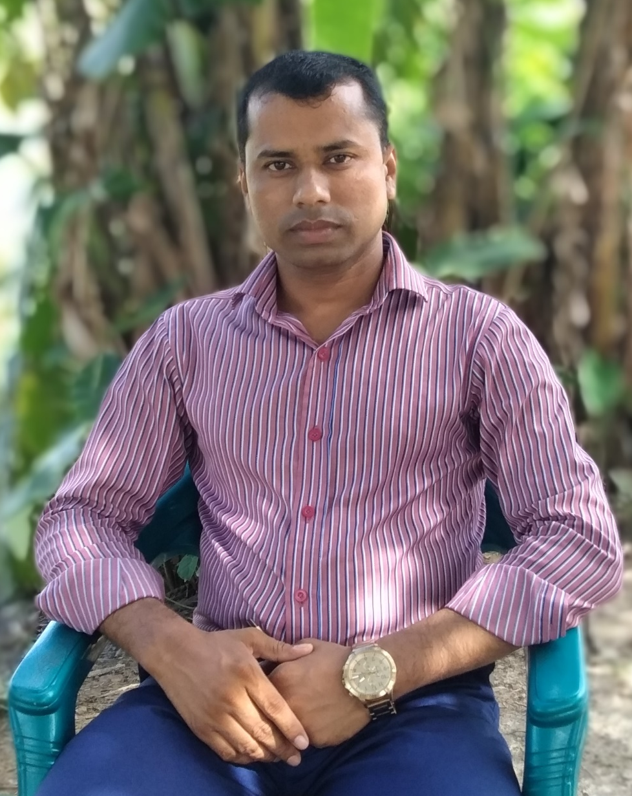

R
R
Khalidur Rahman Manik
Assistant teacher
Khasgaon G.P.S
Chhatak,Sunamganj
01712-114197
I
D
E
N
T
I
T
Y
Subject: English
Class: Five
Unit:21
Lesson:Last…station.
Date:19/10/2019
Time: 40 Minutes.
R
R
MKRM#AT#Khasgaon GPS#Chhatak#Sunamganj# 01712-114197

Slide 3
R
R
Good morning students.
How are you today?
Let’s sing the good morning song.
R
R
MKRM#AT#Khasgaon GPS#Chhatak#Sunamganj# 01712-114197

Slide 4
R
R
Can you tell me what we had learnt last class?
Several jobs descriptions.
Very good
R
R
MKRM#AT#Khasgaon GPS#Chhatak#Sunamganj# 01712-114197

Slide 5
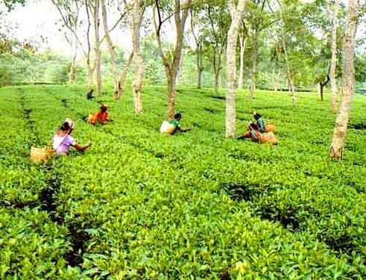
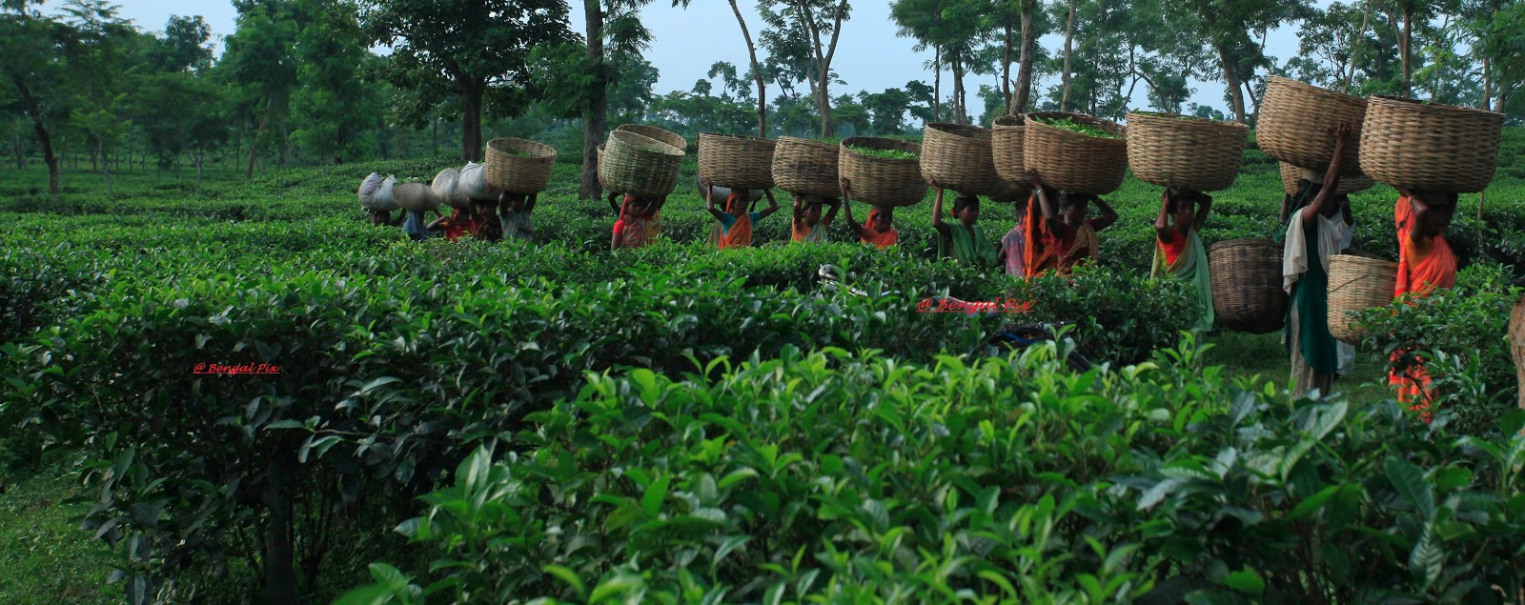
R
R
Have you ever been to a tea garden?
How was your experience?
R
R
MKRM#AT#Khasgaon GPS#Chhatak#Sunamganj# 01712-114197

Slide 6
R
R
Our today’s lesson is…
It was a great day!
R
R
MKRM#AT#Khasgaon GPS#Chhatak#Sunamganj# 01712-114197

Slide 7
R
R
Learning Outcomes
By the end of this lesson students will be able to…
Listening# 4.2.1 understand and enjoy simple stories.
Speaking# 6.2.1 talk about people,objects,events etc.
# 1.5.1 read words,phrases and sentences
in the text with proper pronunciation
stress and intonation.
R
R
MKRM#AT#Khasgaon GPS#Chhatak#Sunamganj# 01712-114197

Slide 8

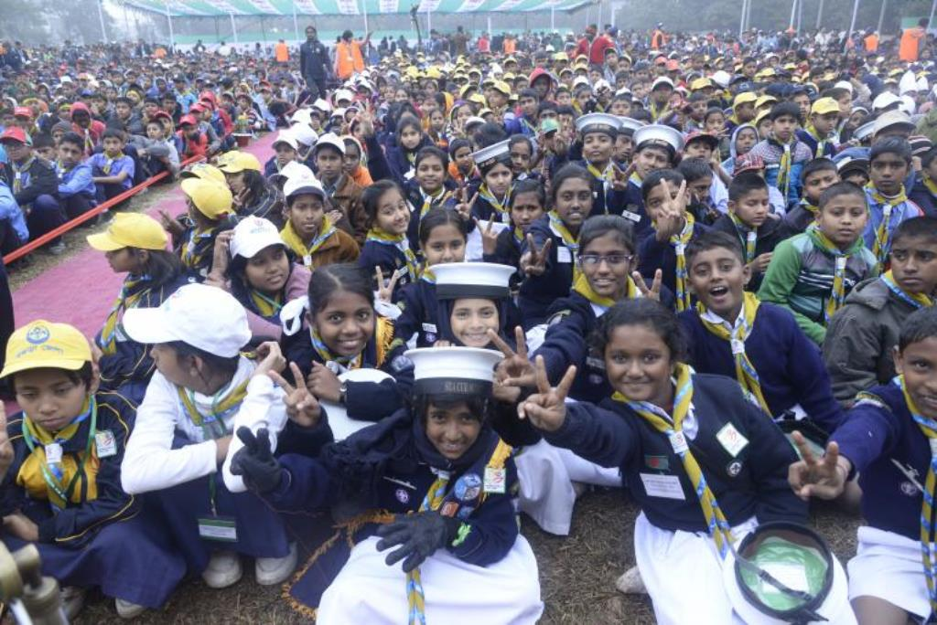
R
R
What is the logo about?
What is the picture about?
Scout logo
Cub camporee
R
R
MKRM#AT#Khasgaon GPS#Chhatak#Sunamganj# 01712-114197

Slide 9
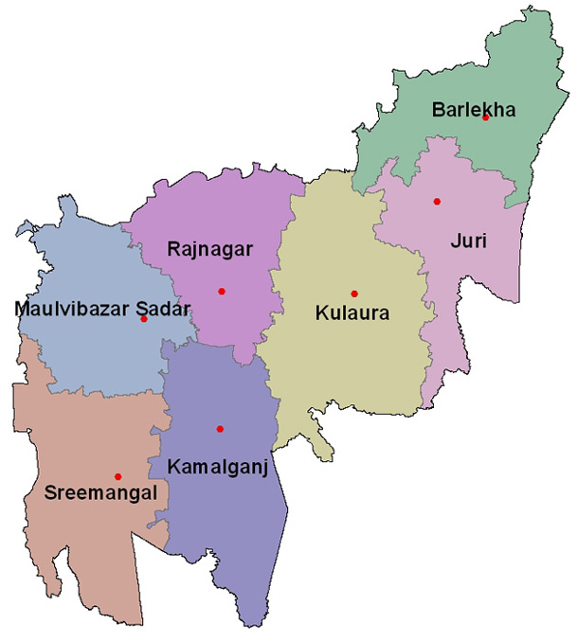

R
R
Look at the map of Moulvibazar district.
Sreemangal upozila.
R
R
MKRM#AT#Khasgaon GPS#Chhatak#Sunamganj# 01712-114197

Slide 10
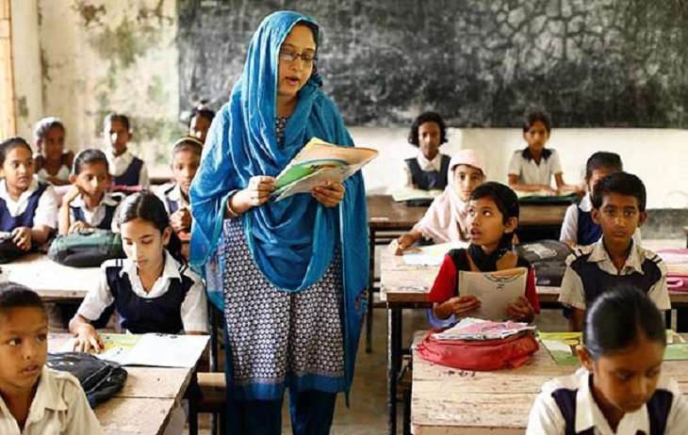
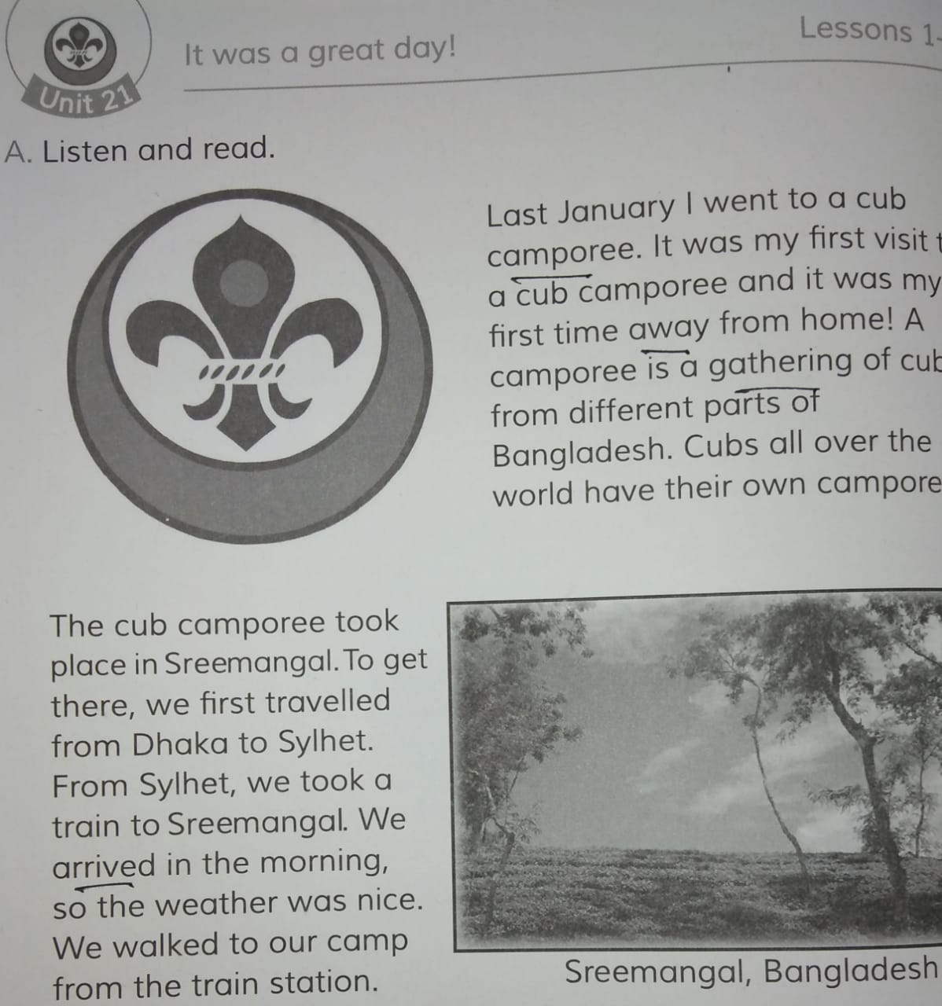
R
Open at page 82 0f your EFT book.
R
I’ll read the text and you will repeat after me.
R
R
MKRM#AT#Khasgaon GPS#Chhatak#Sunamganj# 01712-114197

Slide 11
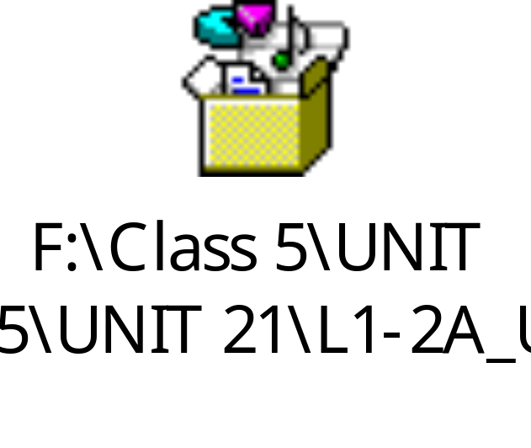
R
R
Dear students, now I’ll play the audio of the text.
You will listen very carefully and then repeat aftet it.
R
R
MKRM#AT#Khasgaon GPS#Chhatak#Sunamganj# 01712-114197

Slide 12
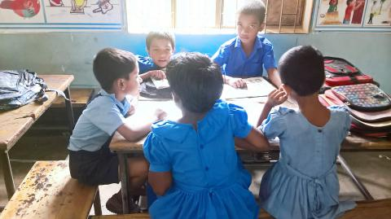
R
R
Group reading.
Every five students will make a group
and read out the text among themselves.
R
R
MKRM#AT#Khasgaon GPS#Chhatak#Sunamganj# 01712-114197

Slide 13
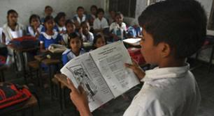
R
R
Some students will read out the
text by turns before the class.
R
R
MKRM#AT#Khasgaon GPS#Chhatak#Sunamganj# 01712-114197

Slide 14
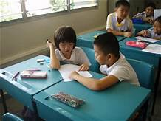
R
R
Students will read The text in pairs.
R
R
MKRM#AT#Khasgaon GPS#Chhatak#Sunamganj# 01712-114197

Slide 15
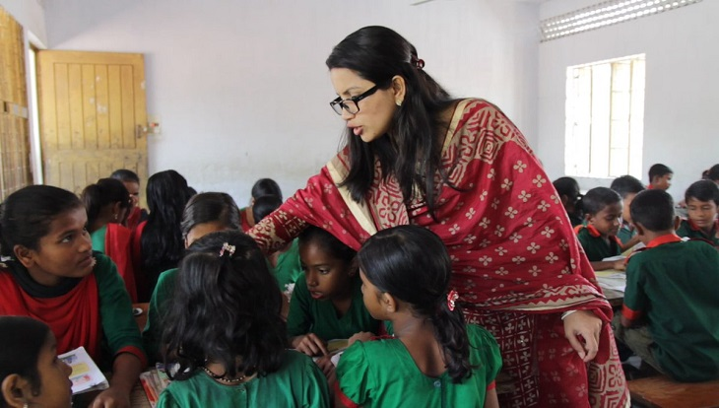
R
Students will read the text in pair.
R
Teacher will observe and evaluate
R
R
MKRM#AT#Khasgaon GPS#Chhatak#Sunamganj# 01712-114197

Slide 16
R
R
New words
Camporee
(Meeting of cubs)
Away
(Far)
Gathering
(Conference)
Arrived
(Reached)
I
N
D
I
V
I
D
U
A
L
W
O
R
k
R
R
MKRM#AT#Khasgaon GPS#Chhatak#Sunamganj# 01712-114197

Slide 17
R
R
Evaluation
Write the answers of the following questions in your notebooks.
(1) What is a camporee?
(2) Where did the cub camporee take place?
(3) How was the weather?
R
R
MKRM#AT#Khasgaon GPS#Chhatak#Sunamganj# 01712-114197

Slide 18
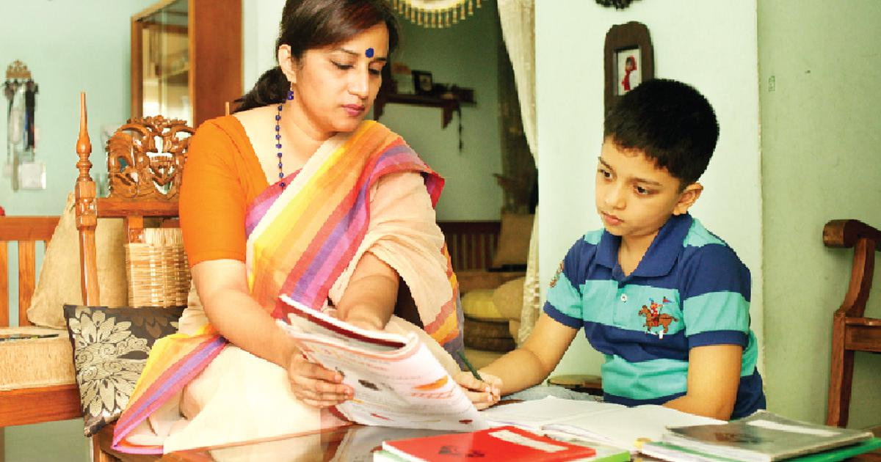
R
Home work
R
You will write a letter to your best friend
describing a great day you enjoyed ever.
R
R
MKRM#AT#Khasgaon GPS#Chhatak#Sunamganj# 01712-114197

Slide 19
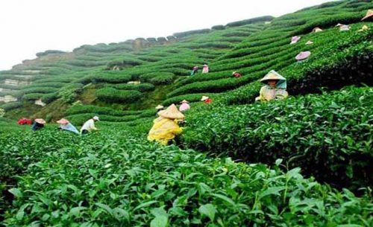
R
R
Thank you for your active participation.
R
R
MKRM#AT#Khasgaon GPS#Chhatak#Sunamganj# 01712-114197

