Slide 1
Note for the teachers
Dear colleagues,
I like to request you to follow the instructions below the note options before going to the class so t hat the class may be effective to the students.

Slide 2

Welcome

Slide 3



Introduction
Zakir Hossen
Lecturer in English
Bhulkara Islamia Alim Madrasah
Email-zakirhossen78@gmail.com
Mobile-01818713909
Notes:
সম্মানিত শিক্ষকমন্ডলী আপনারা ইচ্ছে করলে এই slide টি Hide করে রাখতে পারবেন। Hide করার পদ্ধতি হলো রিবন বার এর Slide Show তে ক্লিক করে Hide Slide এর উপর ক্লিক করলে hide হয়ে যাবে। এক্ষেত্রে f5 চেপে Slide Show করলে Hide করা page আর দেখা যাবে না।

Slide 4


What do you mean by the pictures?
Networking

Slide 5
Our today’s Lesson is-
Social network services

Slide 6
Learning outcomes
After the lesson Ss' will be to ….
Say about social media;
Narrate the activities of social media;
Understand texts.

Slide 7
What is social networking or social media?
The internet technology has helped design a large number of web sites to facilitate social relations among people around the world. These are known as social networking services or social networks or social media.

Slide 8
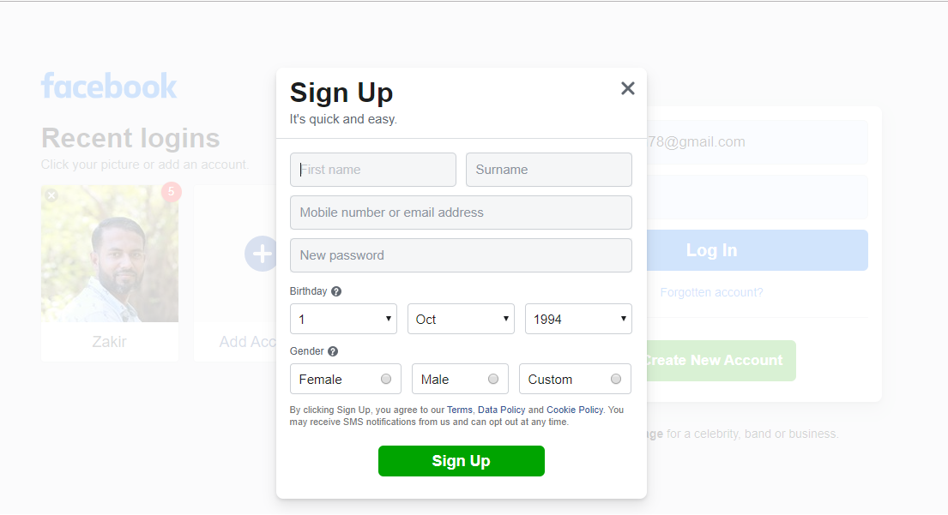
Process of creating Facebook account.

Slide 9





These are social networking media.
Among them Facebook is most popular social media site

Slide 10
Single work
Time-5 minutes
What is social networking services?
Write the name of some social networking services.

Slide 11

By this services…..
Possible to connect people
Sharing interests and activities across the borders.
Thus the user feel that they live in a global village.

Slide 12
Why are social network expanding so fast?
Firstly, most of social services are cost-free.
Secondly, it is like presenting yourself before the entire world and know other people.it is easy and simple.
Thirdly, Social network allows users to upload pictures, multimedia contents and modify the profile.

Slide 13

Fourthly, networks allows users to post blog entries and dedicated comment from friends and other users.
Finally, there are privacy protection measures too. A users himself or herself decides over the number of visitors /viewers, and what information should be shared with others.

Slide 14
Group work
Time-8 minutes
What are some uses of social networks?
Make a list of arguments as to why social networks are expanding so fast. Why do you think this is happening?

Slide 15
Evalaution
Time-5 minutes
What has helped social networking sites to emerge?
What do you mean by social networking?
Tell some social networking sites name.

Slide 16

Home work
Write a paragraph on about the uses and abuses of Facebook with 120 words.

Slide 17

Thank you

