Slide 1
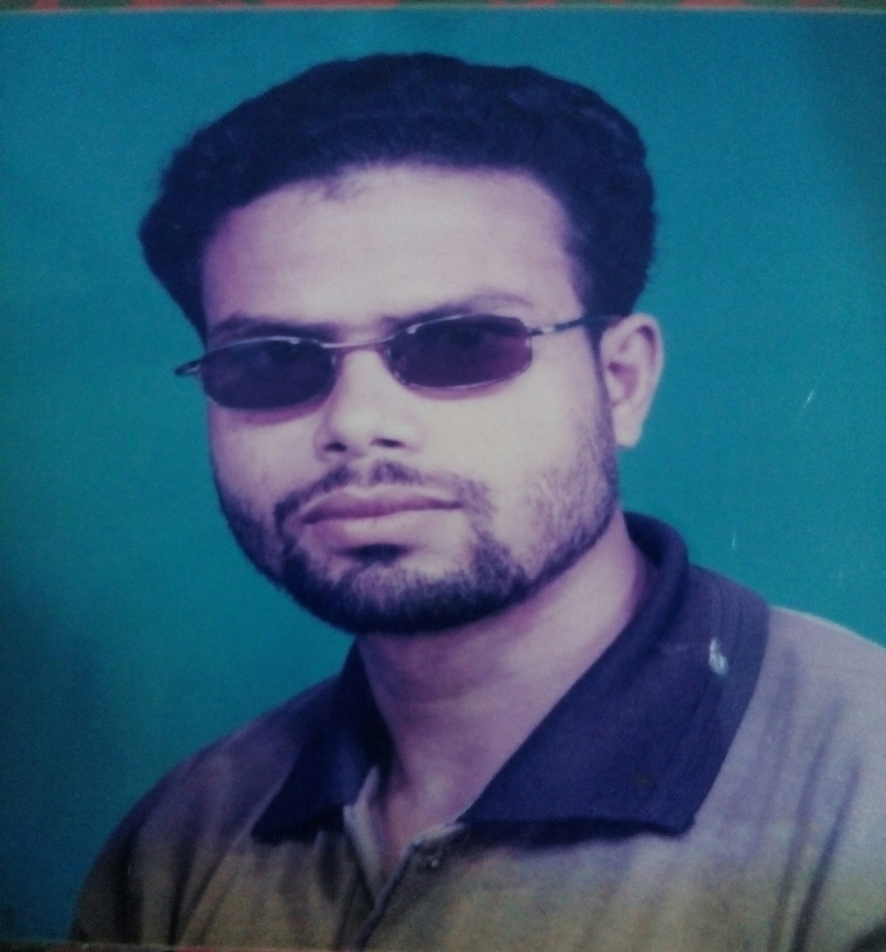
WELLCOME TO ENGLISH CLASS
MD. ANISUL HAQUE
ASSISTANT TEACHER ( ENGLISH )
JAFARGONJ SCHOOL & COLLAGE
MANANAGAR, RANGPUR.
Mobile: 01719463059
E-mail no: anis127299@gmail.com

Slide 2
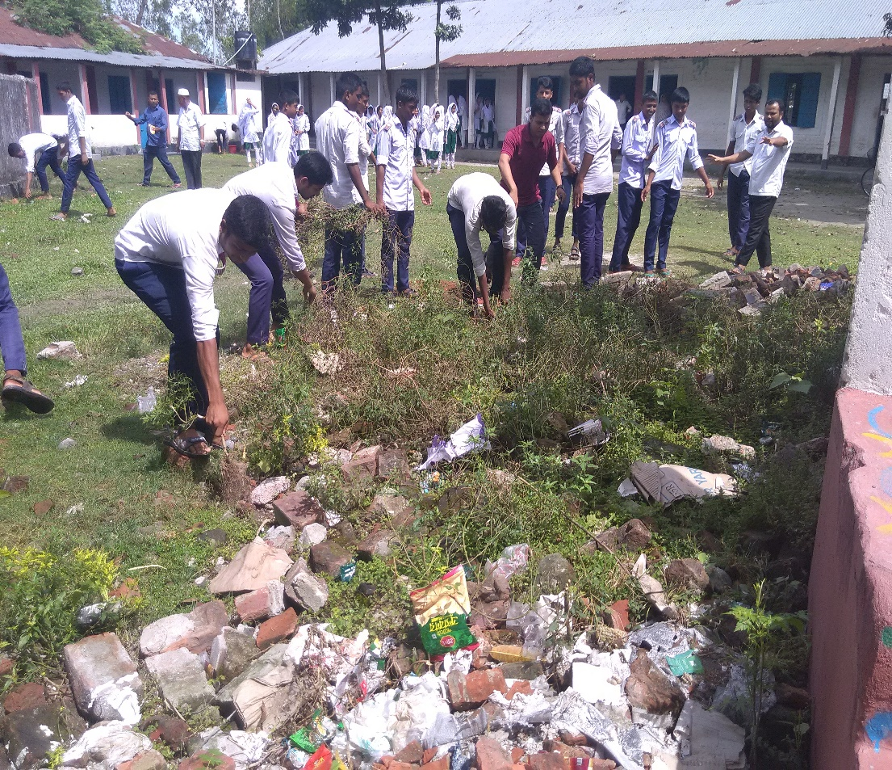
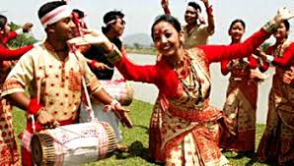
LOOK AT THE PICTURES AND ANSWER THE QUESTIOS:
Are the people enjoying their work? If, yes why?
Elicit and declare the lesson.

Slide 3
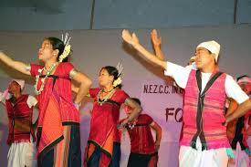
Todays Lesson is--------
Unit: 8, Lesson: 1
Todays lesson: I like folk songs.
After completing the lesson students will be able to:
Ask and answer questions.
Listen to and understand conversations on familiar, everyday topics.
Read and understand texts.
Complete guided writing tasks.
Ask and answer questions about like/dislike.
Know meaning about these key words.

Slide 4
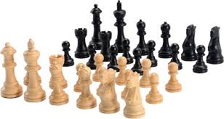
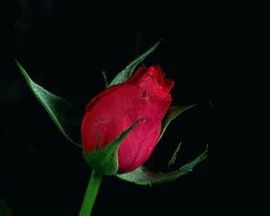
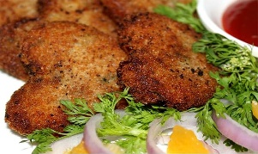
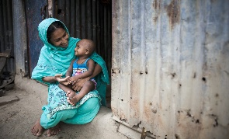
Key words: Match pictures with words and make sentences.
Photography
Fish cutlet
Adore
To bloom
Chess
Make Sentence:
1. I often like to play chess.
2. Cats fond of fish cutlet very much.
3. My passion is photography.
4. Everyone likes to blooming rose.
5. Every Mother adore her child.

Slide 5
Read the dialogue every students silently and act out the dialogue in pairs.
A: Hello. How are you doing?
B: I’m OK. I’ve just finished a course on photography.
A: Great! Did you like the course?
B: Yes, I loved the course so much! You know, I like photography a lot. How about you? What sorts of things do you like?
A: I don’t like photography but I like fishing. I went fishing to a nearby village last week. Did you ever go fishing?
B: Errr. I like eating fish. I actually love fish cutlet. But I don’t like to go fishing. It’s hard to wait for hours looking at the water! A: That’s right. You need to have patience. I enjoy fishing. It’s really exciting when you catch a fish after hours of waiting. Would you like to come with me next time?
B: I’m not sure. But I would love to taste the fish cutlet.
A: Well. I’ll certainly invite you to come to my place and enjoy fish cutlets with me.
B: Thank you. Sounds great! Thanks!
Key

Slide 6
Read the text silently and answer the questions in pairs.
Why doesn’t Kobita like classical music?
2 What does Kobita’s father think about pop music?
3 Who is Kobita’s favourite singer? Why does she like her so much?
4 What does Kobita think about her garden?
5 What does the sentence “I just adore them!” mean?
Hello ,I am Kobita. I am a class 7 student of Sundarpur High School .I like listening to music in my free time. I like folk songs but I don’t understand classical music that much. However, my father likes classical music very much. But he doesn’t like pop music. He never watches pop musical programs on TV. He says he hates them because they don’t appeal to emotions. My favourite singer is Farida Parvin. I like her songs very much. She has a wonderful voice. I also like gardening. I have planted many flowers in my garden. When the flowers are in full bloom, I love to watch them. I’m very happy about the flowers that I grow. I just adore them!

Slide 7
Home work:
Write an e-mail to your friend about country foods.
THANK YOU MY DEAR STUDENTS SEE AGAIN.

