Slide 1


Dear learners,
welcome to English class

Slide 2


Introduction
Abul Kashem Miah
Assistant Teacher, English
Shaheed Alauddin High School
Mirjapur, Pakundia, Kishoreganj
Email Address: abulkashembd1992@gmail.com
Class: Nine
Subject: English For Today
Time : 50 Munites

Slide 3
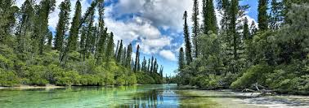
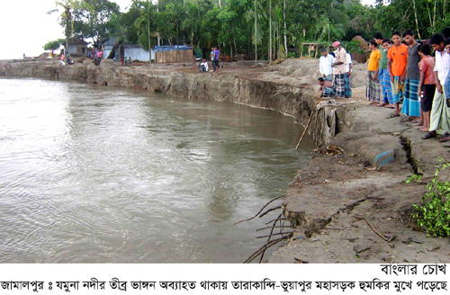
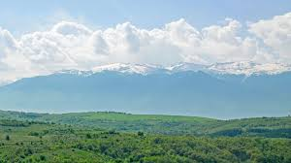
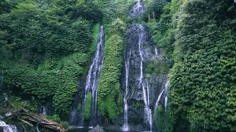
Lesson Declaration
The greed of the mighty river
Unit-5: Nature And Environment.
Lesson-1: The Greed of the mighty river
Nature
Nature
Nature

Slide 4
After completing the lesson, the students will be able to-
Say the meaning of the word.
Ask and answer the questions.
Summarize the text.
Take part in debate competition on given topic
Learning Outcomes:

Slide 5
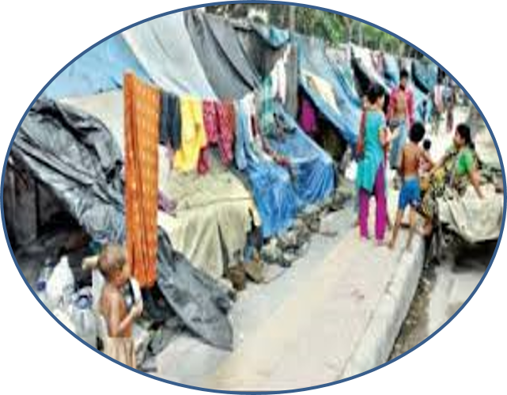
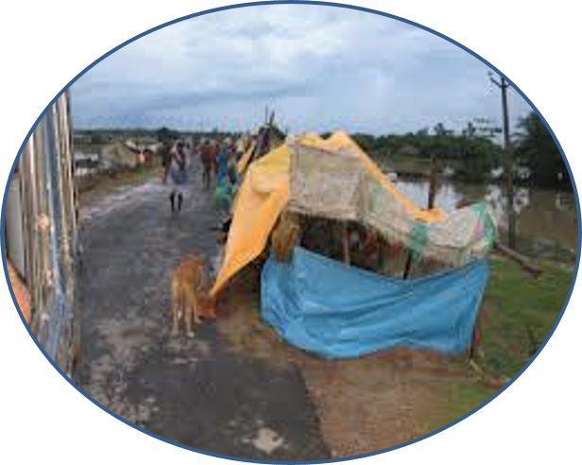
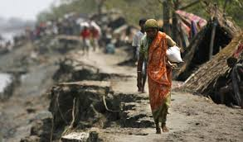
Meherjan lives in a slum on the Sirajganj Town Protection Embankment.
Her polythane-roofed shelter looks like a cage.

Slide 6
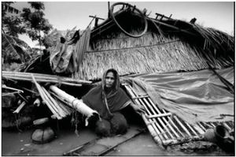
She is nearly 45 but looks more than her age.

Slide 7
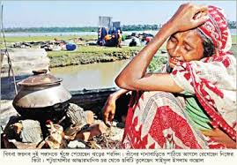
In front of her shelter , she is trying to make fire to cook the day`s only meal. Her weak hands tremble as she adds some fallen leaves and straw to the fire.

Slide 8
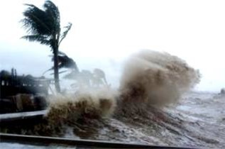
The whispering wind from the river Jamuna makes the fire unsteady. The dancing flames remind Meherjan of the turmoil in her life.

Slide 9
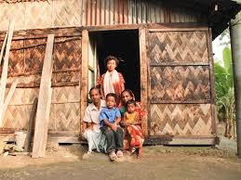
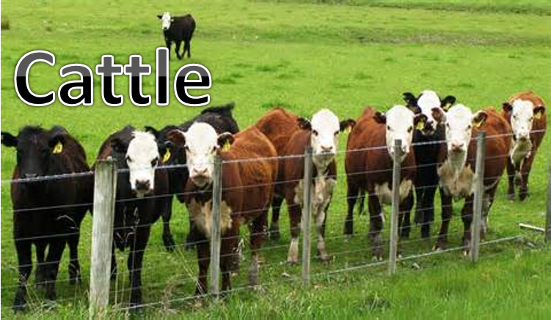
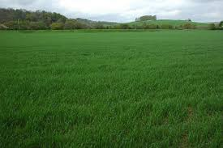
Not long ago Meherjan had everything – a family , cultivable land and cattle.

Slide 10
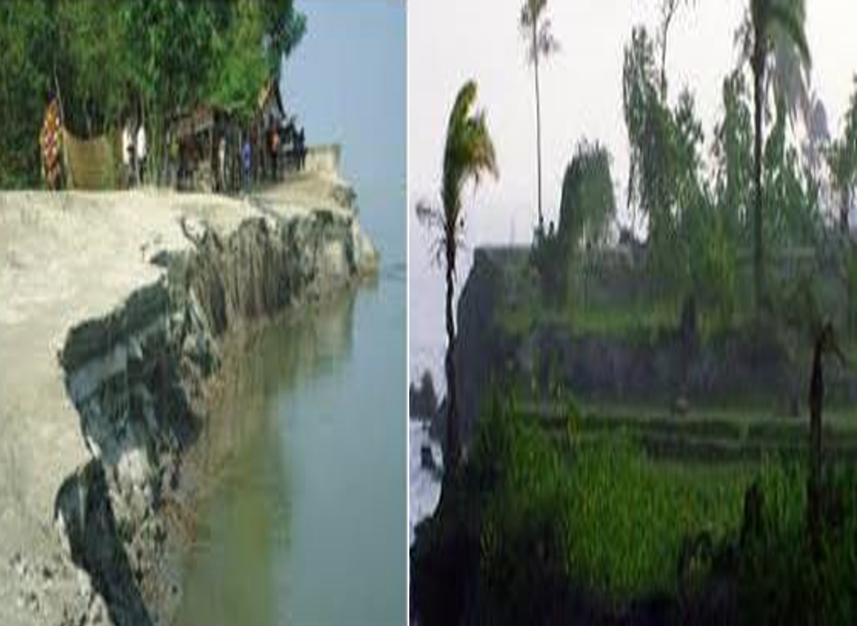
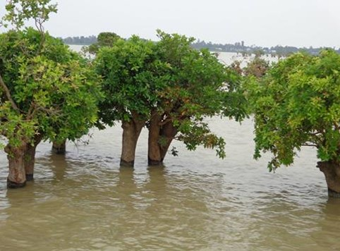
The erosion of the Jamuna gradually consumed all her landed property. It finally claimed her only shelter during the last monsoon.

Slide 11
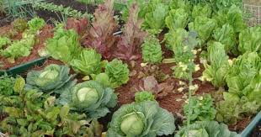
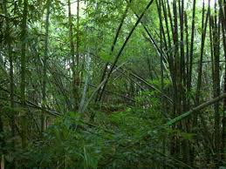
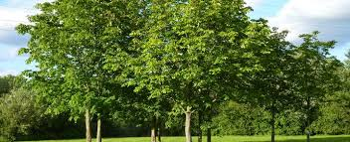
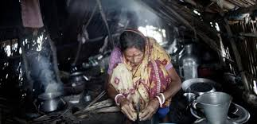
It took the river only a day to devour Meher`s house , trees , vegetable garden and bamboo bush.

Slide 12
She had a happy family once.
Over the years , she lost her husband and her family to diseases that cruel hunger and proverty brought to the family. Now she is the only one left to live on with the loss and the pain. The greedy Jamuna has shattered her dream and happiness.

Slide 13
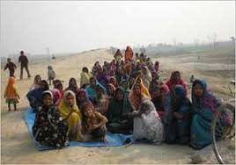
There are thousands others women waiting to share the same fate like Meherjan.

Slide 14


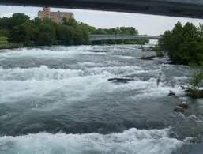

Meaning of the words:
Embankment --- a wall of earth or stone to build to prevent a river flooding an area.
Slum -- A overcrowded urban area inhabited by very poor people.
Erosion – the process of eroding or being eroded by water,or other natural agents.
Turmoil-a state of great disturbance, or great danger
Consume- eat, drink,devour, gulp
Tremble – vibration
Mighty rivers– rivers that have huge volumes of water and very strong currents.
Landed property-property in the form of a source of income to its owner.
Whispering wind –wind that blows with a hissing sound.
Dancing flame- flames that are made unstable by the blast of air.

Slide 15
Individual Work
Complete the summery of Meherjan’s life with words/ phrases from the box.
Meherjan is a typical (1)…………….. woman who lives in a slum. She lost her shelter and properties (2)…………….. the erosion of river Jamuna. She also lost her family. Her husband had died of disease caused by poverty and (3)…………………….. . Now, she is only a (4)………………… . Like Meherjan there are many people who have become the (5)…………….. of river erosion. River erosion is still possing (6) ……………… to the lives and properties of thousands of people. People living (7) ………….….. Rivers are most likely victimes of river erosion. Each year about (8) ……………… people become homeless due to river erosion in Bangladesh. Meherjan’s life is just one (9) ………………… of how climate change (10)……………… the lives of thousands of people
Victims, affects, close to, slum dweller, homeless,
Threats, example, due to, shortage of food, one lakh

Slide 16
Evaluation:
What does Meherjan use to make fire for cooking her meals?
What property did Meherjan lose due to river erosion?
What do you know about Meherjan`s family?
In which season is river erosion most likely to occur?

Slide 17
Home work:
Write the Summary of the text.

Slide 18

Thank you all.

