Slide 2
My Profile
Md.Kamruzzaman
ID:18136134056
Lecturer,Dept of Management
Govt Sundarban Adarsha College,Khulna.

Slide 3
Post Presentation Learning will be….
1.What is Management?
2.Functions of Management.
3.What is Planning?
4.What is Organizing?
5.What is Leading?
6.What is Controlling?

Slide 4
Topic:Introduction to Management
What is Management?

Slide 5
???

Slide 6
Functions of Management
There are four functions of Management.For example-
Planning
Organizing
Leading
Controlling

Slide 7
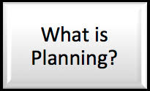

Slide 9
…………………………………………..

Slide 14
What is Controlling?

Slide 15
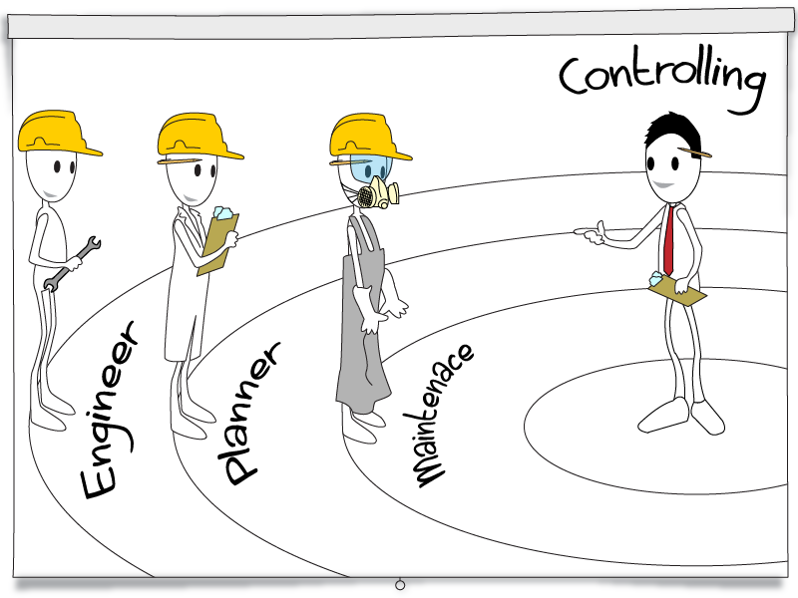

Slide 16
Controlling
The process of monitoring performance, comparing it with goals, and correcting any significant deviations

Slide 17
The most contributors in the field of Management:

Slide 18
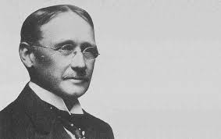
F.W. Taylor

Slide 19
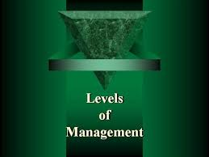

Slide 20
There are 3 levels of Management.For example: 1.First level 2.Mid level 3.Top level

Slide 21
Can you tell anything about the below image?
Notes:
A manager must be a light house to light his/her surround.

Slide 22
Do you have any question???

