Slide 1
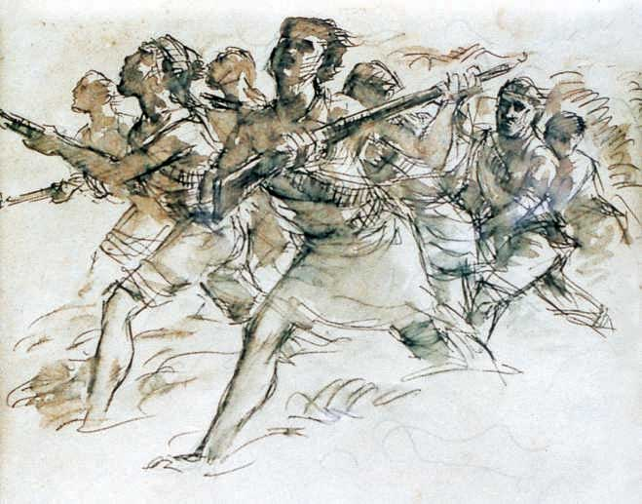
welcome

Slide 2
Introduction
Md. Zakir Hossain
Principal
Robertsongonj High School & College, Rangpur.
ENGLISH FOR TODAY
Unit—seven
Lesson– 1
Time: 50 minutes.

Slide 3
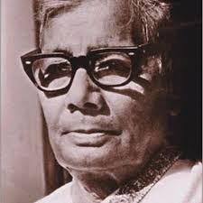
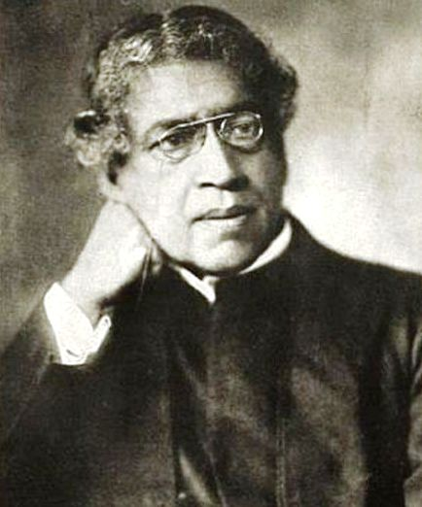
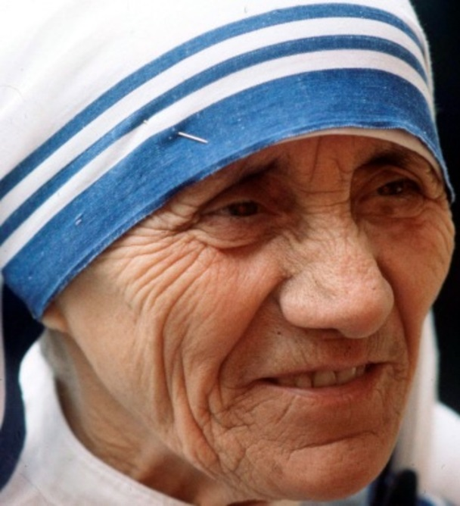
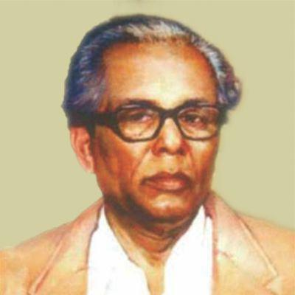
Do you know these persons?
Why are they famous for?
Who is a painter of them?

Slide 4
Zainul Abedin,the great artist

Slide 5
Learning Outcomes
By the end of the lesson the learners will be able to
say something about Zainul Abedin
ask and answer questions
describe the painting and drawings of Zainul Abedin.

Slide 6
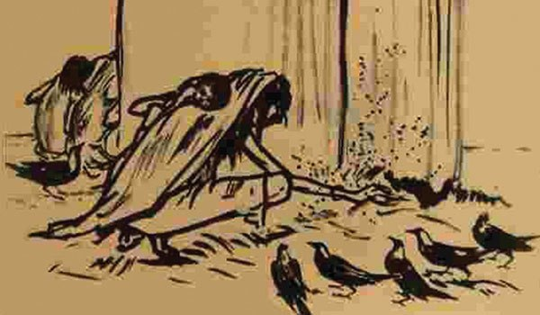
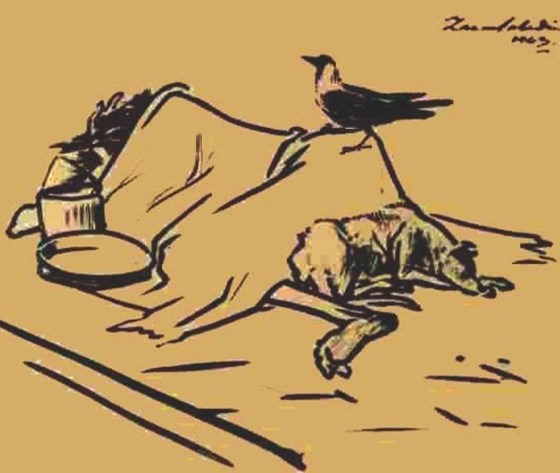
Read the text in section ---A.
Famine Sketches

Slide 7
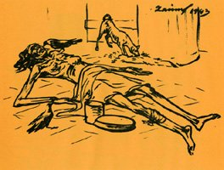
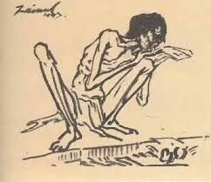
Skeletal Figures

Slide 8
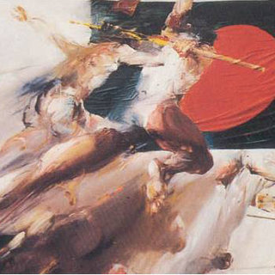
Brush and Ink drawing

Slide 9
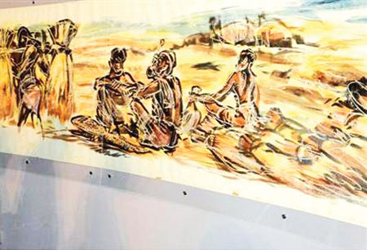
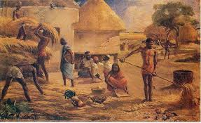
Nabanna[Harvest]

Slide 10
Write in detail how Zainul Abedin portrayed the sufferings of people.
Ans. He portrayed the sufferings of people through his `Famine Sketches` during the famine of 1943.He portrayed the death of thousands of people in the devastating cyclone of 1970 through his painting called ` Manpura`

Slide 11

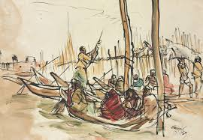
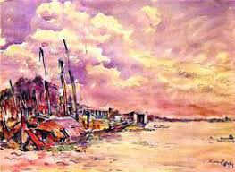
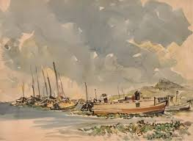
Brahmaputra was a source of his inspiration all through his career

Slide 12
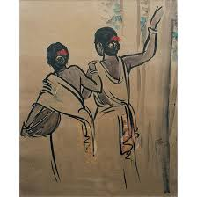
Now look at the picture in section B and describe them in pairs
It depicts a skeletal figure, that is sitting beside a road and is suffering from hunger .
Rural women, who are going to work to survive.

Slide 13
A crow is sitting on a dead body, who died from hunger.
Life in water.

Slide 14
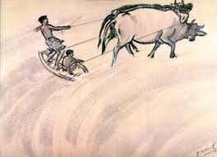
A village by the side of a river
Farmers of Bengal

Slide 15
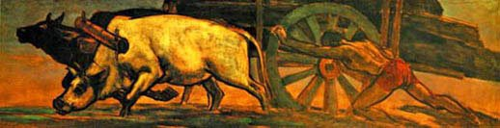
Hard working people

Slide 16
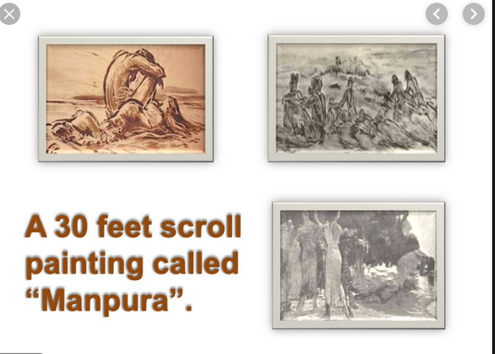

Slide 17

Zainul Abedin designed the pages of the Constitution of the Bangladesh

Slide 18
Read the text in section A and answer the questions in pairs
What influence did the river Brahmaputra have on Zainul Abedin .How did he show this influence in his works?
2.What did these works earn him in his life?

Slide 19
Choose the best answer
1. The US Ambassador to Bangladesh considered Zainul Abedin
Great painter.
Popular painter
Master painter
Unique painter.
2 .Zainul`s art gallery was set up in----
3 The phrase ` visionary qualities` is a----
a.1972
b.1973
c.1974
d.1975
Noun
  Verb
Adjective
adverb

Slide 20
Evaluation
Why is Zainul famous for?
Why was a 65 feet long scroll portrayed?
What do his `Famine Sketches` portray?

Slide 21
Home work
Write a paragraph on the life and activities of ZainulAbedin..

Slide 22
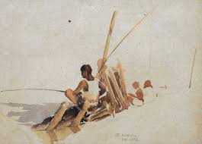
Thanks to all

