Slide 1
O
E
L
W
M
C
E
Mithu kumar Roy,
Assistant Teacher, Tularampur Gov’t Primary School. Narail.
Email: mithuroy0007@gmail.com ..

Slide 2
Class Two
Sub: English For Today
Unit:2, Alphabet
Lesson: 4. Activity: A
Time: 50 min
Lesson Introduction

Slide 3
Good morning, students.
Good morning, teacher.
Greetings
How are you?
Fine. Thank you.

Slide 4
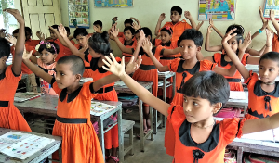
Greeting song
Now We sing the alphabet song with action.

Slide 5
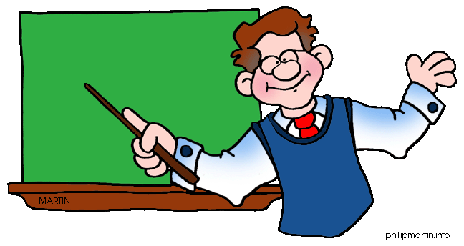
Today we will learn...
Alphabet
Today’s Lesson
Ff Gg Hh Ii Jj

Slide 6
Listening :
1.1.1 become familiar with English sounds by listening to common English words.
Speaking :
1.1.1 repeat after the teacher simple words and phrases with proper sounds and stress.
1.1.2 say simple words and phrases with proper sounds and stress.
Learning outcomes
Reading :
1.2.1 recognize and read the alphabet both small and capital (non-cursive).
1.3.1 recognize and read the names of objects having the same initial and final sounds.
1.4.1 read words and phrases with the help of visual clues (about 30 new words ) and simple sentences.

Slide 7
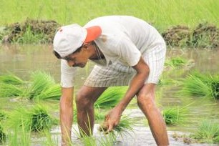
Now, Look at the picture, discuss with others and say...?
Farmer

Slide 8
Now, Look at the picture, discuss with others and say...?

Slide 9
Now, Look at the picture, discuss with others and say...?
Girl

Slide 10
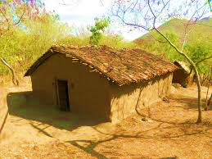
Now, Look at the picture, discuss with others and say...?
Hut

Slide 11
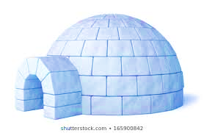
Now, Look at the picture, discuss with others and say...?
Igloo

Slide 12
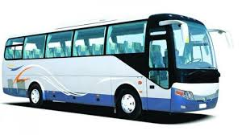
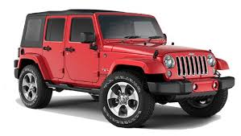
Now, Look at the picture, discuss with others and say...?

Slide 13
Now, Look at the picture, discuss with others and say...?
Jeep

Slide 14
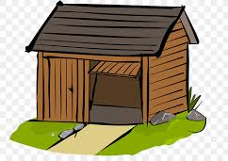
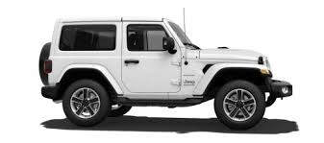
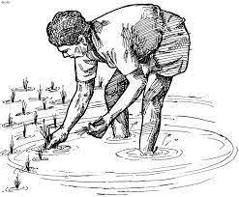
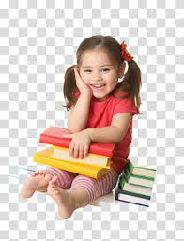
Now See the pictures, think alone and say.
Individual Work

Slide 15
Now See the pictures, think alone and say.
Farmer
Igloo
Individual Work
Girl
Jeep
Hut

Slide 16
Look the chart and Listen to the audio.
F f
F f
farmer
farmer
/f/
/f/
Whole Class Work
G g
G g
girl
girl
/g/
/g/
hut
H h
hut
H h
/h/
/h/
I i
I i
igloo
igloo
/i/
/i/
jeep
J j
jeep
J j
/j/
/j/

Slide 17
Sit in Groups. Say the words, letters and letter sound loudly.
f
farmer
/f/
g
girl
/g/
Small Group Work
h
/h/
hut
igloo
i
/i/
jeep
j
/j/

Slide 18
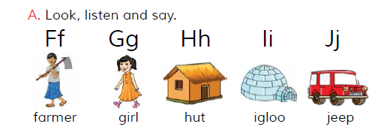
Open your book at page 5, See Activity A
Small Group Work

Slide 19
Read with Peer and Support each other.
Pair Work

Slide 20
Now Practise the word Farmer
Word
Pronunciation
Meaning
Spelling
One day One word
Farmer
কৃষক
Far mar

Slide 21
Read the word and Say letter sound..
farmer
f
/f/
girl
g
/g/
Assesment
hut
h
/h/
igloo
i
/i/
jeep
j
/j/

Slide 22
Say a new word with the letter sound..
/f/
fish
goat
/g/
Assesment
/h/
hat
/i/
Ice
/j/
juice

Slide 23
Closing
THanks

Slide 24
THanks
Closing

