Slide 2
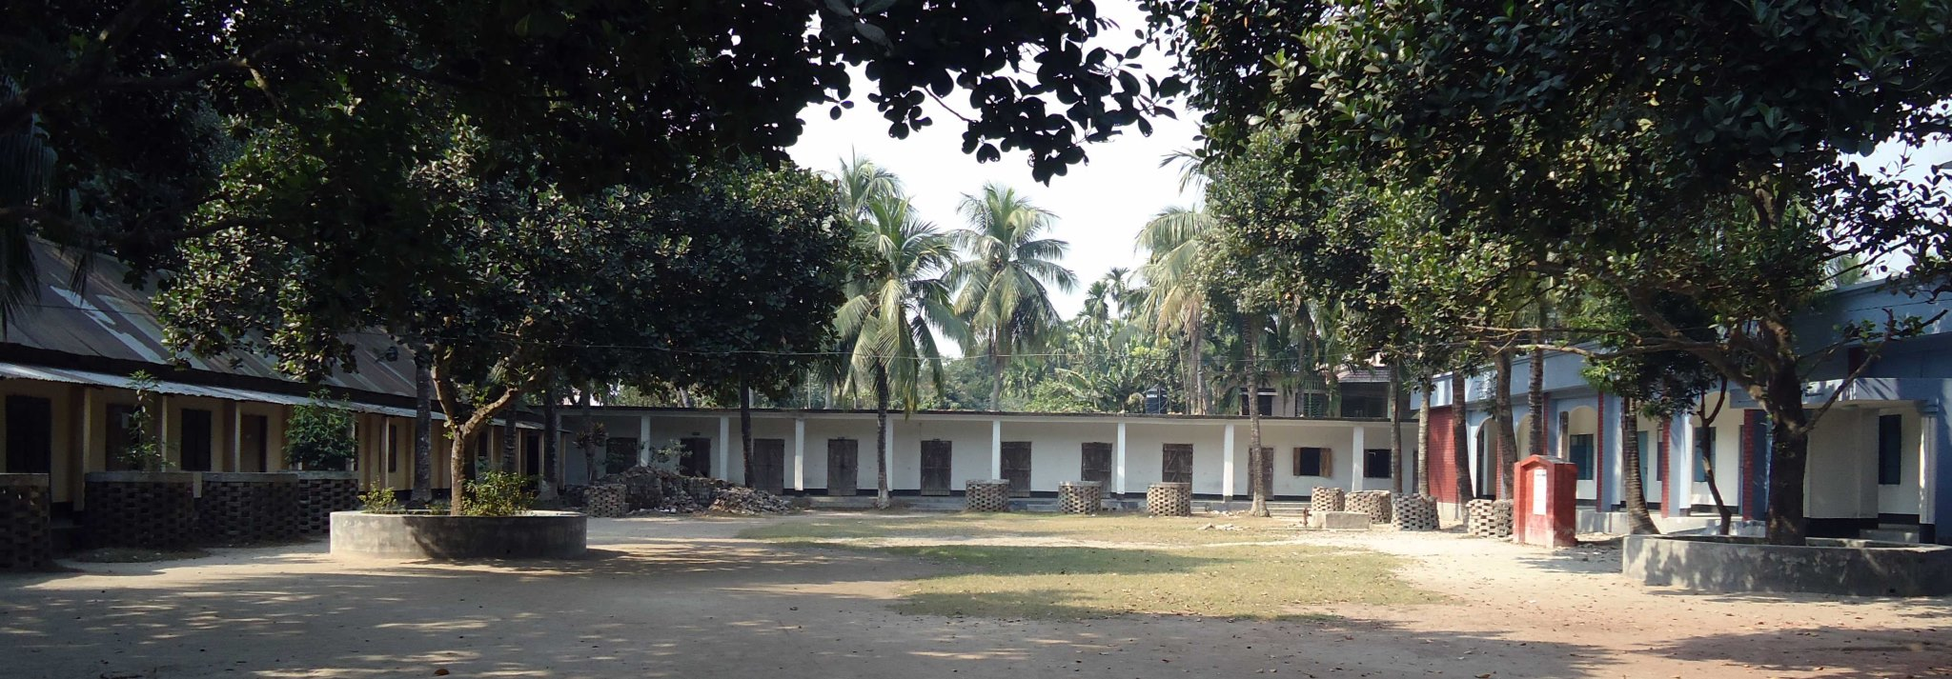

Slide 3
Discussion meeting on Networking and Global Citizenship
Networking is great for sharing and exchanging ideas , information, language and culture . It helps one to expand knowledge and allow seeing things from different perspectives . It brings benefit creating relation with partners at home and abroad. It’s a window and like a win- win situation for both the parties. It creates the access in the world of international and builds Global Citizenship. Global Citizenship is a demand of today and one of the core skills of learning. The world is advancing in minutes. Teachers and students need to keep pace with the advancement. Information technology has created the way to develop partnership with International schools exchanging and sharing project based learning. When we will do so, we will build network and be Global Citizen.

Slide 4
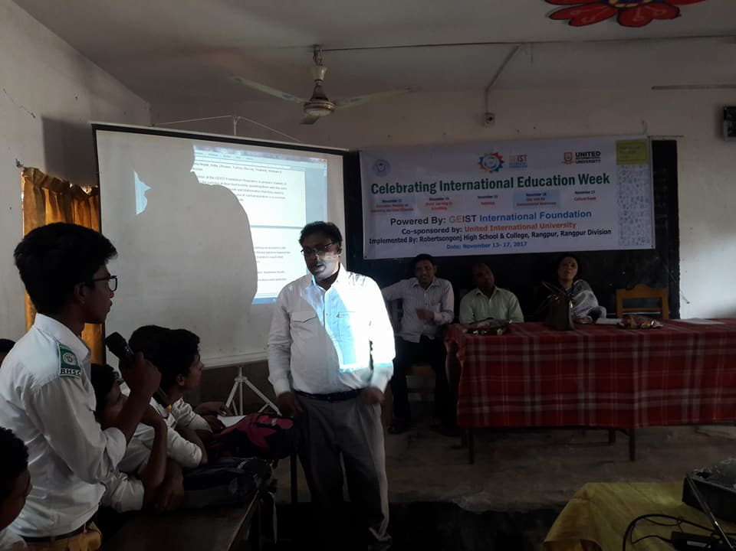

Slide 5
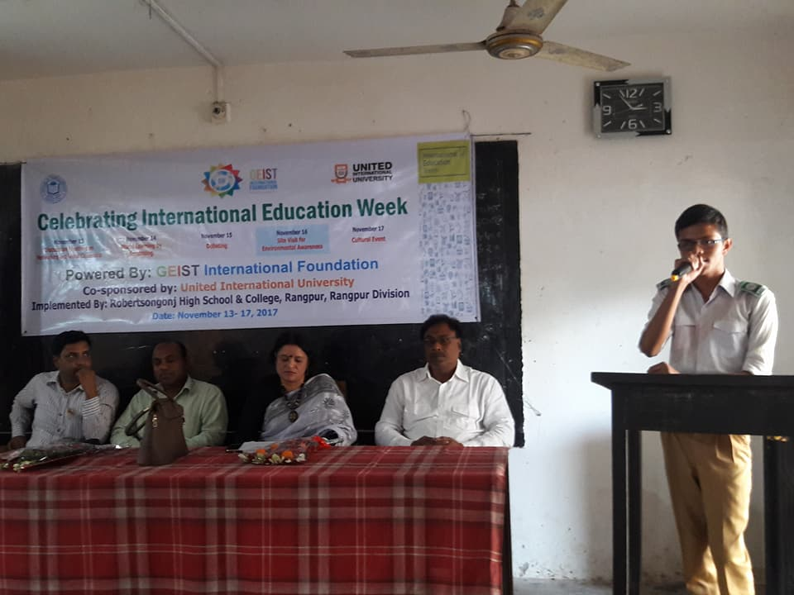

Slide 6
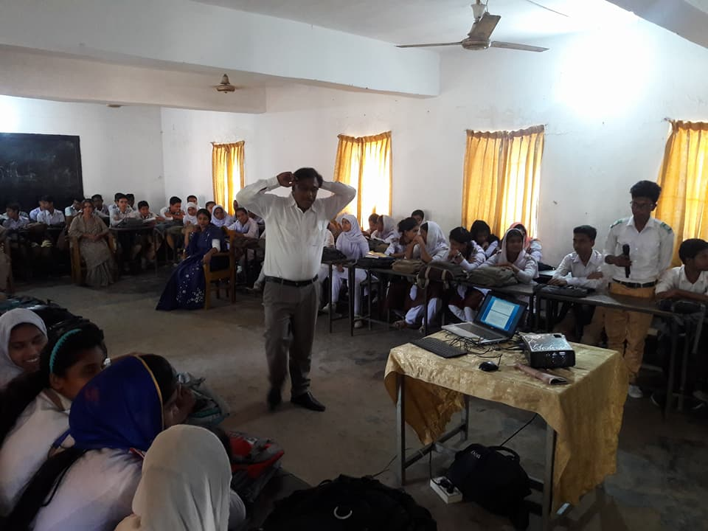

Slide 7
Word learning by Scrabbling.
Language learning is essential to build network,exchanging ideas, information,culture and to be international.Scrabble is a game to learn language. It is very interesting, effective and and sustainable for teaching learning. Students will learn language playing the game amid joy.

Slide 8
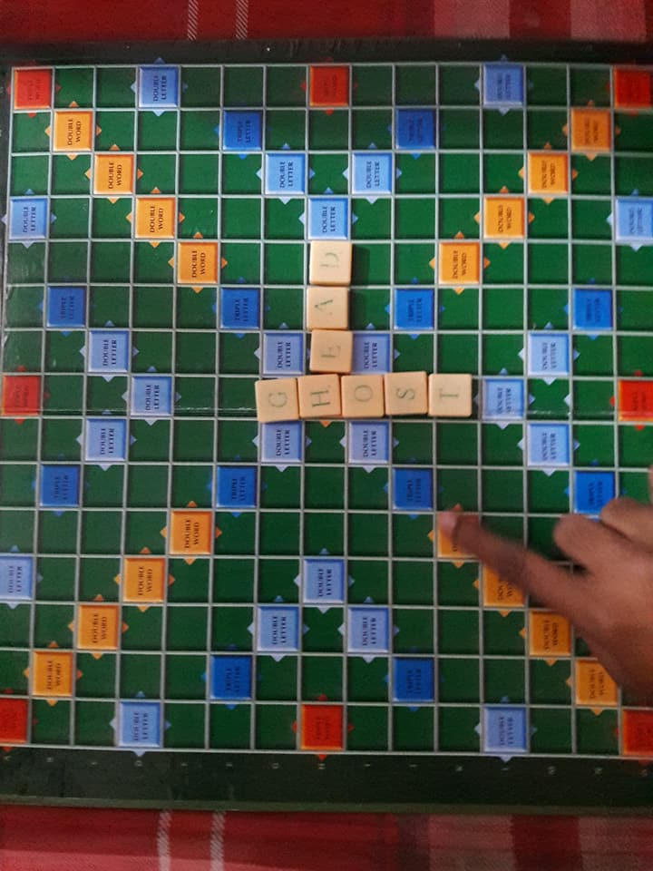

Slide 9
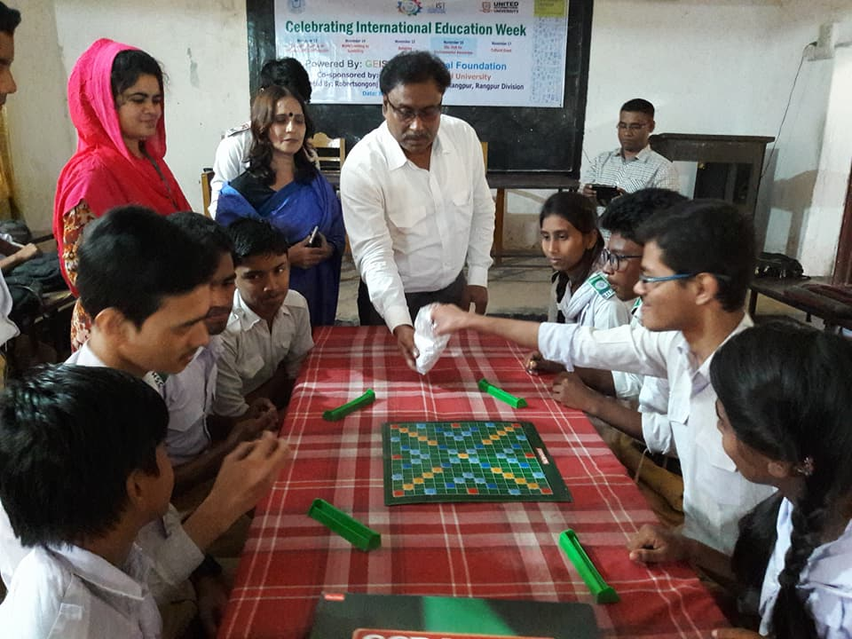

Slide 10
Debating
Debating develops and sharpens the presence of wit.It creates asense of confindence and empowerment among the students. It improves students critical thinking and problem solving skills which is one of the core skills of learning.Debate helps the students to improve their range of reading, writing ,listening and speaking skills.It widens knowledge,information and improves persentation skills.It helps one to develop his or her ability to present logic and refute the logic in a justified way.

Slide 11
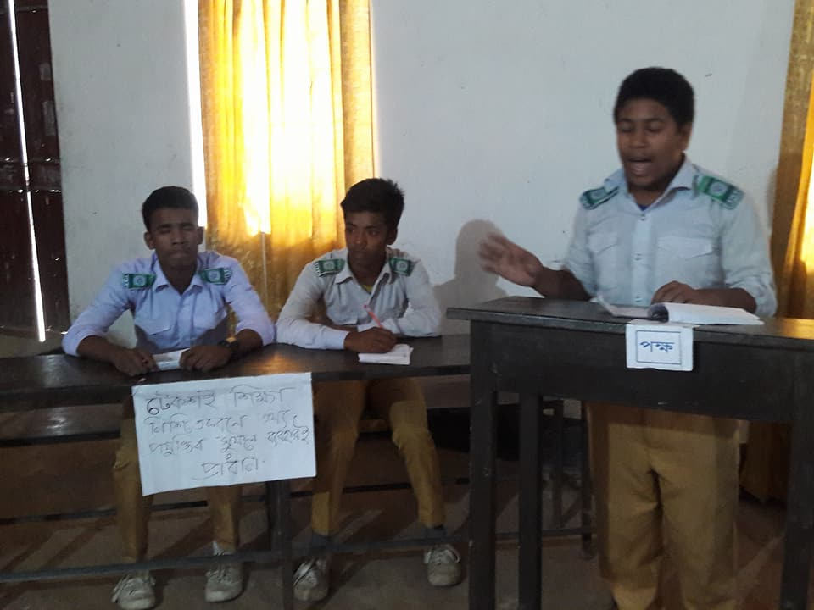

Slide 12
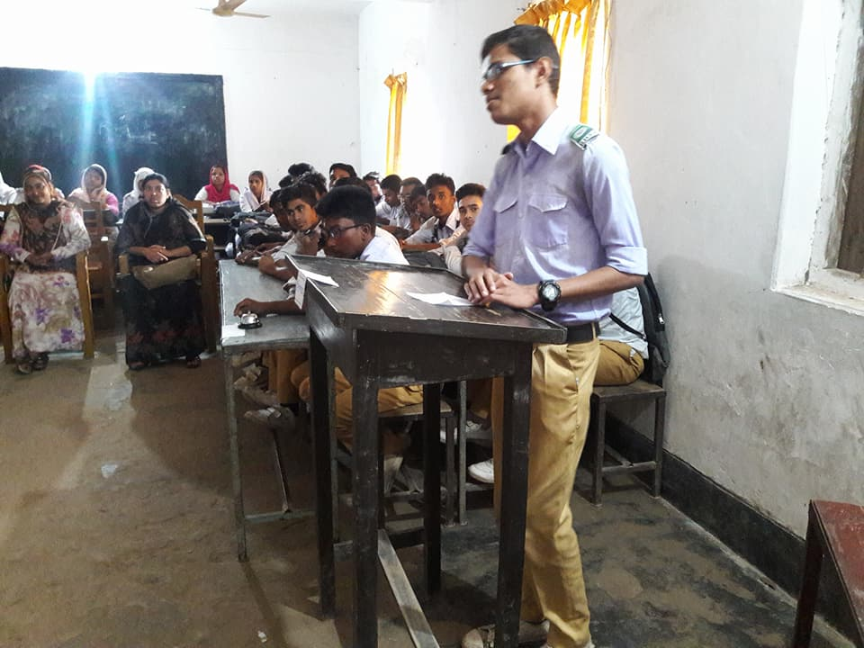

Slide 13
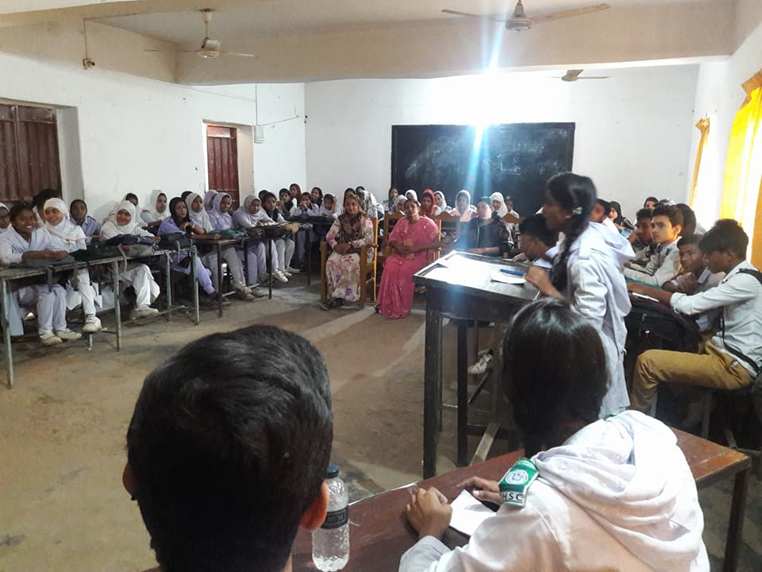

Slide 14
Site visit for Environmental Awareness
This is a unique event to create awareness among the students Love for Nature.Teachers and students made a site visit Nandini, a wonderful natural beauty spot with different varieties of plants and trees blended amid urban industrial structure.They learnt different plants and trees name know how to beautify nature.
God has created the beautiful universe and we have the responsibility to love and preserve it.

Slide 15
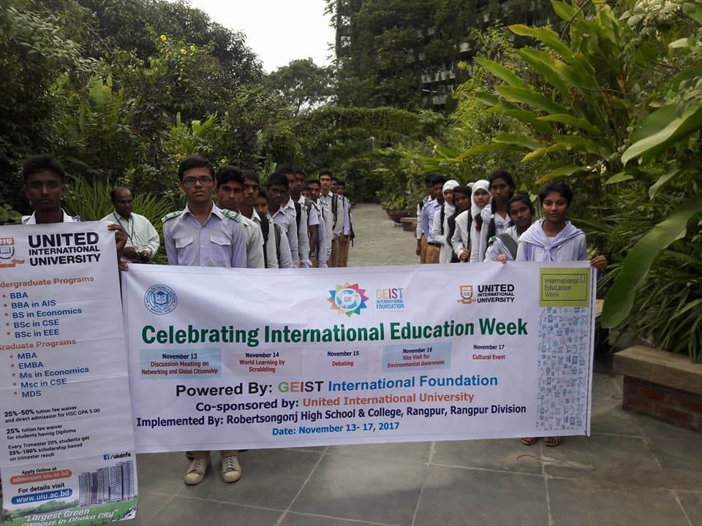

Slide 16
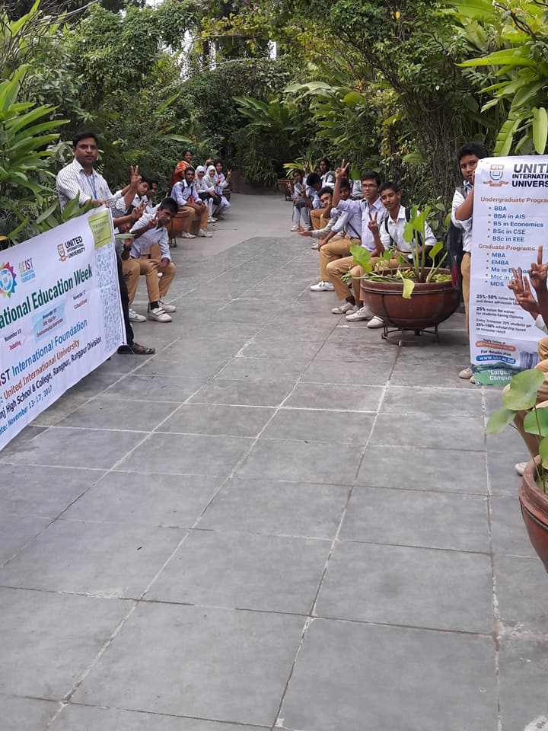

Slide 17
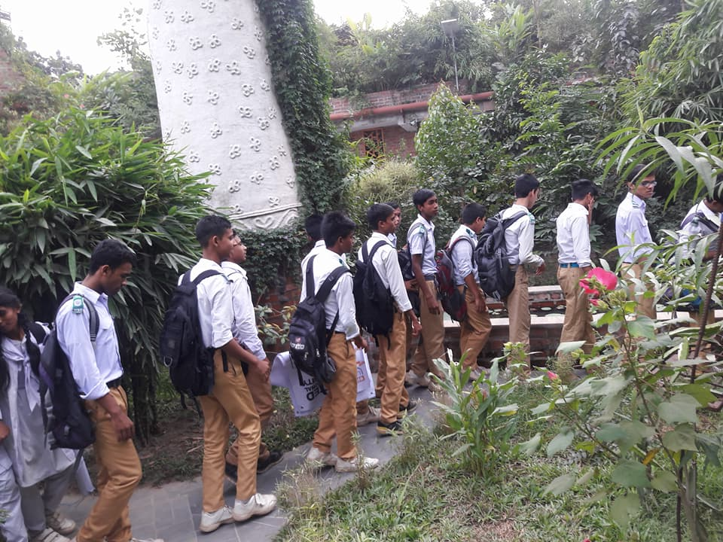

Slide 18
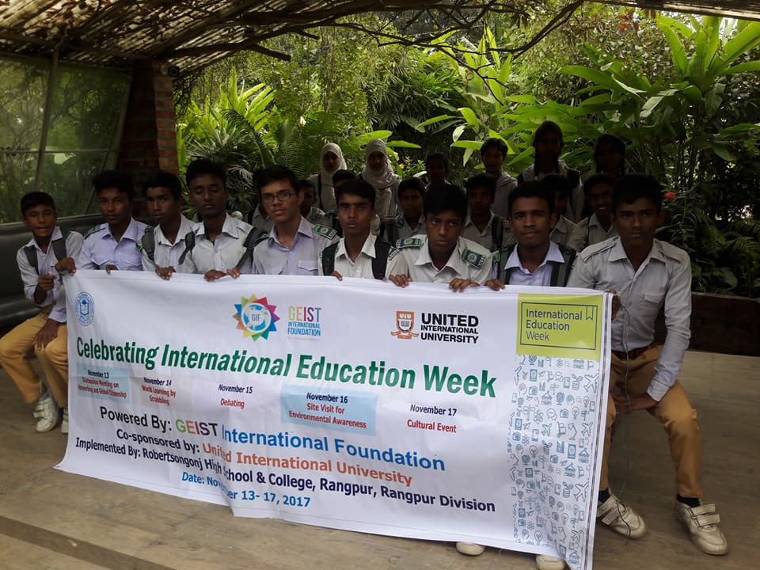

Slide 19
Cultural Event and Prize giving Cremony
Cultural fest upholds national culture, heritage literature, tradition and
patriotsm. Students joined the program spontaneously and joyfully as it gives them chance to explore their latent quality and origin beyond their class room practice. It develops the creativity and imagination, leadership and collaboration skills among the students. It helps the institute to bring together the students, parents and community people. It adds value to students learning experience. It promotes and allows the students to share their knowledge and latent creative skills Cultural practice enlightens and ennobles the students and make their learning meaningful.
.
Teachers students, parents, community people,and Governing body members tookpart in the event. District . Education officer,Ruksana Begum attended the program as chief guest.

Slide 20
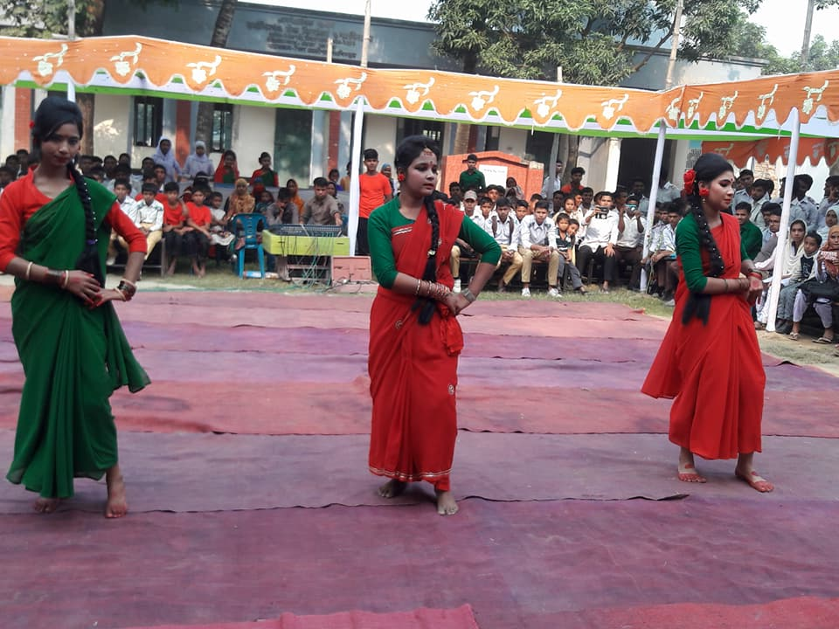

Slide 21
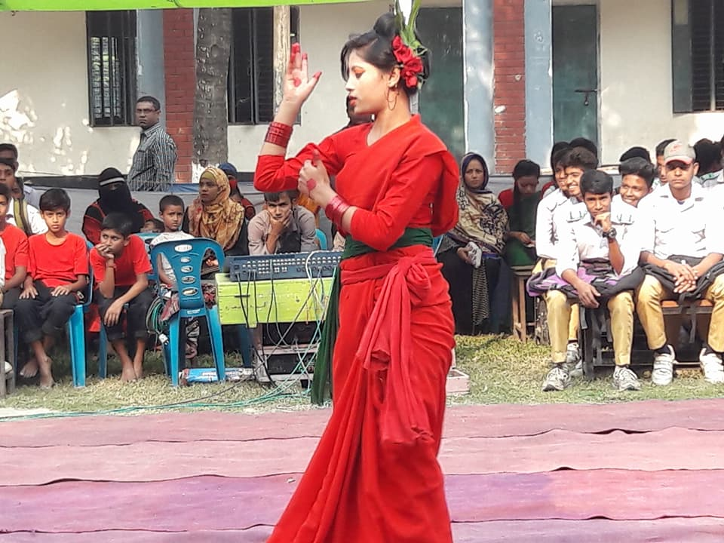

Slide 22
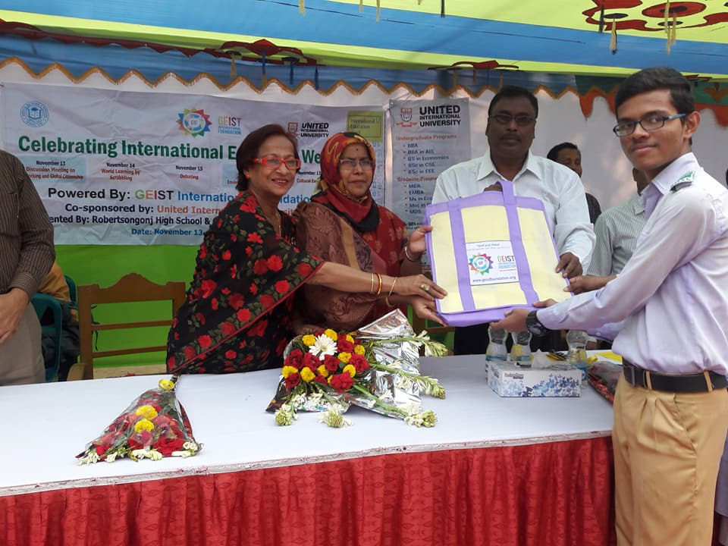

Slide 23
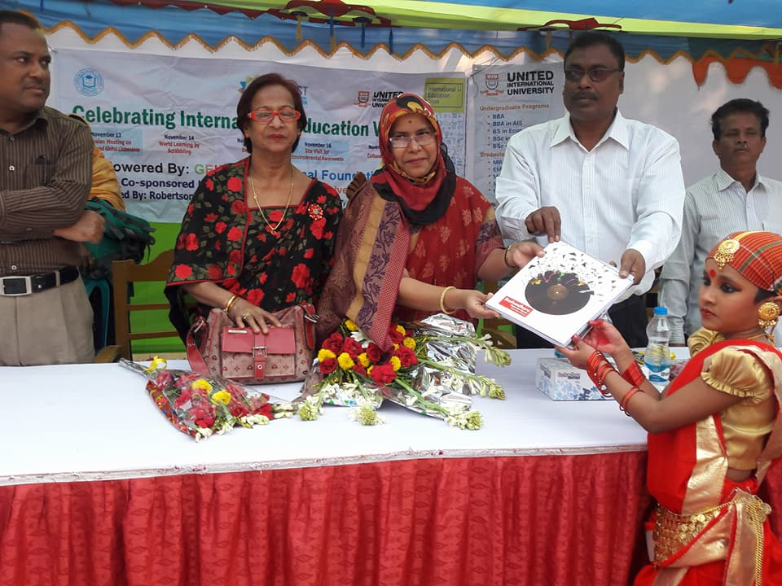

Slide 24
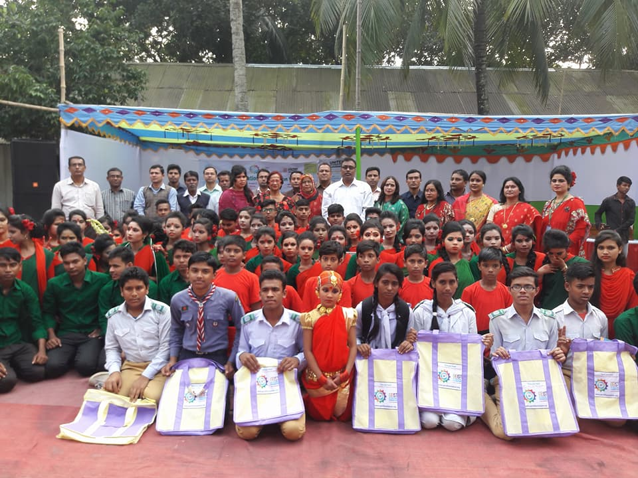

Slide 25
