Slide 1
Welcome to my Student

Slide 2
IDENTITY
Mohammad Sharif Hossen Mozumder
Asst. Teacher in English
Bataichhari High School
Barura, Cumilla
Lesson
ENGLISH FOR TODAY
CLASS : SIX
UNI – 16

Slide 3
Let’s watch a video clip
Click here
Congratulation
What do we say to hear something good.
Notes:
Thise video will be shown for students mental preparation, to practise conversation.

Slide 4
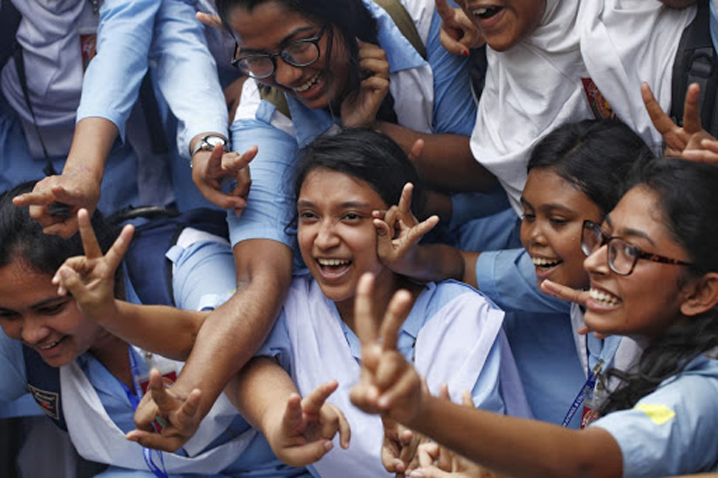
Look at the picture and talk with your partner what do we say to hear good news.
Hurrah ! We have got GPA 5.00
Congratulations to you ! You have well done !
Notes:
Teacher will try to elicit the answer from the SS then he/she will give feedback by animation.

Slide 5
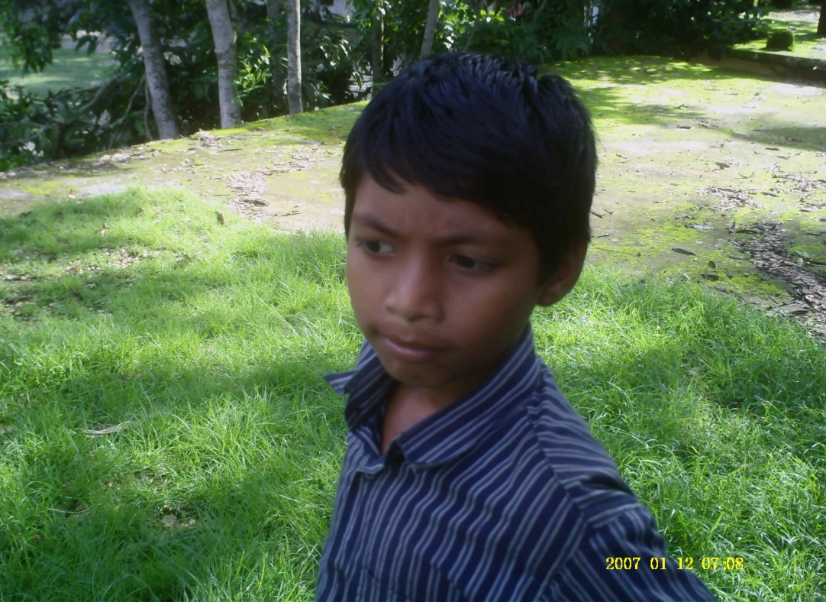
Look at the picture and talk with your partner what do we say to hear sad / bad news.
Alas ! Mahadi has died.
That’s hard luck ! We are sorry to hear that.
Notes:
Teacher will try to elicit the answer from the SS then he/she will give feedback by animation.

Slide 6
Lesson declaration
So, Today is our lesson…..
Congratulations ! Well done !
Lesson : 2

Slide 7
Learning outcomes
After finishing this lesson we will be able to-
read and understand written instructions
ask and answer questions
Participate in short dialogues and conversations on familiar topics.

Slide 8
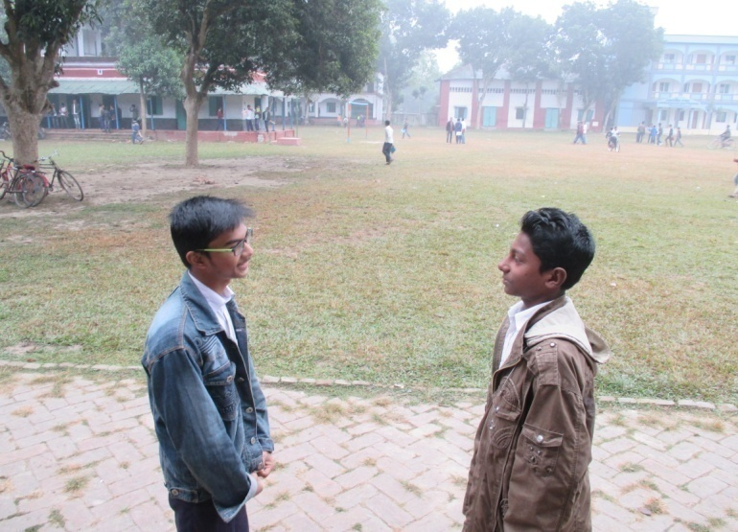
Follow the conversations
Hello, Nahid ! You look very happy today !
Oh, thanks ! Congratulations !
I am happy, I just heard that I have got Golden A+.
Thanks, Hridoy. I can’t tell you how happy I am !
Notes:
Here SS will only follow the conversation.

Slide 9
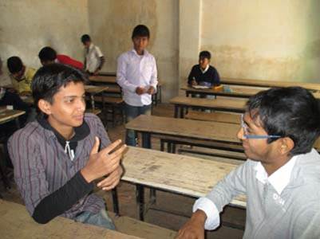
Presentation.
Go to section A there are three conversations. Read and discuss them carefully , then practise the conversations in pair.
Notes:
Teacher can ask 2/3 pairs infornt of class for practise.

Slide 10
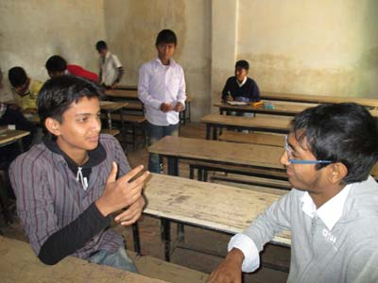
Pair works
Go to section B2 then answer the following questions by conversations in pairs. One is done for you.
I have won a lottery, so I am very happy today.
Oh, great ! Congratulations !
Thanks, See you again.
Hi, Saad ! You look very happy today.

Slide 11
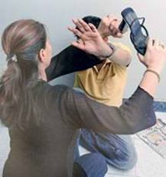
Hit
Key word
She is beating the noughty boy.
Meaning
(Click here)
The other meaning of ‘Hit’ is ‘to beat somebody.
Notes:
After showing the meaning teacher will show the picture and asked the learners to make sentence then he/she will give feedback.

Slide 12
Follow the conversation.
Now go to section B. read the conversation (ii) and (iii) then practise in pairs.
I had the flu. I was in bed most of the time.
I am all right now. Thanks.
Oh, I am sorry to hear that. How do you feel now ?
Hi, Saad ! Why didn’t you come to school last week ?
Notes:
Teacher can ask 2/3 pairs infornt of class for practise.

Slide 13
HOME WORK
Make a short conversation with your friend about she/he has got GPA 5.00 in JSC examination 2014.

Slide 14
THE END

