Slide 1
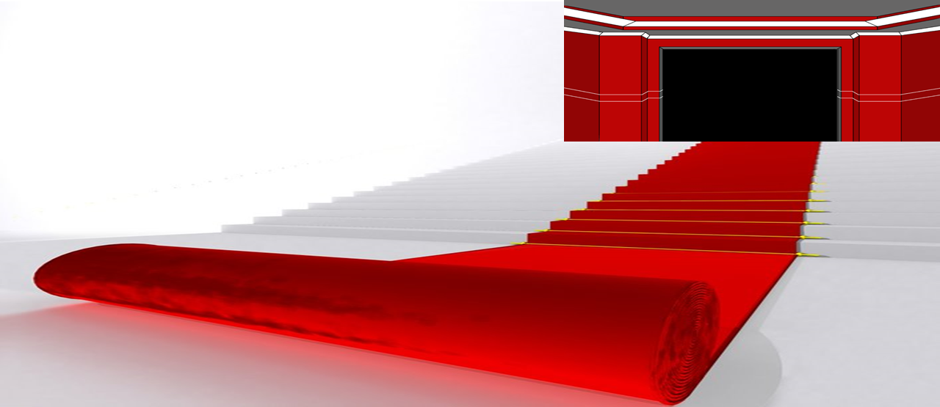
Welcome
to
Our Class

Slide 2
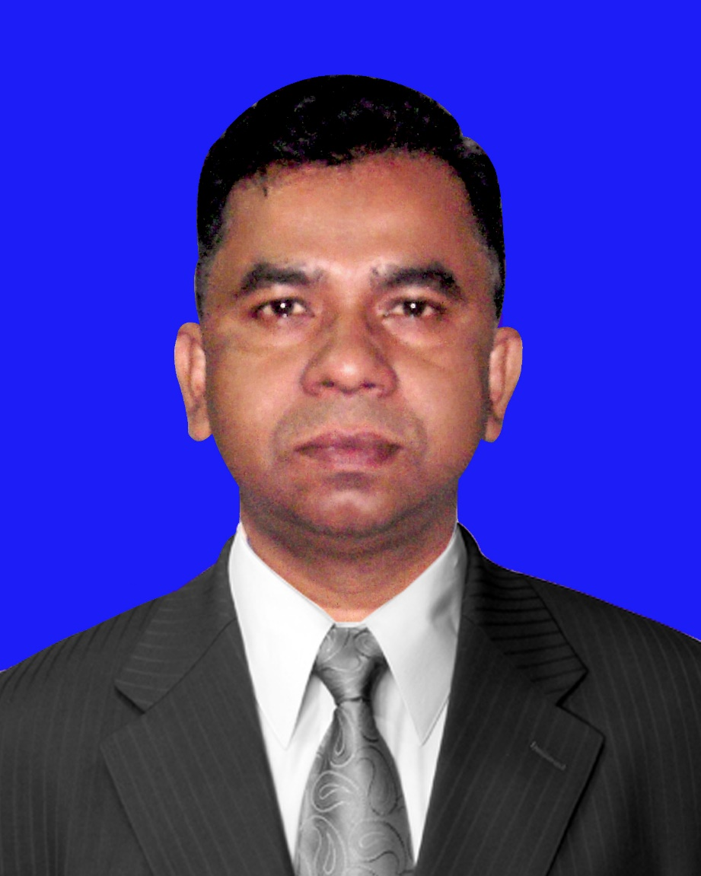
Conducted by
S. M. Saraful Islam
Assistant teacher
Shiromoni Alim Madrasah,
Fultala, Khulna.
Phone – 01915455262
E-mail: sarafuli31@gmail.com
Subject : English 1st Paper
Class – 7, Unit – 5, Lesson - 3

Slide 3
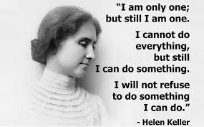
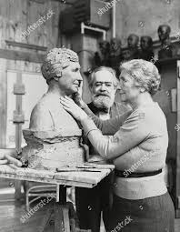
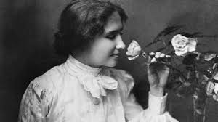
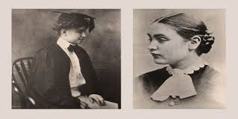
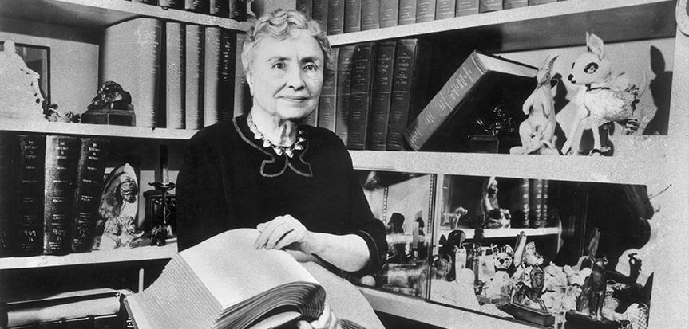
Let’s see some picture
Do you know the woman?
Who is she?

Slide 4
Our today's lesson is
Helen Keller (1)

Slide 5
Learning outcomes
After the end of the lesson, students will be able to...
ask and answer questions
read and understand texts

Slide 6
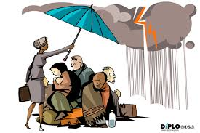
Vocabulary
Humanitarian (n)
Meaning :
a person who is involved in or connected with improving people's lives and reducing suffering.
The woman is a humanitarian.

Slide 7
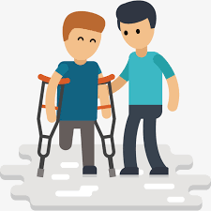
disabled (n, Adj, v)
Meaning :
not having one or more of the physical or mental abilities that most people have.
Though he is disable he tries to do.

Slide 8
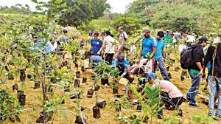
plantation (N)
Meaning :
a large farm, especially in a hot part of the world, on which a particular type of crop is grown
a tea/cotton/rubber plantation.
Plantation drive to increase green world.

Slide 9
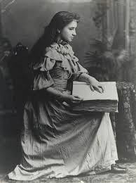
Look at the pictures and discuss the following in pairs.
1 Who is the woman in the picture?
2 What is she famous for?

Slide 10
Text
Read the text and Match the words with their meanings.
Words | Meanings
humanitarian | a large area of land where crops like sugar, banana, etc. are grown
disabled | a person who has discovered something
plantation | making people’s sufferings less and improving their living conditions
inventor | unable to use a part of the body easily or completely because of illness, injury, etc.

Slide 11
Helen Keller is a great humanitarian. She deeply cared for the people who were sick and injured. These disabled people could not use a part of their body. Helen worked for these disabled people all through her life. Helen Keller was born in 1880 in Tuscumbia, Alabama. Her father was Captain Arthur Keller and mother Katherine Adams Keller. Her family was not rich and its main source of income was cotton plantation. Helen was quite healthy when she was born. But in 1882 she had a high fever and she became blind, deaf and dumb. At that time her father was a newspaper editor. He saw Alexander Graham Bell about Helen. Bell, the inventor of telephone, was working with deaf children at that time. Later Bell met Helen and her parents. He suggested Perkins School for the Blind in Boston for Helen. Captain Arthur went to the director of the school Michael Anaganos. Mr Anaganos sent one of his best students called Annie Sullivan to help Helen in 1887. Annie greatly helped Helen to communicate.
Back

Slide 12
Text
Read the texts ‍and answer True or false? If false, give the correct answer.
1. Helen always helped the suffering people.
2. She came from a rich family.
3. She was born blind, deaf and dumb.
4. Alexander Graham Bell was both an inventor and a social worker.
5. Annie Sullivan was a good teacher of Helen Keller.

Slide 13
Helen Keller is a great humanitarian. She deeply cared for the people who were sick and injured. These disabled people could not use a part of their body. Helen worked for these disabled people all through her life. Helen Keller was born in 1880 in Tuscumbia, Alabama. Her father was Captain Arthur Keller and mother Katherine Adams Keller. Her family was not rich and its main source of income was cotton plantation. Helen was quite healthy when she was born. But in 1882 she had a high fever and she became blind, deaf and dumb. At that time her father was a newspaper editor. He saw Alexander Graham Bell about Helen. Bell, the inventor of telephone, was working with deaf children at that time. Later Bell met Helen and her parents. He suggested Perkins School for the Blind in Boston for Helen. Captain Arthur went to the director of the school Michael Anaganos. Mr Anaganos sent one of his best students called Annie Sullivan to help Helen in 1887. Annie greatly helped Helen to communicate.
Back

Slide 14
Evaluation
What did Helen Keller do for the disable people?
Why did she become blind?
Who is the inventor of telephone?

Slide 15
Home work
Write five sentence about a blind man or woman.

