Slide 1
Identity
Raihana haque
Head teacher
Banshgari one GPS
Bhairab,Kishoreganj
English
Class: V
Unit:6
Page:24
Lesson unit: What food is….our health.
Time: 45 minutes

Slide 2
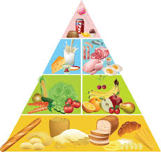
Look at the picture carefully
Could you tell me what have you watched?
Yes, you are correct

Slide 3
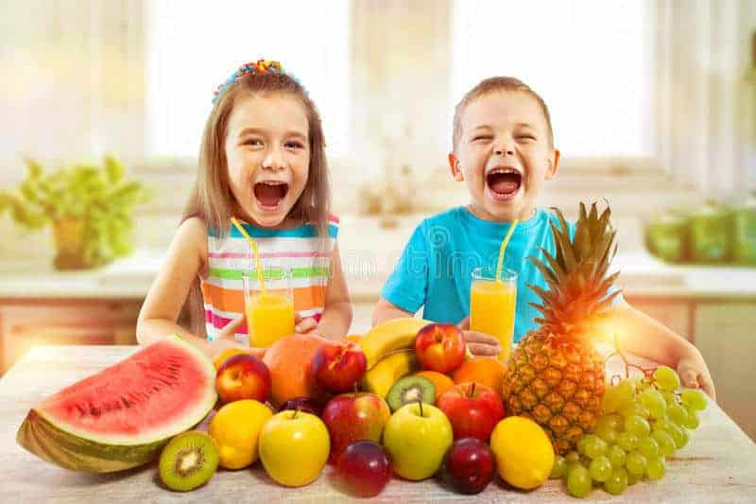
Today we will read
Eat Healthy

Slide 4
Learning outcomes:
5.1.1 Read silently with understanding paragraph
8.1.1 make sentences using words and phrases given in the text.

Slide 5
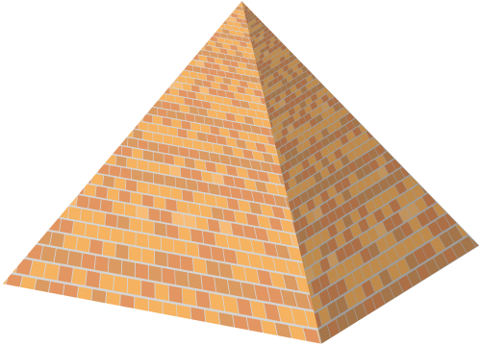
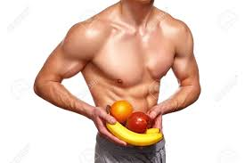
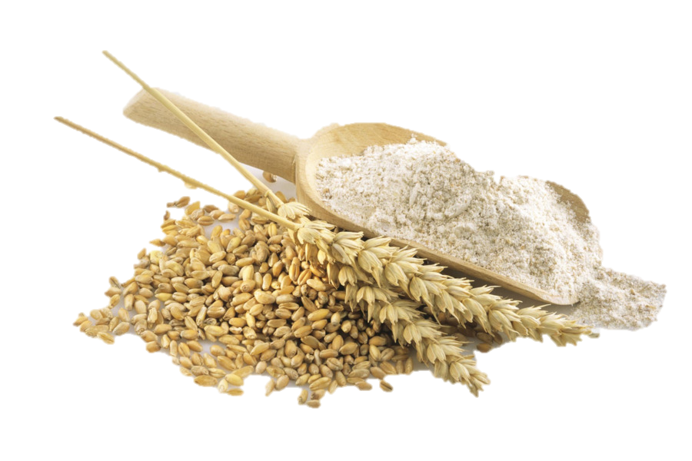
New words
The ancient tombs.
pyramid
Healthiest
Good health
Grains
Seed

Slide 6
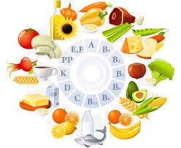
A group of organic compounds
Vitamin
Groups
Class
Under
Bottom

Slide 7
Open at page-26
Teachers reading
And than
Students reading

Slide 8
Write true or false
Groups works
Group-A
1.There are four levels in the food pyramid.
True
2.Egg helps ours eyes.
False
3.Food made of grain give us energy.
False
Group-B
Write the questions answer.
1.What is good food?
2.Which food on the top of pyramid?

Slide 9
Pair works
Re-arrange the word and sentences.
a. lheathy.
Healthy
b. Food/is /good/what/food?
What is good food?
c. have/vitamins/They.
They have vitamins.

Slide 10
Bingo games
Individual work
Write five words from this words
pyramid
food
grain
health
vitamin
bottom
energy

Slide 11
Checking learning
Click on the right answer

Slide 12
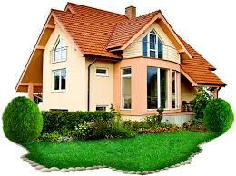
Home work
Write five sentences about your food habit.
See you!

