Slide 1

Welcome to my class.
dear Students
Notes:
Welcome slide.

Slide 2
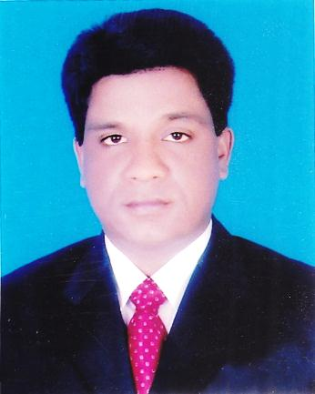
Conducted by-
Mohammad Azharul Islam
English Teacher
Hugra Habib Kader High School, Tangail
Class-(9-10)
English First Paper
Unit-1; lesson-2

Slide 3
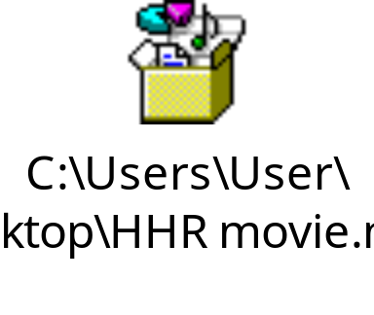
Watch the vidio and guess about
------ and--------.
What things are focused in the video?

Slide 4

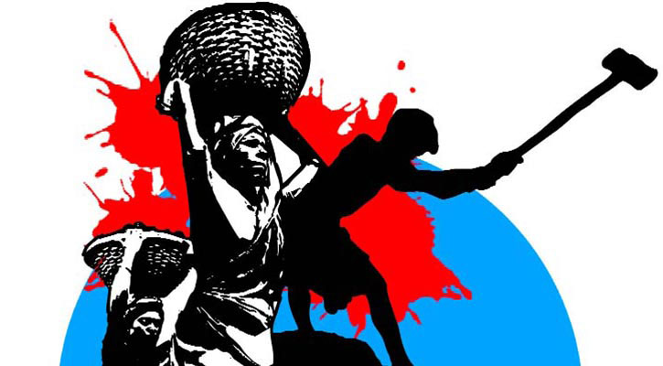
Symbol of knowledge and skills.
Knowledge
Skills

Slide 5
Our Today’s Lesson is-
Knowledge, skills and attitudes
Unit-1, Lesson- 2

Slide 6
Learning outcomes
After completing the lesson , we will be able to—
ask and answer questions
read and understand text through silent reading
write a short paragraph
Learn about his life style

Slide 7
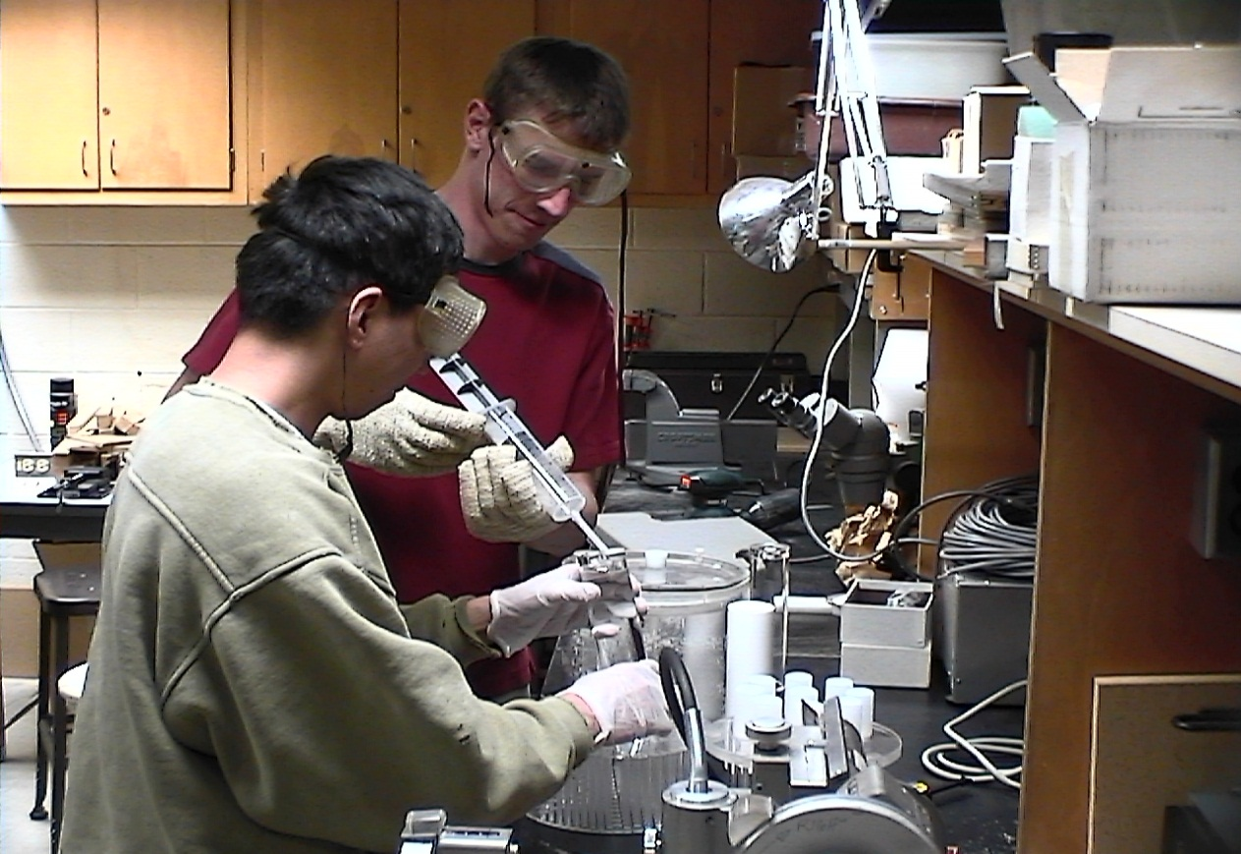
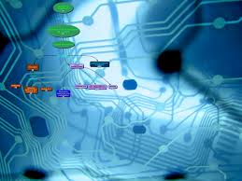
What kind of knowledge is essential to prepare yourself?
The knowledge of--
modern science, technology including ICT .

Slide 8
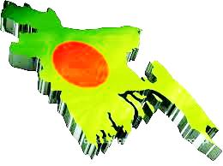
The other areas you, as a good citizen, you should have knowledge of---
our country,

Slide 9

its constitution,

Slide 10
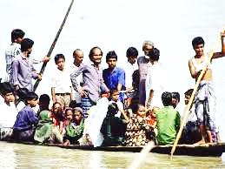
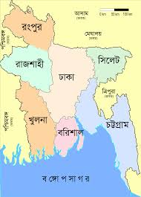
geography
and
people.

Slide 11
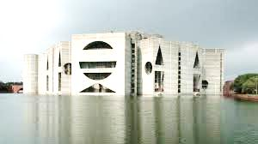
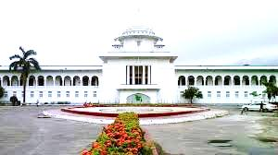
our state
our legislative power

Slide 12
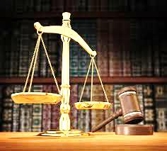
our judicial system.
Anything more?
Yes, our government, its structures and functions, our history, cultures, traditions, literature, moral values and religions, our socio-economic activities and educational system.

Slide 13
What is needed more?
It is skill & attitude.
Let’s have a look at the text book page-6 and go through “you need skills to do things----- Dhaka city corporation” including section C and D silently and loudly.

Slide 14
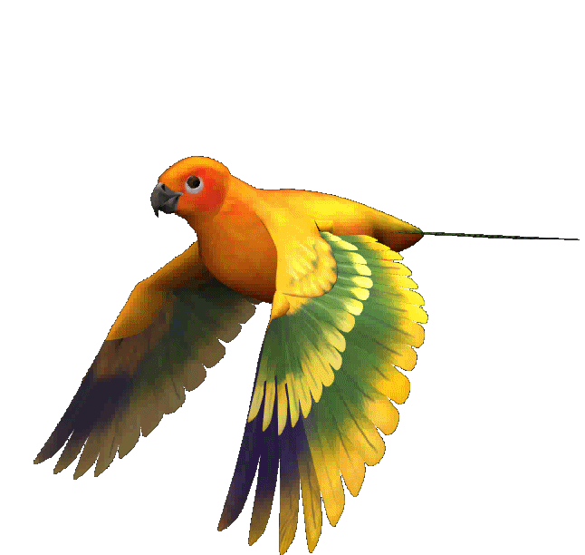
May Allah
bless you all

