Slide 1

Good Morning, Students

Slide 2
Teacher’s Identity
Nazmul Huda
Asst.Teacher.
Islampur Govt.Primary School
Upozila:Alamdanga
Dist: Chuadanga

Slide 3
Class-3
Subject: English
Unit-11

Slide 4
Learning Outcomes
Students will be able to
2.3.1 respond to requests.
1.1.1 repeat after the teacher and say words,phrases and sentences with proper sounds and stress.
1.6.1 recognize and read simple, statements, commands, greetings, questions and answer.

Slide 5
Today’s Lesson-Commands, instructions and requests

Slide 6
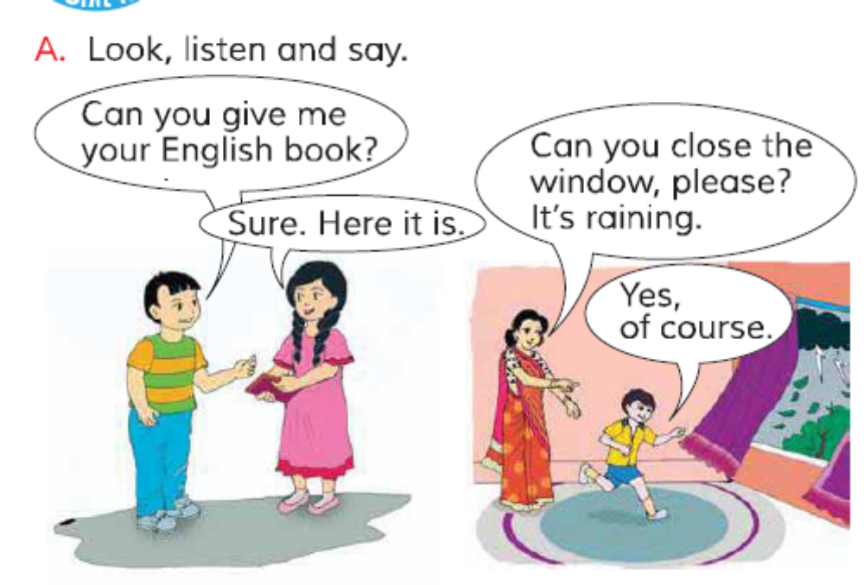

Slide 7
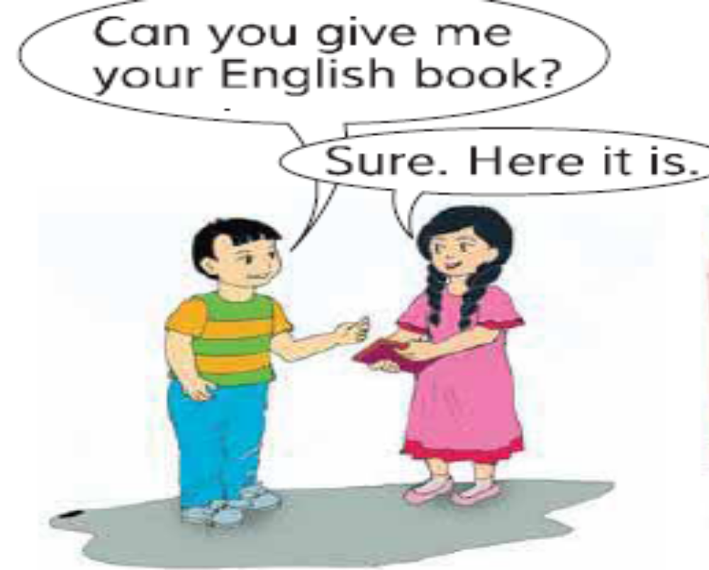

Slide 8
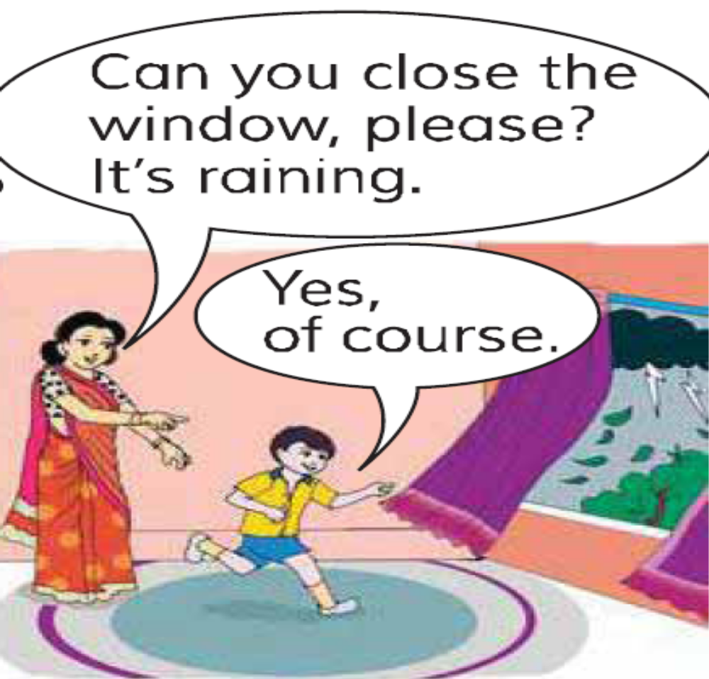

Slide 9
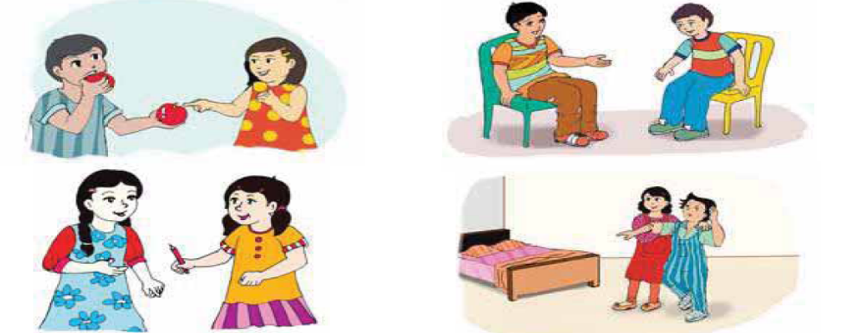
Activities

Slide 11
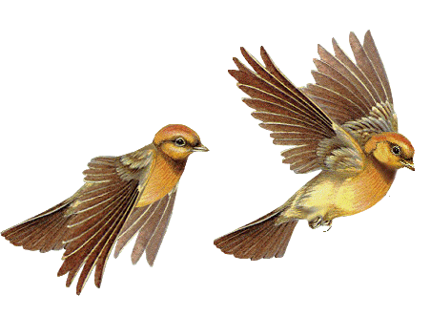
Goodbye

