Slide 1
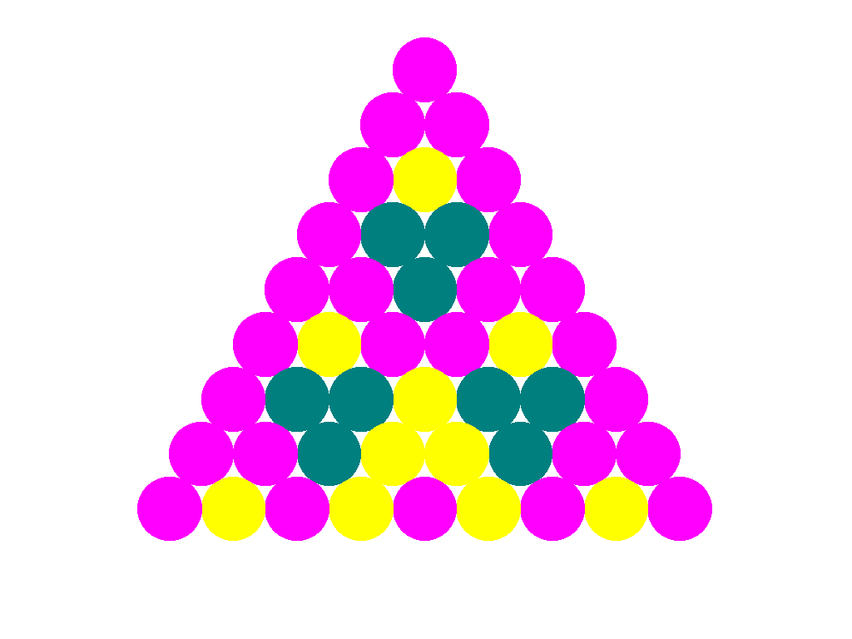
WELCOME
WELCOME

Slide 2
Teacher’s Introduce
Mohammad Abdul Gafur Mojumder
Assistant Teacher
Gaiar Bhanga Govt. Primary School
Lalmai, Comilla.

Slide 3
Class: Two
Subject: English
Unit: 16
Lesson:4(A)
Time: 45 minutes

Slide 4
What do you see in the picture?
Colours s

Slide 5
Lesson Declaration
Colours

Slide 6
Learning outcomes
Students will be able to:
Listening: 4.2.1 1.1.1 become familiar with English sounds by listening to common English words.
Speaking: 1.1.1 repeat after the teacher simple words and phrases with proper sounds and stress.
1.1.2 say simple words and phrases with proper sounds and stress.

Slide 7
What colour is it ?
What colour is it
What colour is it
What colour is it?
Red
Violet
Indigo
Green

Slide 8
What colour is it?
What colour is it?
What colour is it?
Yellow
Orange
Blue

Slide 9
Colours
Orange
Red
Yellow
Blue
Violet
Green
Indigo

Slide 10
Green
Yellow
Orange
Indigo
Blue
Red
Violet

Slide 11
Kims games

Slide 12
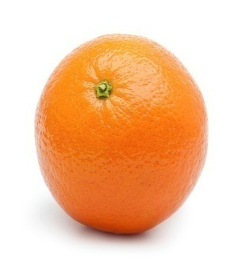
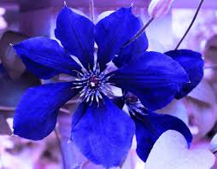
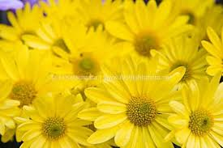
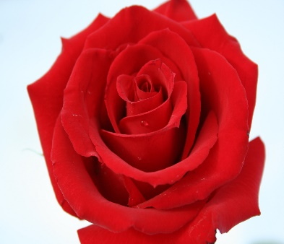
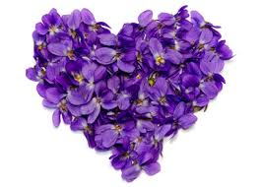
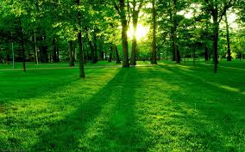
Match the flowers with the names of the colours
Indigo
Orange
Violet
Green
Blue
Yellow
Red

Slide 13
Match the colours with the letters.
I
O
R
G
B
Y
V

Slide 14
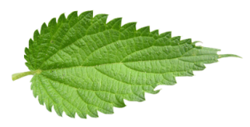
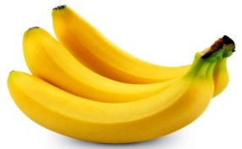
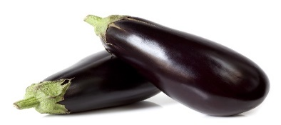
Green group
Match the word with the letter.
Group work
Red group
Match the picture with the letter.
y
Red
y
1
y
b
Green
b
2
b
r
Yellow
r
r
3
i
Blue
v
v
4
g
Indigo
g
5

Slide 15
Evaluation
Write five colours name of your note book.

Slide 16
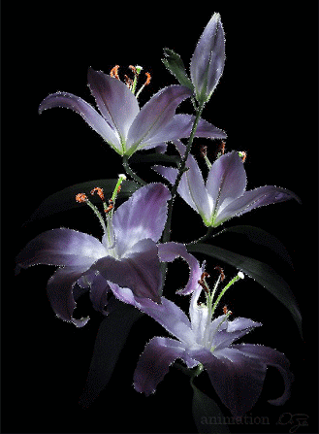
Thanks everybody, Goodbye.

