Slide 1

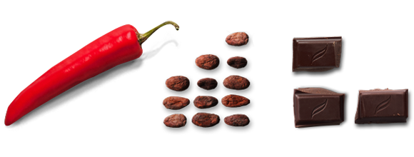
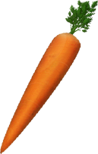

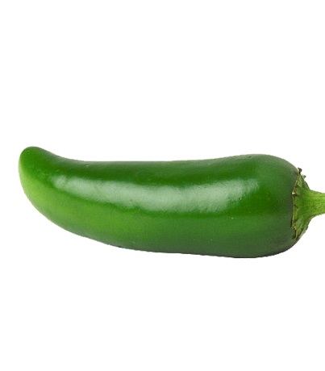
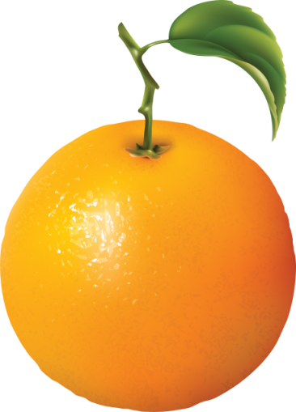
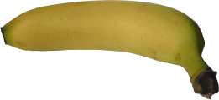

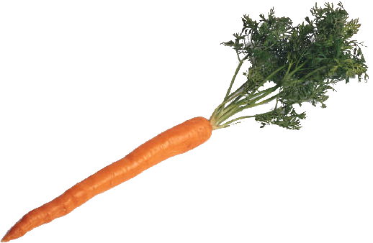
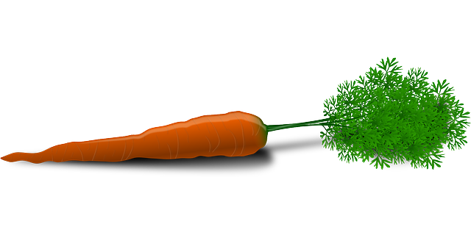


To dear students.
Notes:
This is a food related topic. So to transfer ideas about food these pictures are added. Just one click.

Slide 2
Introduction
Md.Ashraful Islam
Assistant teacher (English) D.I.N.G.S Secondary School(Nawly)Abhaynagar,Jashore. | Class- 8 Subject- English First Paper
Notes:
Introduction of teacher & class.

Slide 3
_{Previous lesson}

Slide 4
Our Today’s Lesson is-
Bangladeshi Cuisine
Unit-6, Lesson-5
Notes:
Lesson declaration.

Slide 5
Learning Outcomes
After we have studied this lesson, we will be able to-----
ask and answer questions
Infer meaning form context from silent reading
Participate in short discussion
write answers to questions
Notes:
All the four skills will be focused in this lesson.

Slide 6

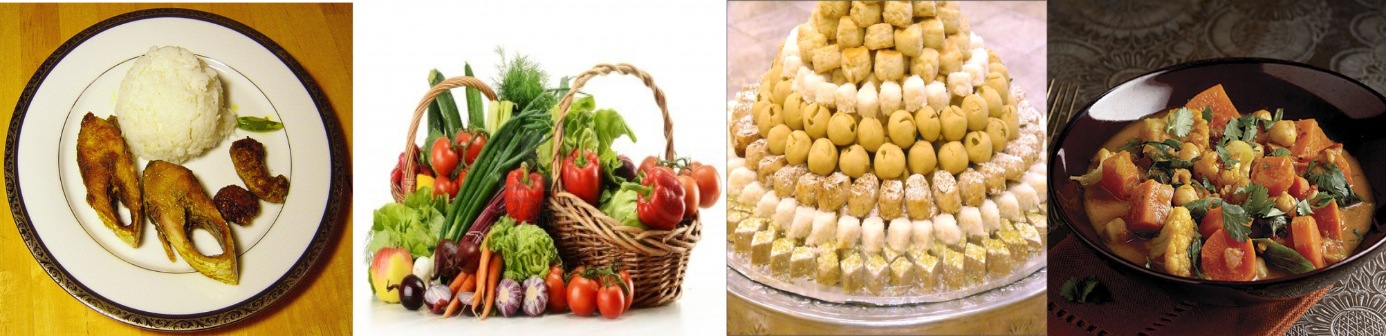
A Look at the pictures and discuss in pairs.
Notes:
Text started.

Slide 7
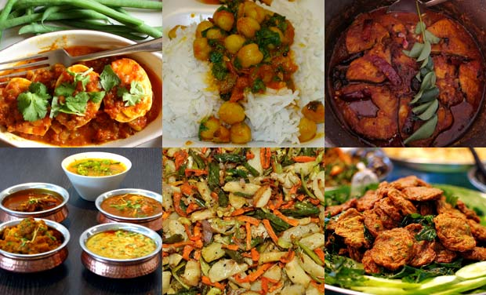
Key words
Cuisine
Food, Gastronomy
Bangladeshi cuisine is rich in taste.
Notes:
After showing the word, teacher may ask the meaning, then he may go one by one according to animation.

Slide 8
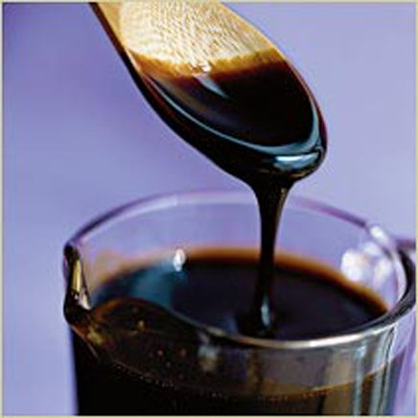
molasses
Syrup
/treacle
Many kinds of cakes are made with molasses.
Notes:
After showing the word, teacher may ask the meaning, then he may go one by one according to animation.

Slide 9
Dear students,
Open your book at page 69 and read silently.
B Read the text below and answer the following true-false questions.
Bangladeshi cuisine is rich and varied with the use of many spices. We have delicious and appetizing food, snacks, and sweets. Boiled rice is our staple food. It is served with a variety of vegetables, curry, lentil soups, fish and meat. Fish is the main source of protein. Fishes are now cultivated in ponds. Also we have fresh-water fishes in the lakes and rivers. More than 40 types of fishes are common.
Notes:
Students will read it silently and teacher will monitor and help the students moving in the class.

Slide 10
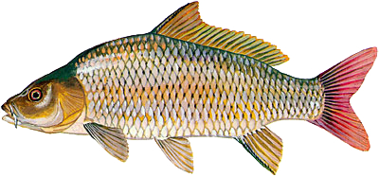
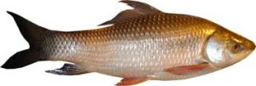
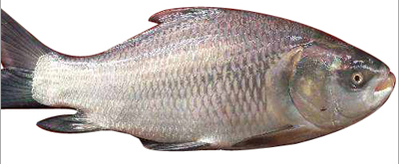
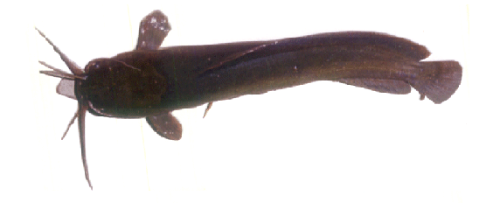
Some of them are…
Carp
Rui
Katla
Magur
Notes:
Teacher may ask the name of the fishes to the students, then he can show the names according to animation.

Slide 11
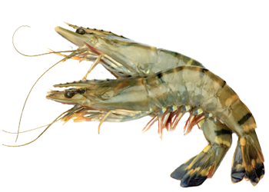
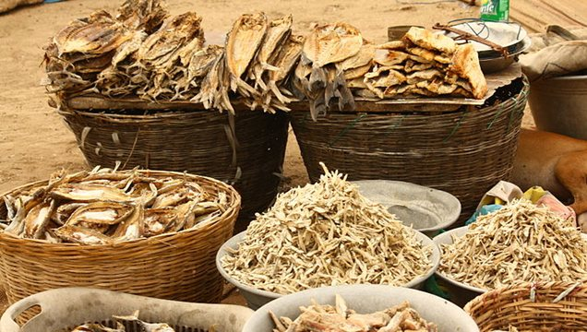
Shrimp
Sutki/dried fish
Notes:
It will cover listening skill.

Slide 12
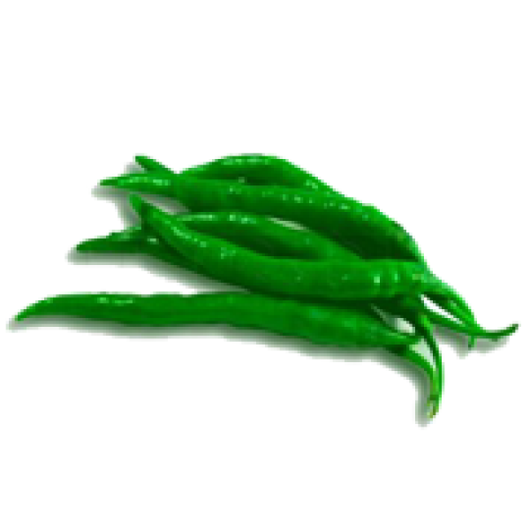
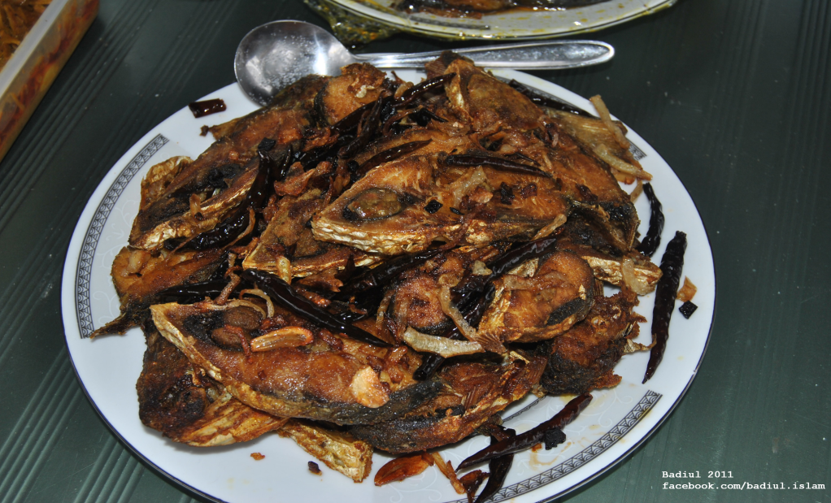

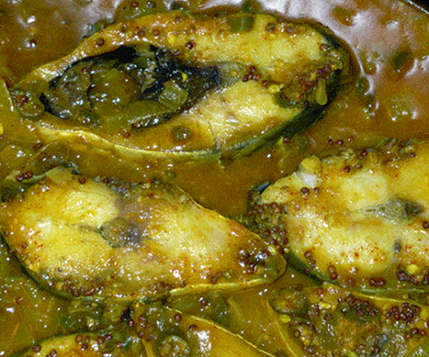
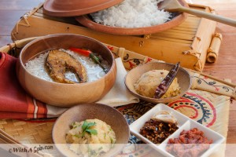
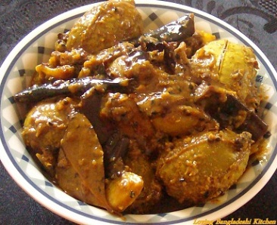
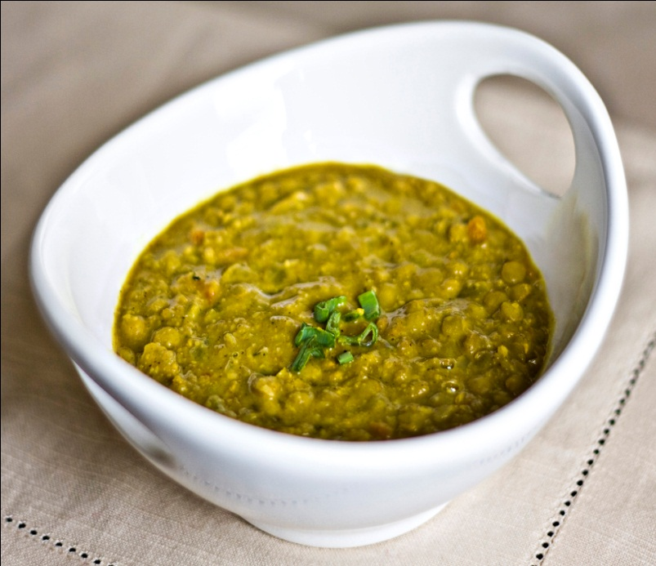
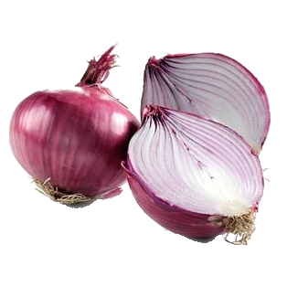
Pantha bhat is tasty with…
Fried hilsa
Hilsa slice
Pickles
Onion
Lentil soup
Notes:
It is for listening skill.

Slide 13
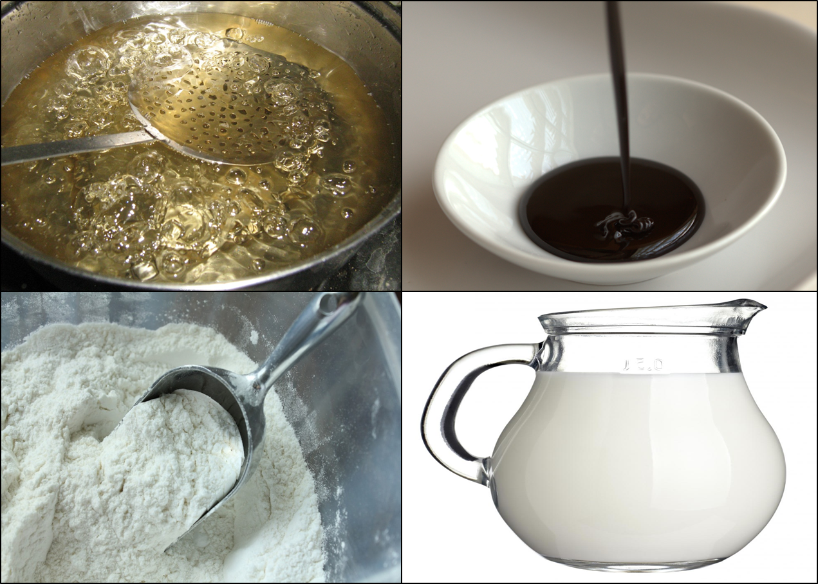
‘Pitha’ a kind of sweet is made from-
Sugar syrup
Molasses
Rice flour
Milk
Notes:
Teacher may ask the students about these pictures, than he can explain.

Slide 14
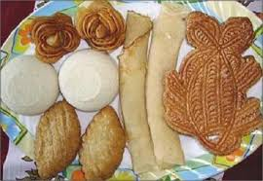
During winter Pitha Utsab, meaning pitha festival is organized by different groups of people.
Notes:
It focuses one of the cultures of our country.

Slide 15
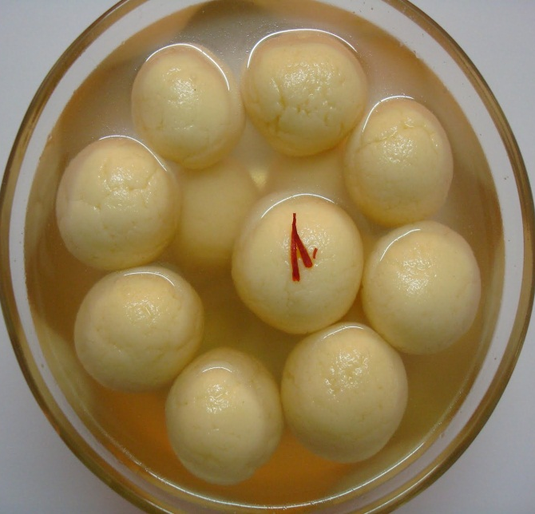
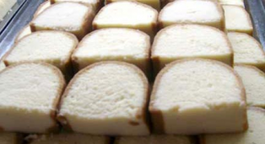
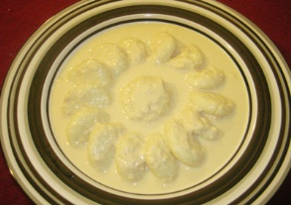
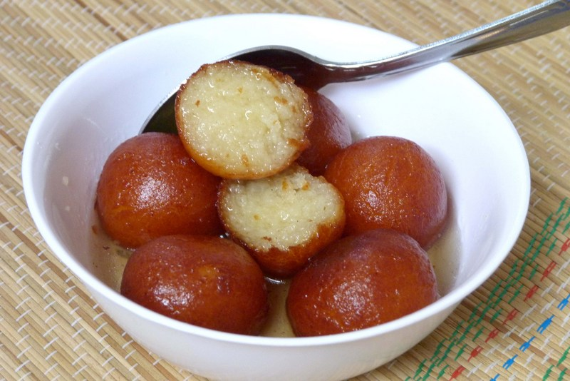
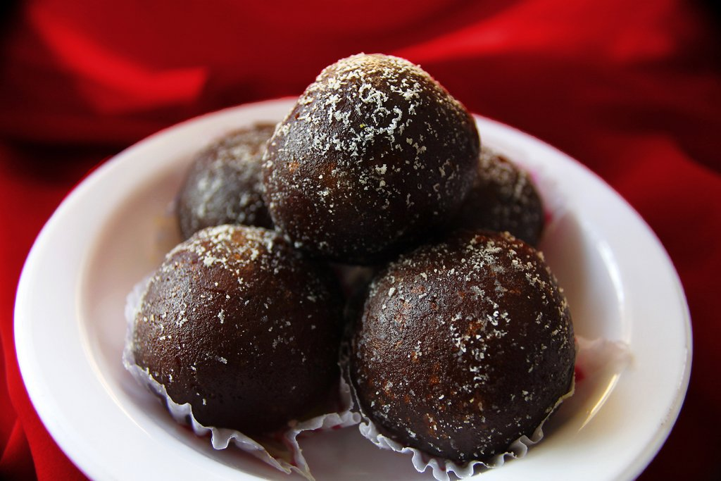
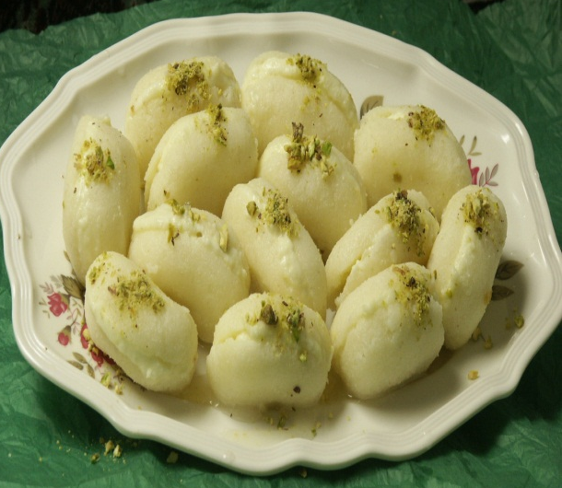
Roshgulla
Sandesh
Rasmalai
Gulap jamun
Kal jamun
Chom chom
Milk-based sweets.
Notes:
Teacher may make conversation on the foods given in the slide about Bangladeshi sweets.

Slide 16
Individual Work
C True or false? If false, give the correct information.
1 Our foods are rich because they have a lot of oil in them.
2 We get protein mostly from fish.
3 On Pohela Boishkh the traditional food is steamed rice and fried hilsha.
4 Pitha Uthsab takes place almost all the year round in Bangladesh.
5 Sweets are not much appreciated by the people of Bangladesh.
Notes:
Teacher may conduct this orally.

Slide 17
Pair work
E Discuss and answer the questions in pairs.
1 Describe a Bangladeshi food that you like best.
2 Make a list of the things you and your partner eat every day.
3 Make two lists of food eaten by the urban and the rural people.
4 Why are there differences between the food eaten by the urban and the food eaten by the rural people?
Notes:
Alternative of group work.

Slide 18
Home Work
D Read the text in B again and answers the following questions.
1 What has made Bangladeshi food so special?
2 Where do we get the fishes from?
3 Apart from fish, what other foods do we eat with rice?
4 Why are sweets an important part of our life?
Notes:
Home work for next class.

Slide 19
Allah Hafez
Notes:
Ending slide.

