Slide 1


Slide 2

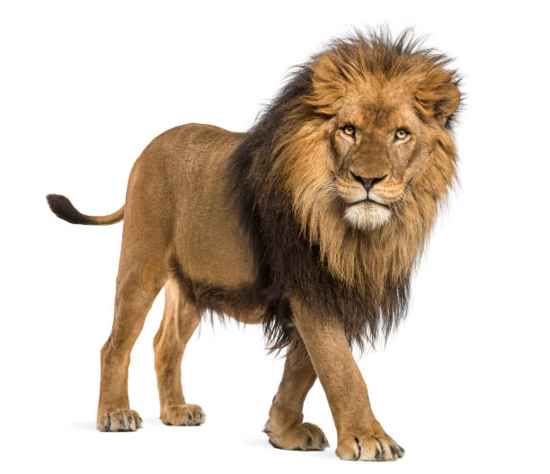
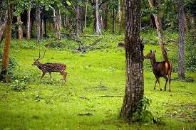
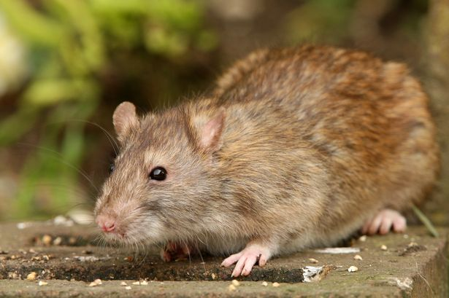
L
M
W
C
E
E
O

Slide 3
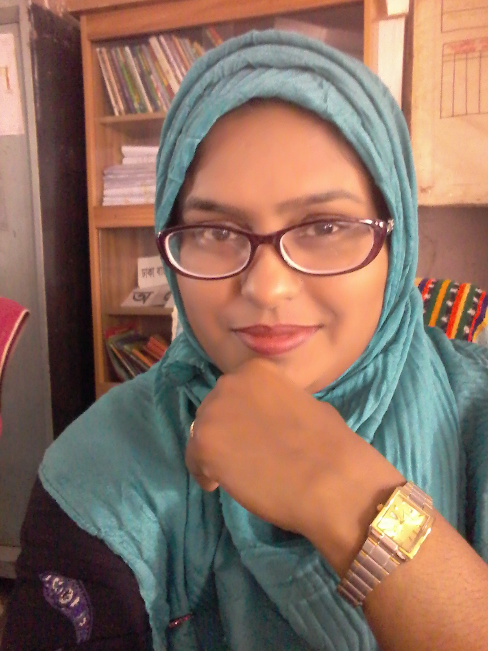
Presented by
Shahrina Bin Sweety
Assistant Teacher
Chormonai Madrasha Government Primary School
Barishal.

Slide 4

Lesson Identity
Class : Four
Subject : English
Unit : 42
Lessons : 1-2 ( One day…..was angry.)
Page No. : 84

Slide 5
Learning Outcomes :
Students will be able to –
Speaking :
1.1.1. repeat after the teacher and say words, phrases and sentences with proper sounds, stress and intonation.
6.2.1 talk about people, objects, events, etc.
Listening :
1.1.1. recognize sound differences in the context of words.
1.2.1. recognize which syllable in a word is stressed.
1.3.1. recognize which words in a sentence stressed.
4.3.1. enjoy and understand simple stories.
Reading :
1.4.1. to read words, phrases and sentences in the text.
1.5.1. read words, phrases, and sentences in the text with proper pronunciation, stress and intonation.

Slide 6


GREETINGS
Good morning, students.
Good morning, teacher.
How are you today?
Fine. and you?
Fine, thank you.

Slide 7

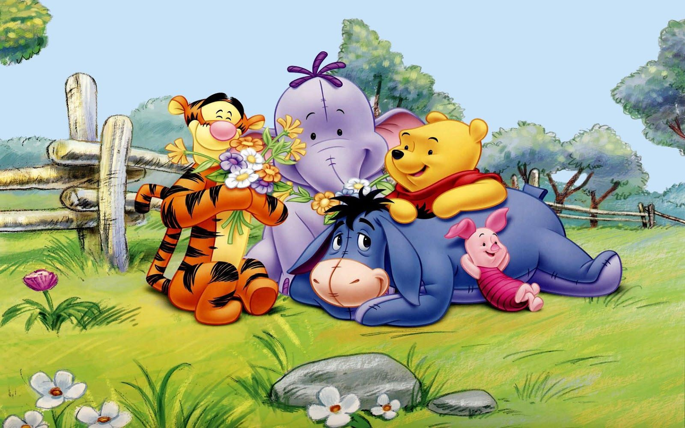
Dear students, Let’s watch a video.
link
https://www.youtube.com/watch?v=4NkFMkgh0wY

Slide 8
Discuss about the video
With the students
What do you see in the video ?
Some animals.
Say the names of the animals .
Lion, Monkey, Zebra.
Is the lion big ?
Yes, its very big.

Slide 9
Look at the picture
What is this ?
It’s lion.
What does the lion eat?
The lion eats meat.

Slide 10
Look at the picture
What is this ?
It’s mouse.
What does the mouse eat?
The mouse eats seeds, insects, clothes.

Slide 11

Dear students, Today we’ll read a story -
The lion and the mouse

Slide 12
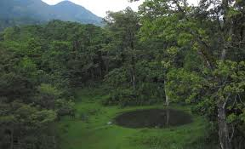

Main key words of the lesson
Forest
Jungle
Strong
Stout

Slide 13
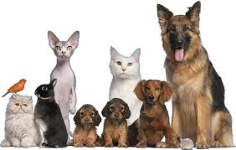
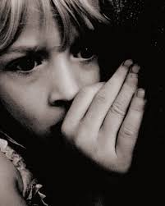
Animals
Creatures
Feared
Be afraid

Slide 14
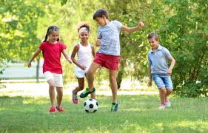
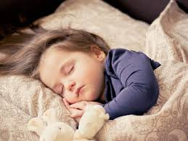
Playing
Enjoying a game
Sleeping
Asleep

Slide 15
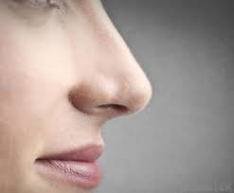
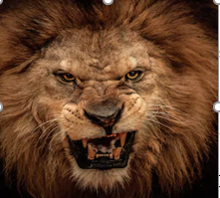
Nose
A part of our body
Angry
Annoyed

Slide 16
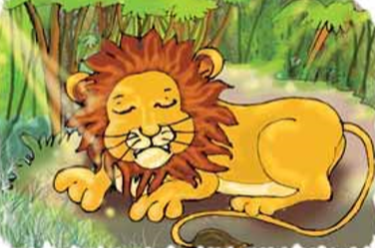
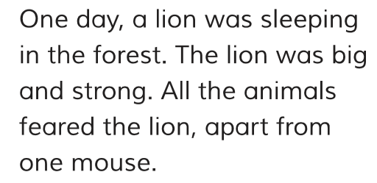
Teacher’s reading

Slide 17
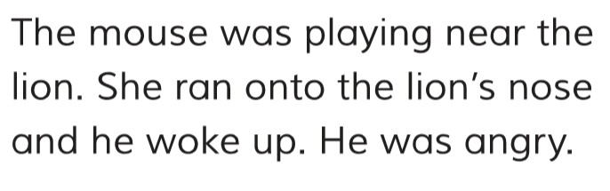
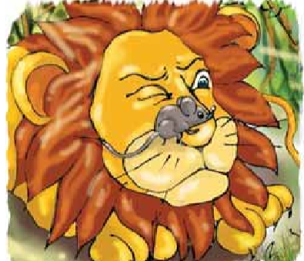

Slide 18
Let’s listen the Audio
Audio file : C4U42LI – 2A

Slide 19

Group Work
Pronounce these words in groups.
Nose
Strong
Animals
Feared
Angry
Forest

Slide 20

Pair work
Ask and answer the following questions with your partner
How was the lion ?
What was the lion doing ?
Who did not fear the lion ?
Why was the lion angry ?

Slide 21
Individual Work
Read the first 2 paragraph silently.

Slide 22
Evaluation
Read the statement and say true or false
1. The lion was sleeping.
2. The animals did not fear the lion.
3. The mouse was sleeping.
4. The lion was big and strong.

Slide 23
Evaluation
5. The lion wasn’t angry.
6. The mouse ran onto the lion’s nose.
7. The mouse didn’t fear the lion.
8. The mouse was big.
9. The lion woke up for the muse.
10. The lion was sleeping in the jungle.

Slide 24


Home Work
Write 5 sentences about the lion.

Slide 25
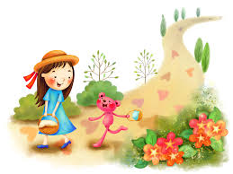
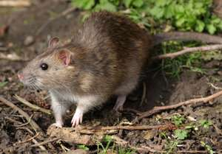
OK! STUDENTS,
Bye..
Thank You.

