Slide 1

Good morning

Slide 2
Introducing
Md. Saiful Islam
Assistant Teacher (English)
Bagbari Chowbaria High School
Tangail Sadar Tangail
E-mail: hridoy9555@gmail.com

Slide 3
Class: Seven
Subject: English 2nd paper
Unit:01
Lesson:1-6
Students: 70
Time: 50 minutes
Date: 12-10-19

Slide 4

The apple is very sweet.

Slide 5
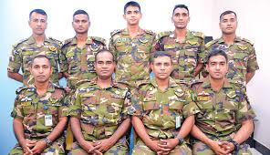
They are Bangladesh Army.

Slide 6

The bird is very beautiful.

Slide 7
Lesson declaration
Parts of speech

Slide 8
Learning outcomes
After finishing the lesson, learners will be able to---
Define parts of speech.
Write their names.
Find out parts of speech.
Classify parts of speech.

Slide 9
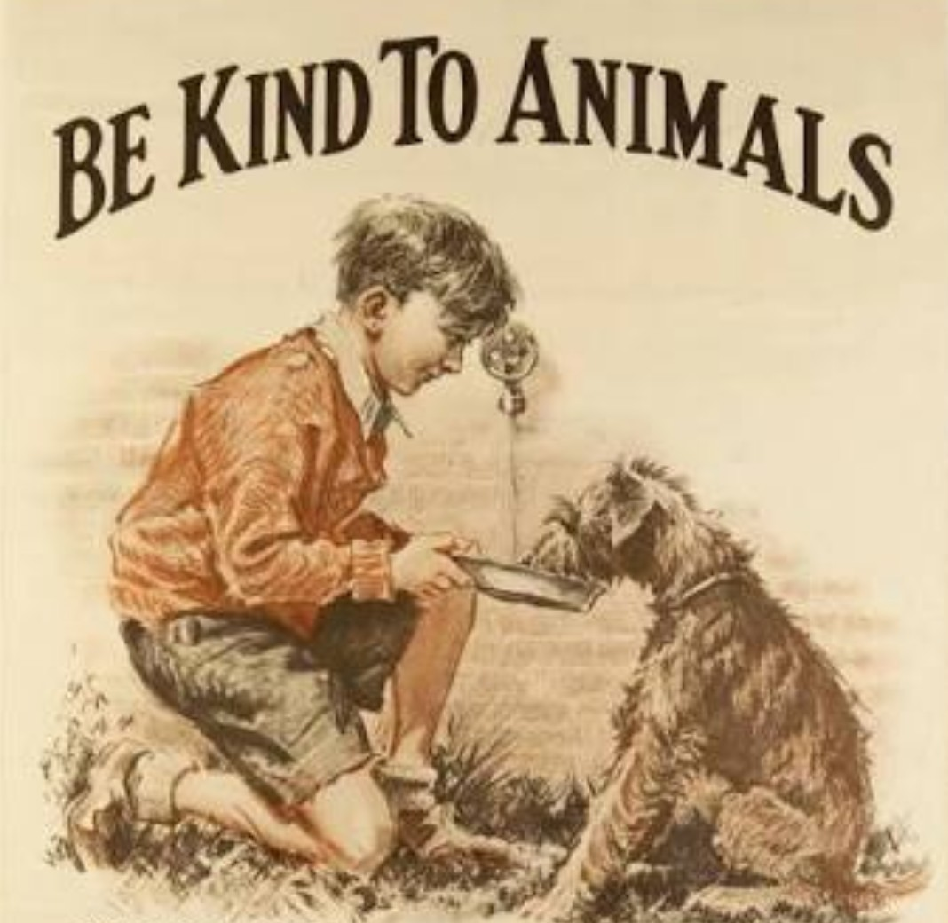
The boy is feeding the animal.

Slide 10
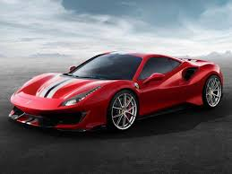
The car runs fast.

Slide 11
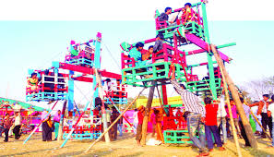
The children are in the merry go round.

Slide 12

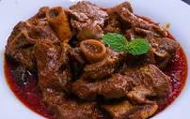
Fish and meat are my favourite menu.

Slide 13

Hello! Friends how are you.

Slide 14
Classification of parts of speech
Parts of speech
Noun
Adverb
Adjective
Pronoun
Verb
Preposition
Conjunction
Interjection

Slide 15
Definition of all parts of speech:
noun: Any name is noun. Example- Rahim, book, Karim, Dhaka, pen, beauty etc.
Pronoun: A pronoun stands for a noun. Example: He, she, they, we, me etc.
Adjective: An adjective is a word which qualifies a noun or a pronoun. Example- good, small, great, large etc.
Verb: A verb is the part of speech that describes an action or occurrence or indicates a state of being. Example- eat, play, rise , do, run etc.
Adverb: An adverb is a word that modifies a verb, an adjective, or another adverb. Example- slowly, kindly, very, greatly, quickly etc.
Preposition: A preposition is a word that sits before a noun or a pronoun to show its relation to other words of the sentence. Example: To, on, upon, after, in, under, with etc.
Conjunction: A conjunction is a word that joins words, phrases, clauses or sentences. Example: And, or, but, though, because, yet etc.
Interjection: An interjection is a word that expresses some sudden feeling of mind. Example: Alas! Oh! Ah! Fie! Hurrah! Hello! Etc.

Slide 16
Individual work
What is called parts of speech?
How many kinds of parts of speech are there?
What is pronoun?
Answers
The different classes into which words are arranged according to their functions in a sentence are called parts of speech.
There are eight kinds of parts of speech.
A pronoun stands for a noun.

Slide 17
Group work
Identify the following parts of speech
Habib is a good boy. He goes to school regularly. One day he was going to school with Sumon but they were very late. Alas! we are late.

Slide 18
Evaluation
Find out noun, adjective, verb and preposition from the following passage: Once there lived a farmer in a village. He was very old but clever. He had two sons. They were lazy and did not do any work. The old farmer told his sons to work hard. After some days the farmer died. The sons became sad but they were greedy. They dug the soil and sowed seeds.

Slide 19

Home work
Write the definition of all the parts of speech

Slide 20

Thank you very much.

