Slide 1

Welcome

Slide 2
Introducing
Md. Saiful Islam
Assistant Teacher (English)
Bagbari Chowbaria High School
Tangail Sadar Tangail
E-mail: hridoy9555@gmail.com

Slide 3
Class: Seven
Subject: English 2nd paper
Unit:06
Lesson:1-6
Students: 70
Time: 50 minutes
Date: 12-10-19

Slide 4

Hasan is a businessman.

Slide 5
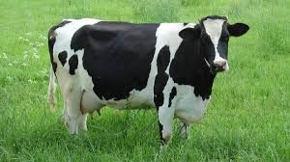
The cow is a domestic animal.

Slide 6
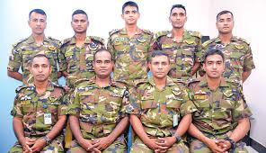
Bangladesh Army are very organized.

Slide 7
Lesson declaration
Noun

Slide 8
Learning outcomes
After finishing the lesson, learners will be able to---
Define noun.
Write their names.
Find out noun.
Classify noun.

Slide 9
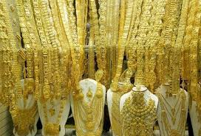
The gold of this ornament is pure.

Slide 10

The kindness of the boy is praiseworthy.

Slide 11
Classification of noun
Noun
Proper
Abstract
Collective
Common
Material

Slide 12
Definition of all nouns:
Proper noun: A proper noun is the name of a particular person, place. Example- Rahim, Karim, Dhaka, Tangail etc.
Common noun: A common noun is a name given in common to every person or thing of same class or kind. Example- Cow, dog, cat, man etc.
Collective noun: A collective noun is the name of a group or collection or person or things taken as a whole. Example- army, team, class etc.
Material noun: A material noun denotes the matter or substance of which things are made. Example- Milk, gold, rice , tea etc.
Abstract noun: An abstract noun is the name of a quality or state belonging to a person or an object. Example- Honesty, kindness, beauty, greatness etc.

Slide 13
Individual work
What is called noun?
How many kinds of nouns are there?
What is proper noun?
Answers
Any name is noun.
There five kinds of nouns.
A noun that is used only for a person or a place is called proper noun.

Slide 14
Peer work
Identify the following nouns.
Habib is a good boy.
Water has no colour.
The cow is domestic animal..
Honesty is the best policy.
The class was very quite.

Slide 15
Group work
How many kinds of nouns are there?
Write their names with example.
Answer
There are five kinds of nouns. They are:
(1) Proper noun (2) Common noun (3) Collective noun (4) Material noun (5) Abstract noun

Slide 16
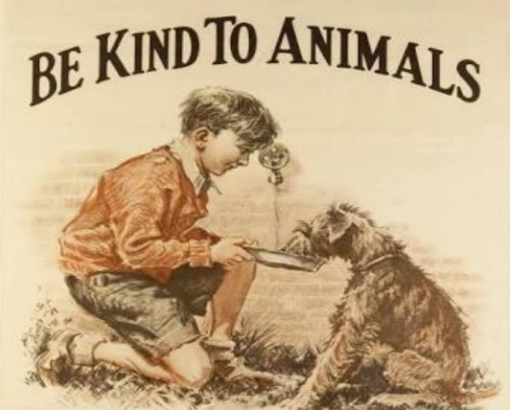
Evaluation
Write down the name of noun of the following pictures.

Slide 17
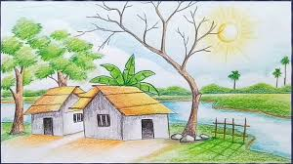
Home work
Write definition of nouns with example.

Slide 18

Thank you very much.

