Slide 2
WELCOME
TO
ENGLISH FOR TODAY

Slide 3
Presented By-
BTT, Batch-13, ID-01090130389, Venue- TTC, Jashore.

Slide 4
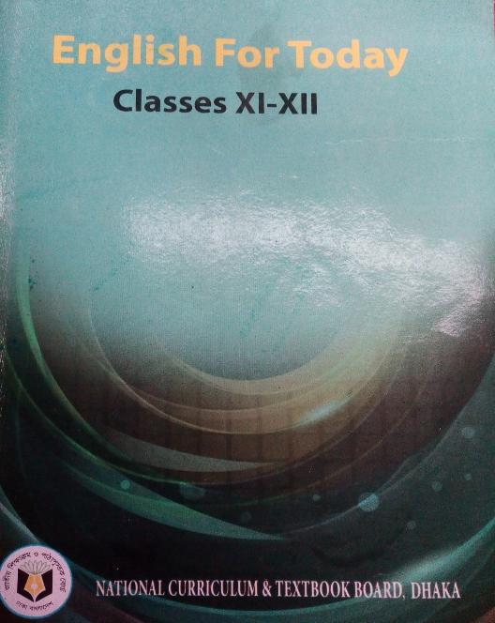
## Love and friendship are the two important demands of human life. Human life becomes unlivable in their absence. Though human beings need them badly, true love and friendship are difficult to find. The short song from William Shakespeare’s (1564 - 1616) play As You Like It laments the absence of true love and friendship in human life.
Blow, blow, thou winter wind,
Thou art not so unkind
As man's ingratitude ;
Thy tooth is not so keen,
Because thou art not seen,
Although thy breath be rude.
Heigh-ho! sing heigh-ho! unto the green holly:
Most friendship is feigning, most loving mere folly:
Then heigh-ho, the holly!
This life is most jolly.
Freeze, freeze, thou bitter sky,
That dost not bite so nigh
As benefits forgot:
Though thou the waters warp,
Thy sting is not so sharpAs friend remembered not.
High-ho! sing heigh-ho! unto the green holly...
Subject Introduction
Subject : English 1st paper
Unit : 04
Lesson : 02(Love and Friendship)
Time : 60 Minutes
Date : 23/08/2019
Click to see the Text

Slide 5
Love
Friendship

Slide 6
## Love and friendship are the two important demands of human life. Human life becomes unlivable in their absence. Though human beings need them badly, true love and friendship are difficult to find. The short song from William Shakespeare’s (1564 - 1616) play As You Like It laments the absence of true love and friendship in human life.
Blow, blow, thou winter wind,
Thou art not so unkind
As man's ingratitude ;
Thy tooth is not so keen,
Because thou art not seen,
Although thy breath be rude.
Heigh-ho! sing heigh-ho! unto the green holly:
Most friendship is feigning, most loving mere folly:
Then heigh-ho, the holly!
This life is most jolly.
Freeze, freeze, thou bitter sky,
That dost not bite so nigh
As benefits forgot:
Though thou the waters warp,
Thy sting is not so sharpAs friend remembered not.
High-ho! sing heigh-ho! unto the green holly...
Today’s Lesson?
Click to see the Text
Love &
Friendship

Slide 7
Learning Outcomes-
At the end of the lesson, Ss will be able to -
Say about William Shakespeare.
Explain some new words.
Describe real friendship and love.

Slide 8
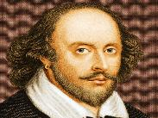
Have you heard the name of William Shakespeare?
William Shakespeare was an English poet, playwright, and actor, widely regarded as the greatest writer in the English language and the world's greatest dramatist. He is often called England's national poet and the "Bard of Avon".
Click above to see the details

Slide 9
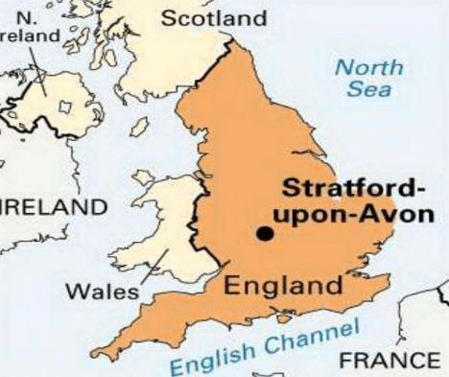
Shakespeare's Birthplace in Stratford Upon Avon
Click above to see the details

Slide 10
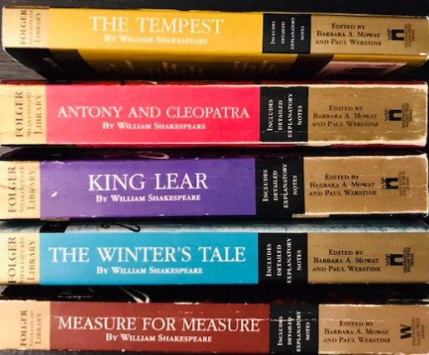
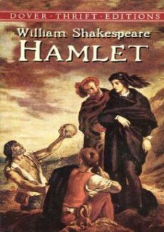
Shakespeare’s famous dramas ……
Click above to see the details

Slide 11
Blow
?
উড়িয়ে দেয়া
Bitter
?
তিক্ত
হাসি খুশি
Jolly
?

Slide 12
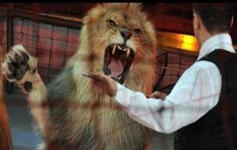
Lament
?
আক্ষেপ করা
Nigh
?
নিকটে
অকৃতজ্ঞতা
Ingratitude
?

Slide 13
Rude
?
রূঢ়
Wrap
?
মোচড়ানো
ঠান্ডায় জমে যাওয়া
Freeze
?

Slide 14
The cruelty of the icy winter-winds is less unkind than man’s ingratitude and hypocrisy.
?

Slide 15
The poet expresses that most friendship is feigned and most loving mere folly.
?

Slide 16
Shakespeare also speaks of the hostile sky the sting of which is not so sharp and painful as the attitude of those who after receiving favours prove thankless.
?

Slide 17
Answer the following questions in group:
10 minutes
Group red
What is worse than the winter wind?
Group black
Why does the poet call the winter wind ‘unkind’?
Group white
What has got sharper tooth than the winter wind?
Group green
What kind of people forget received benefits?

Slide 18
Try to Remember:
1
The word ‘sharp’ means?
painful
2
To the poet ‘friendship’ is ------?
feigning
3
Shakespeare is the greatest ---------?
dramatist
4
‘As You Like it’ is a ---------?
comedy
5
Shakespeare says that most loving is mere ----------?
folly

Slide 19
Be good today
&
Always remain so …..
Thanks to All

