Slide 1
Welcome

Slide 2
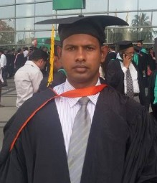
INTRODUCTION
Md. Ikramul Haque
B.Sc, B.Ed,M.A in English
Assistant Teacher( English)
Mirzapur Islamia Dakhil Madrasah
Dapunia, Pabna sadar, Pabna.
E-mail: mirzapur_madrasah@yahoo.com
01716845666
SUBJECT: English 1st Paper
CLASS: Nine
UNIT: Ten (Days to remember)
LESSON: Six
Topic: Sights and sound

Slide 3
OBJECTIVES OF THE LESSON
By the end of the lesson the students will have :
know the new country.
know about the new culture.
read a text and find meaning of some expression.
practices reading, writing, speaking and listening.

Slide 4
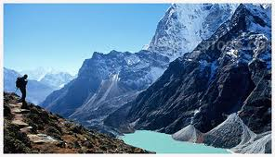
What do you see?

Slide 5
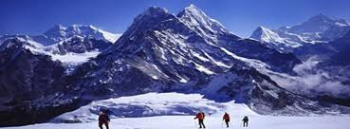
It is a Himalaya at Nepal.

Slide 6
Todays tropic
Sights and sound

Slide 7
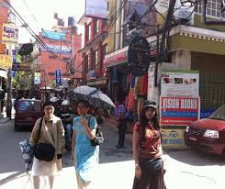
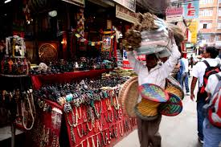
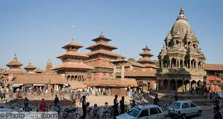
Vocabulary
Buzzing with life
Laden with goods
Over helming

Slide 8
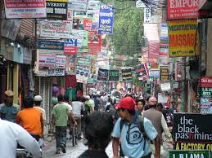
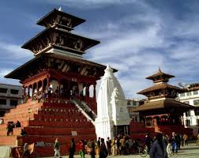
Pairs Work
What are different people has on that picture?

Slide 9
Read the text and write a short paragraph.

Slide 10
Fill in the gap Without clues -
The narrow Thamel road were jam……(a)…….. ,whose are busy seeing and ……(b)……. . Some are feel it is as …(c)……. …., and some are feel it is the suitable place to marketing. Masum fell some tried, for this reason he sat down on ………………(d)…………………………. . The whole place was fill-up by different ………(e)………… , where sights and sounds touched Masum very strongly.
With Tourist
buying
A fair
Top of the stairs of a temple
activity

Slide 11
GROUP WORK
Imagine that you have gone to a local market at Nepal and you lost the way to go at your residence. Write down what will you do?

Slide 12
Evaluation
Whose are busy seeing and buying ?
Tourist
Why did sights and sounds touch Masum very strongly?
For fill-up by different peple.
Where is stay Himalaya ?
Nepal
Where is stay Nepal in the world ?
South Asia

Slide 13
HOME WORK
Do you want to visit the Nepal? Why?

Slide 14
THANK YOU ALL

