Slide 1
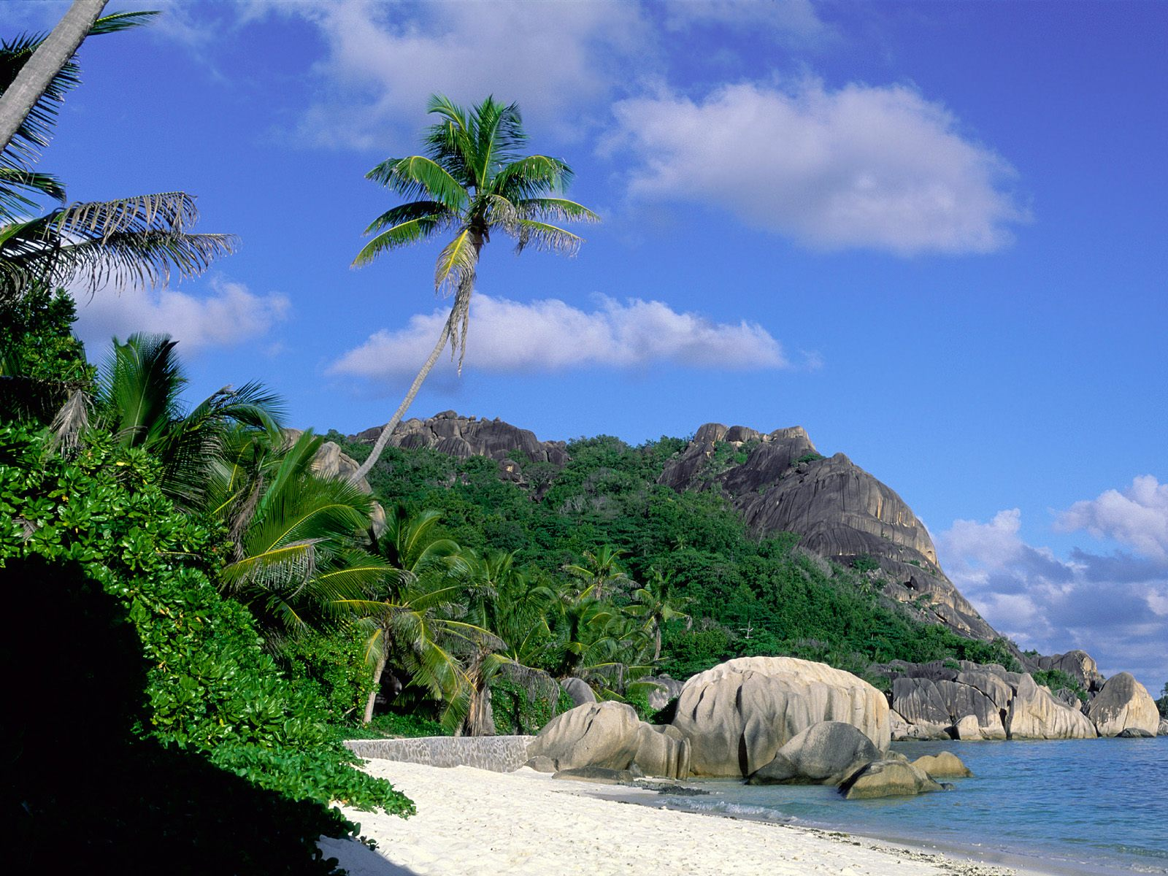
Welcome

Slide 2
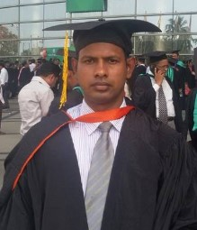
INTRODUCE
Md. Ikramul Haque
B.Sc, M.A in English
Assistant Teacher( English)
Mirzapur Islamia Dakhil Madrasah
Dapunia, Pabna sadar, Pabna.
E-mail: mirzapur_madrasah@yahoo.com
01716845666
SUBJECT: English 1st Paper
CLASS: Nine
UNIT: Three (World Heritage)
LESSON: One
Topic: The Shat Gambuj Mosque
Duration time: 40 min.

Slide 3
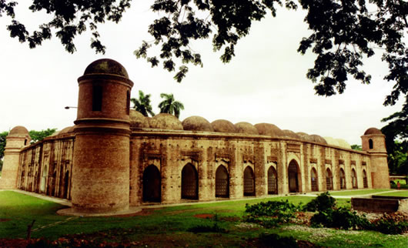
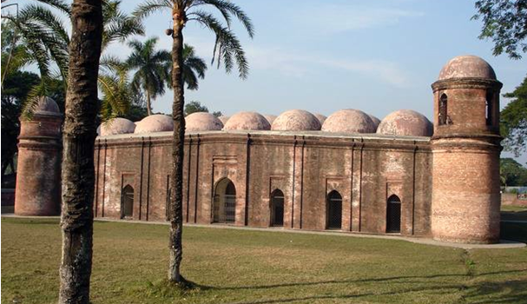
Look Up the Following picture

Slide 4
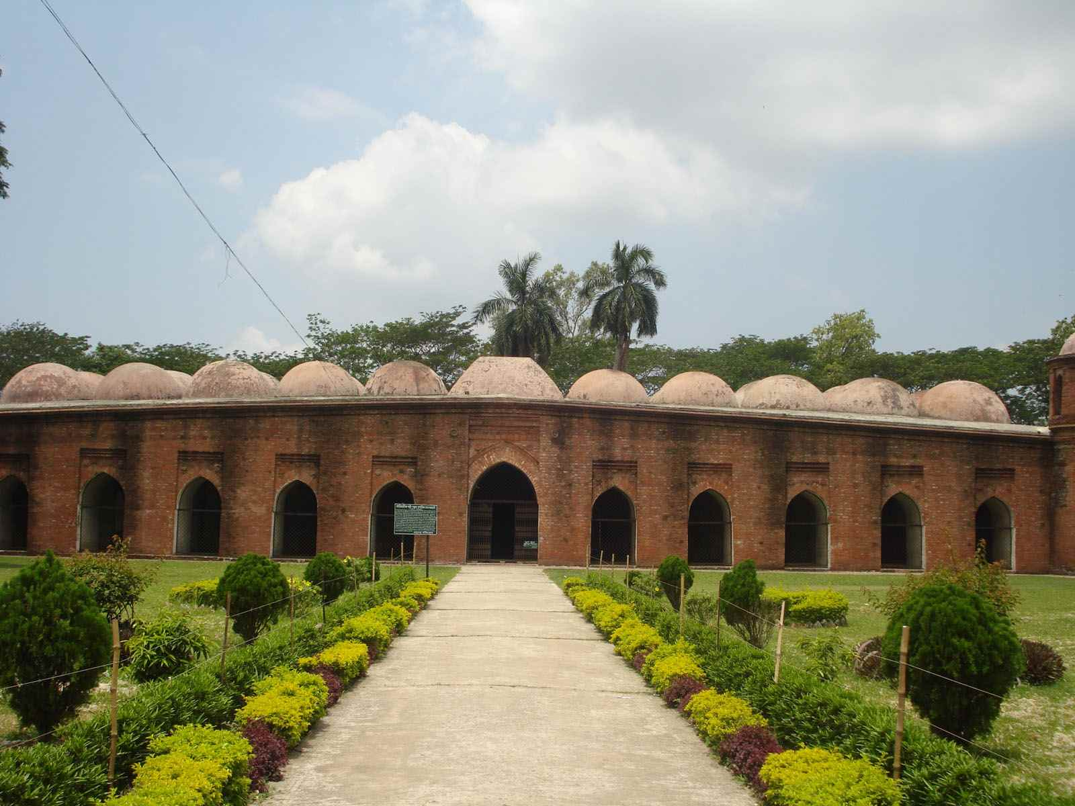
Works All SS
Look at The Picture
What is this building ?
Do you have a building like this in your town/village ?
What do you call it ?

Slide 5
That was picture of
“The Shat Gambuj Mosque”

Slide 6
Objective
After SS have Studied this Lesson, they able to
1. SS will know specific information.
2. SS will read and understand texts through silent reading.
3. SS will ask and answer questions.
4. SS will describe a place with writing/speaking.

Slide 7
New Word
UNESCO - United Nation Education Science and Cultural Organization
Heritage – inherit from the past
Monument – Symbol of any moral activities

Slide 8
Read the passage and fill in the blank Without Clues
Shat Gambuj Mosque
Information
When
15th Century
Founded by
Ulugh Khan Jahan Ali
Number of domes
77
Number of pillars
60
Arches
11

Slide 9
It became a UNESCO world heritage site in 1999
True/False
False
It has stay in Bagerhat (Banglades)
It became a UNESCO world heritage site in 1985
True
Ulugh Khan Jahan Ali was a Bangali Leader
True
False
Ulugh Khan Jahan Ali was Turkish general and saint warrior.
The west wall in the interior has 11 mihrabbs.

Slide 10
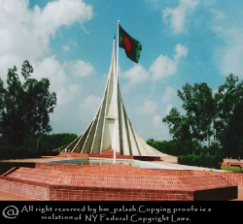
Pairs Work
Write down the different between following two monument with Clues
Hights
Not So High
So High
Stay at Place
Bagerhat
Dhaka
Aims
Religious
Cultural

Slide 11
Group Work
If you go to in front of The sath Gambuj Mosque,
Write down that what will you do ?

Slide 12
Evaluation
What is original name of “Mosque City” ?
Khalifatabad
What is show this monument ?
Islamic Monument
What for it use ?
Prayer Hall
Why do tourist go there ?
To see architectural beuties
How did the floor make ?
By brick

Slide 13
Home Work
Write a paragraph on
“The Sath Gambuj Mosque”

Slide 14

THANKS ALL

