Slide 1

Welcome

Slide 2

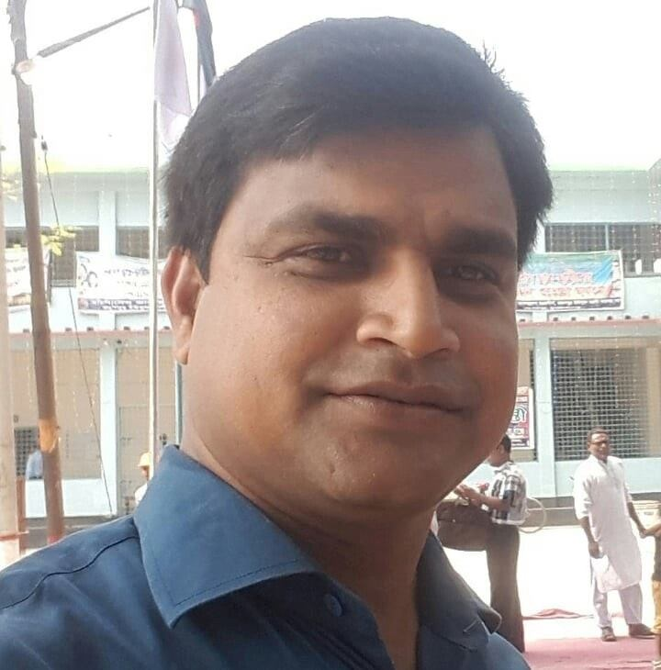
TEACHER’S INTRODUCTION
Md.Soriful Islam
Assistant teacher
Chowrapara Fazil Madrasha
Niamotpur, Naogaon.
soriful03@gmail.com

Slide 3
LESSON INTRODUCTION
Class : Nine
Subject : English 1st paper
Unit : Two
Lesson : 06
Time : 45 min.
Date : 22/10/19

Slide 4
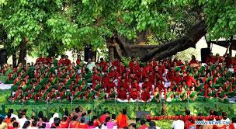
Let’s see a picture

Slide 5

Let’s see another picture

Slide 6
Today’s Topic is ...
Pahela Boishakh

Slide 7
Learning Outcomes
At the end of the lesson students will be able to...
talk about events and festivals
choose the best answer from the alternatives
give correct answer of the questions.

Slide 8
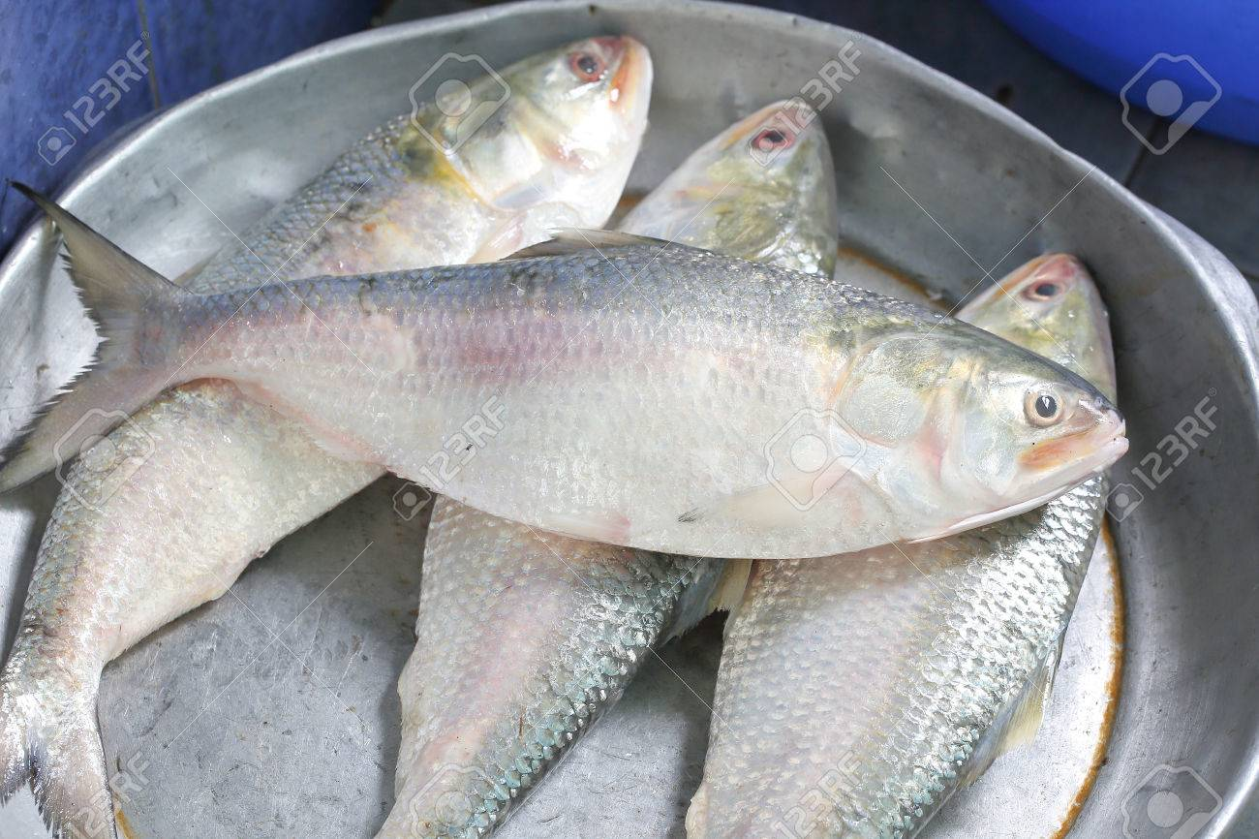
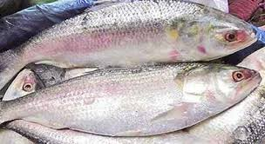
Let’s see some pictures

Slide 9
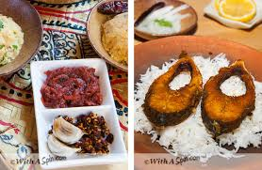

Slide 10
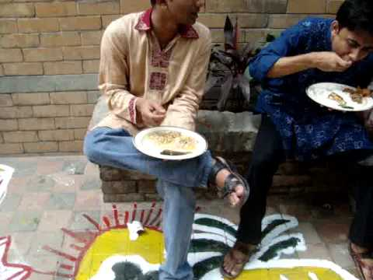

Slide 11
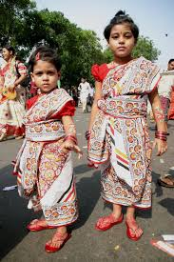
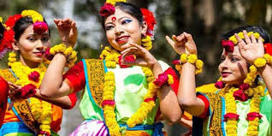

Slide 12
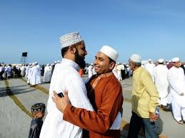
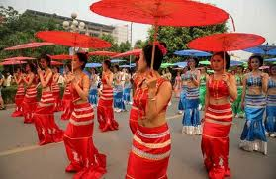
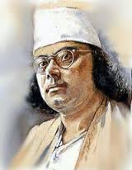
Vocabulary
Festivities
Celebrations
Ethnic
Connected With a nation
Renowned
Famous

Slide 13
Individual Work
Choose the best answer from the alternatives:
1.The Word Pahela means the--
A)Third B) Second c) First D) Fouth
2. Bangla New Year celebration is -- by Chyanat at Ramna Batamul--
A) introduced B) emphasized
c) conducted D) inaugurated
3. BTV begins telecasting the program--
A) early in the morning B) morning
c) late morning D) after the morning
4. In the Passage there are ----- institutions mentioned that organize different programmes on the occasion
A) 4 B) 6 c)7 d)8

Slide 14
Group work
Answer the following questions:-
a)What is Pahela Boishakh?
b)What kinds of food do you eat in the morning of Pahela Boishakh?
c)How do people celebrate the day?
d)What do the shopkeepers do on that day?
e)When does the day’s first programme begin?

Slide 15
Evaluation
Write five Sentences about
“Pahela Boishakh”

Slide 16
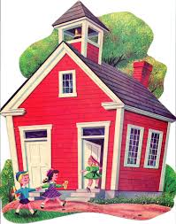
Home Work
Write the main idea of the passage in your own words.

Slide 17

Thanks to All

