Slide 1

welcome

Slide 2
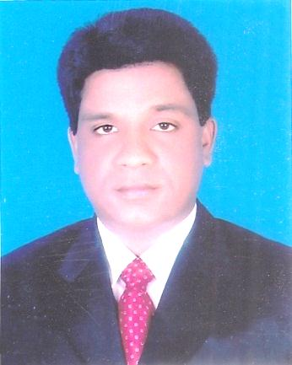
INTRODUCTION
MOHAMMAD AZHARUL ISLAM
Assistant Teacher (English)
Hugra Habib Kader High School
Tangail Sadar Tangail
CLASS: NINE & TEN
SUBJECT: ENGLISH FIRST PAPER

Slide 3
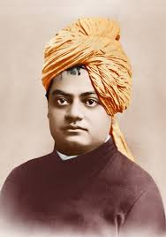
Do you Know him?

Slide 4
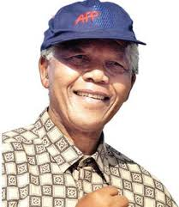
Do you Know him?

Slide 5
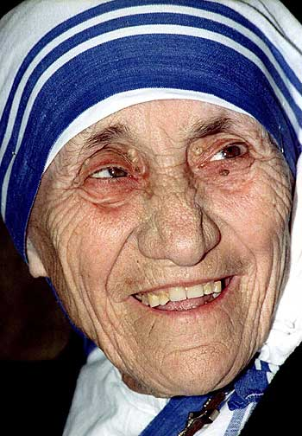
Do you Know her?

Slide 6
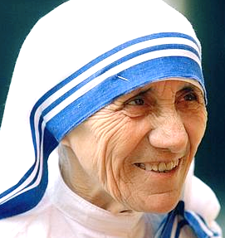
LOVE FOR HUMANITY
Todays Tropic is--------

Slide 7
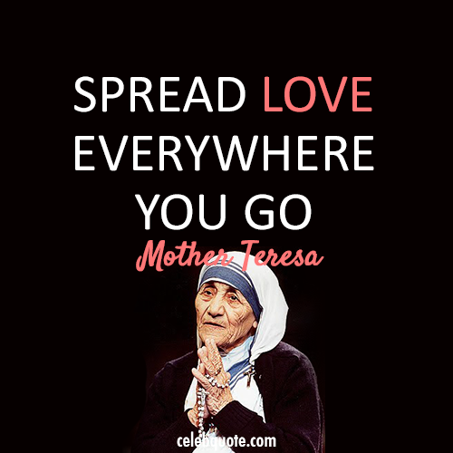

Slide 8
Learning outcomes
By the end of the lesson the learners will be able to able to --------------
describe people
say about mother Teresa’s missions for humanity
ask and answer questions
write statements finding out true/false

Slide 9
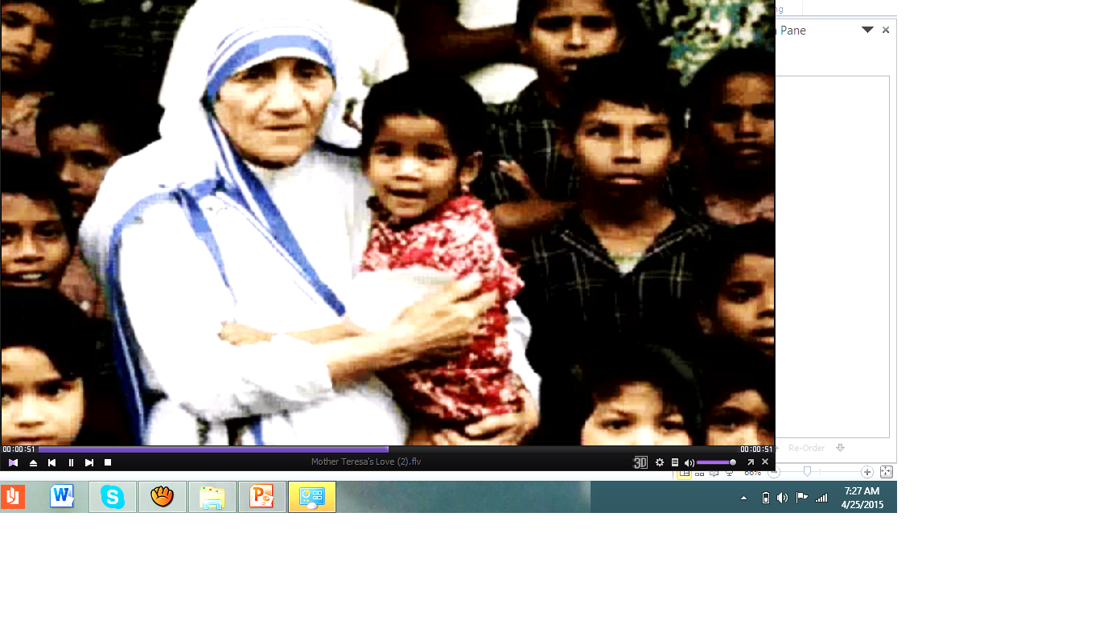
Text reading
Read more about Mother Teresa.

Slide 10
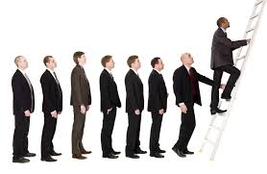
Promotion
Support or encouragement of doing something

Slide 11
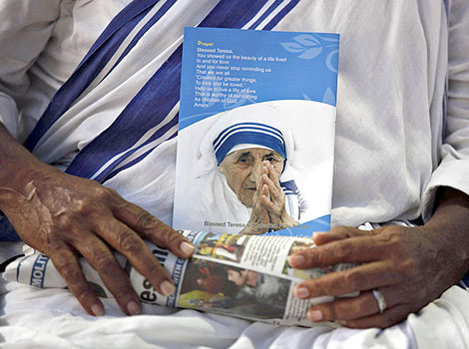
Salute
to pay homage to someone

Slide 12
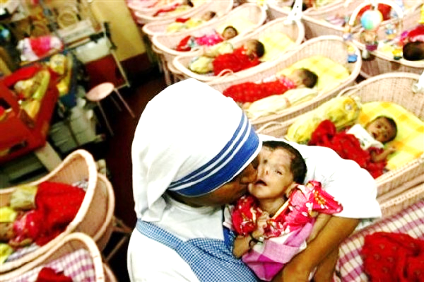
Compassion
pity for the sufferings of others

Slide 13
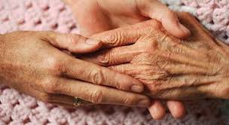
Compassion
pity for the sufferings of others

Slide 14
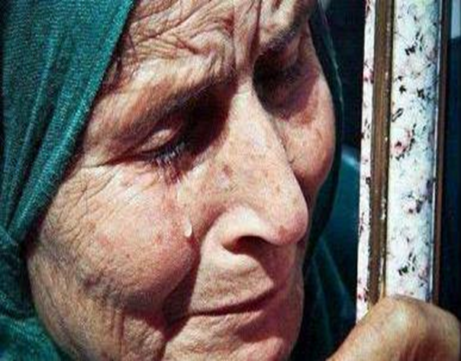
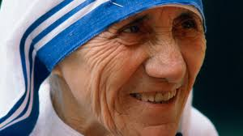
Wrinkled
having or showing a small fold or line in the skin due to age

Slide 15
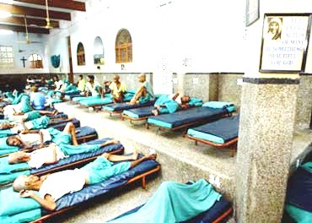
Dying
on the point of death.

Slide 16
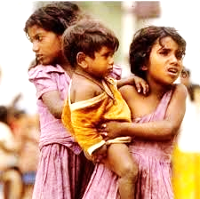
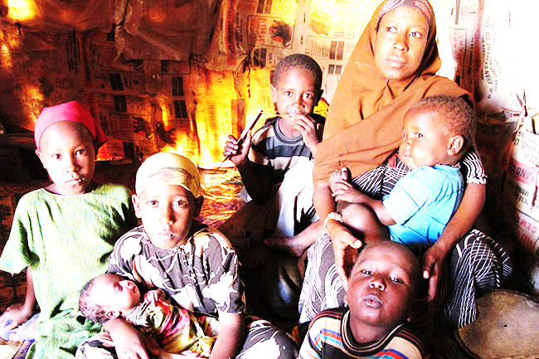
Destitute
Without money, food and other things necessary for life

Slide 17
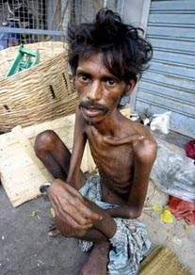
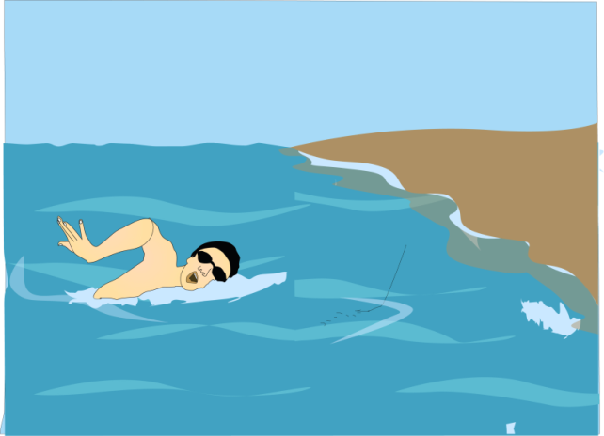

Survive
To continue to live or exist

Slide 18
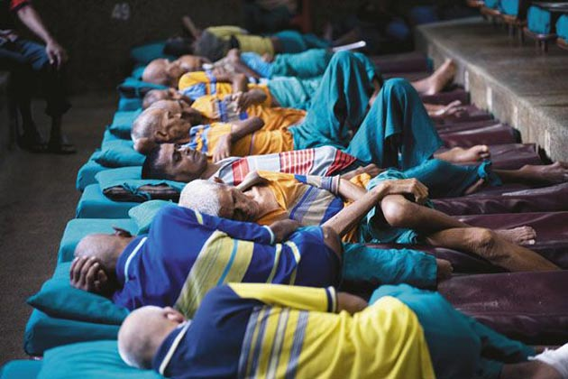
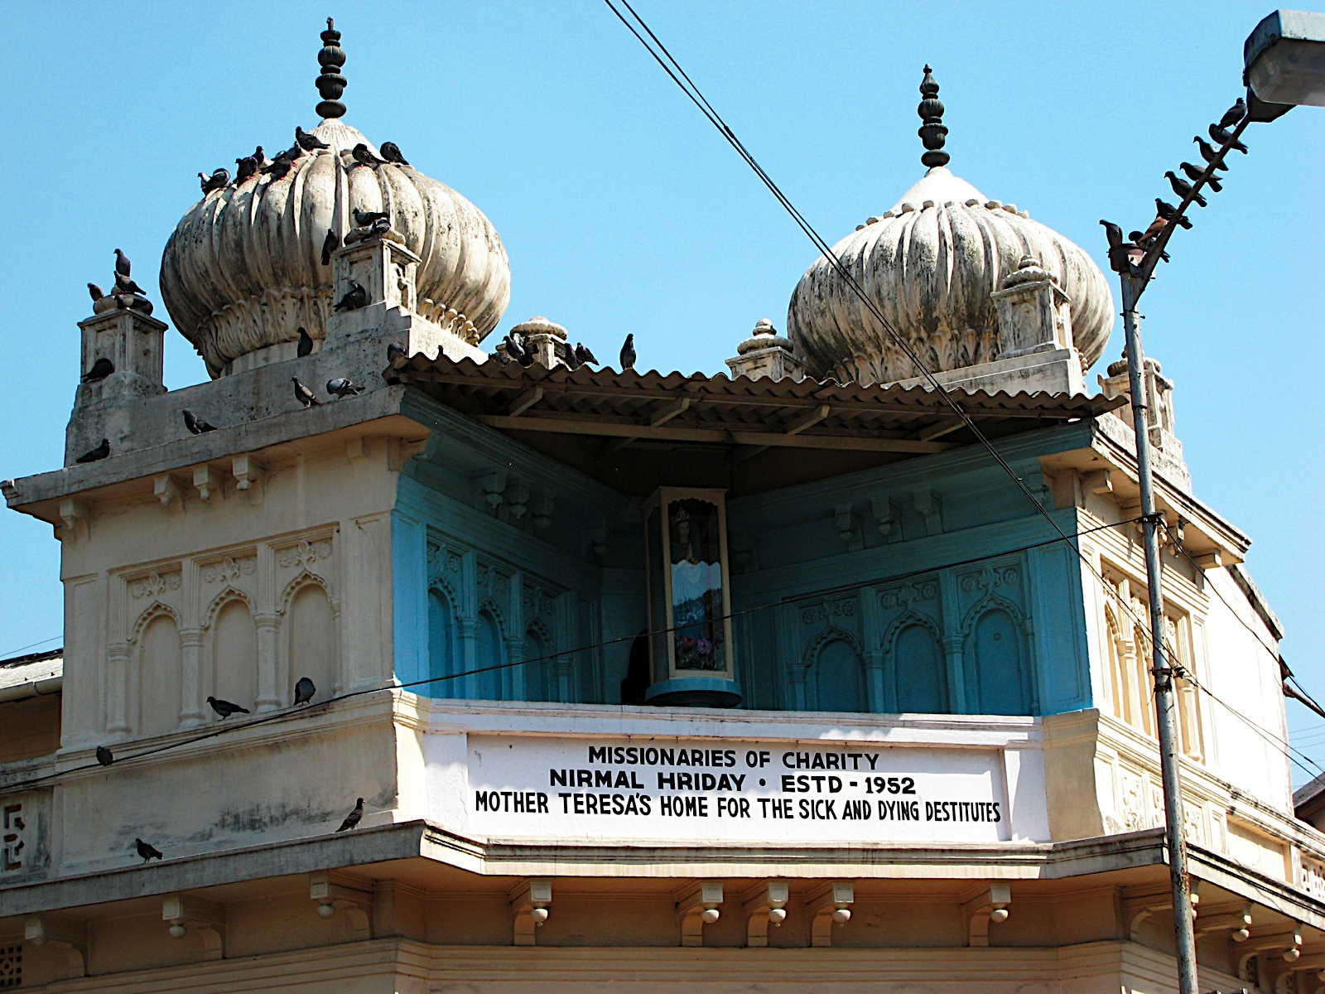
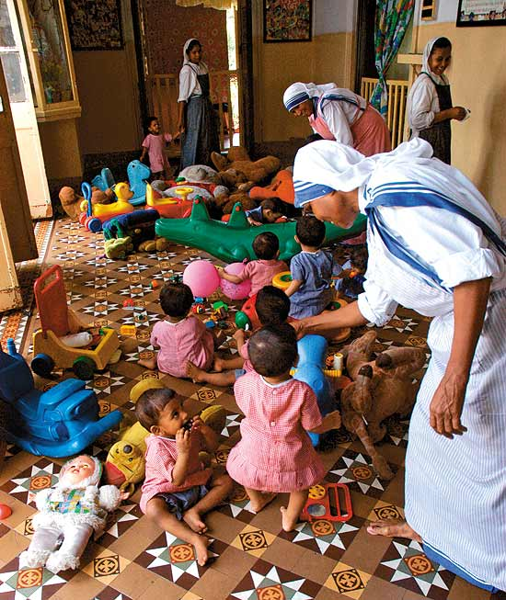
Nirmol Hriday
Pure heart-a home for the dying destitute

Slide 19
Answer the following questions
What do you think about Mother Teresa’s achievement of many awards?
What does Nirmol Hridoy stand for?
What is your thinking about the name?
Why did Mother Teresa want the dying people to feel that they deserve care and love too?
What are the things that you have learnt from Mother Teresa’s life?

Slide 20
Individual Work
Write whether the statement s are true or false. If false , give the correct answer.
Mother Teresa will remain alive in our mind.
b) Mother Teresa had no compassion for humanity.
c) She had love for those who needed love and support
irrespective of creed.
d) She founded home for the poor.
e) Mother Teresa considered the people of her own family.

Slide 21
HOME WORK
Write paragraph on Mother Teresa

Slide 22
NIRMOL HRIDAY
Thank You So Much

