Slide 1


Slide 2


Introducing
Class : Three
Sub: English
Lesson: 1 - 3
Lesson Unit: 23
Time: 45 minutes
Mst. Najmi Khatun
Assistant Teacher
Dewpura GPS
Gomastapur, Chapainawabgonj

Slide 3
Learning outcomes
Students will be able to
Reading:1.5.1- read simple sentences
with proper sounds and stress.
5.3.1- read text

Slide 4

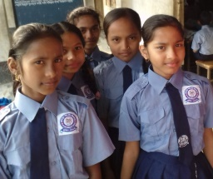
Good morning, students.
Good morning, teacher.
How are you today?
Fine. and you?
Fine, thank you.

Slide 5
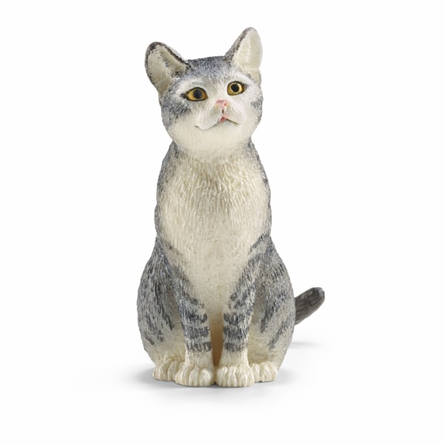
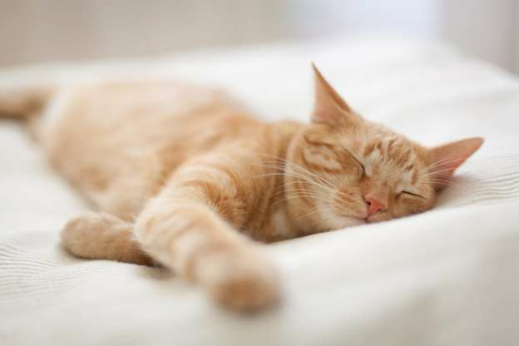
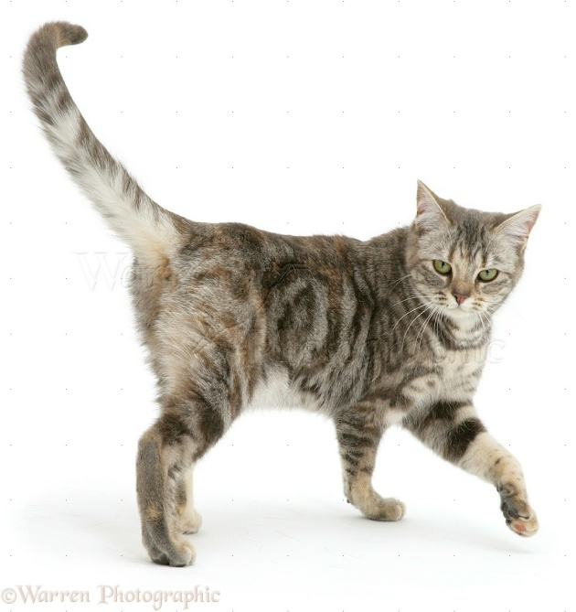
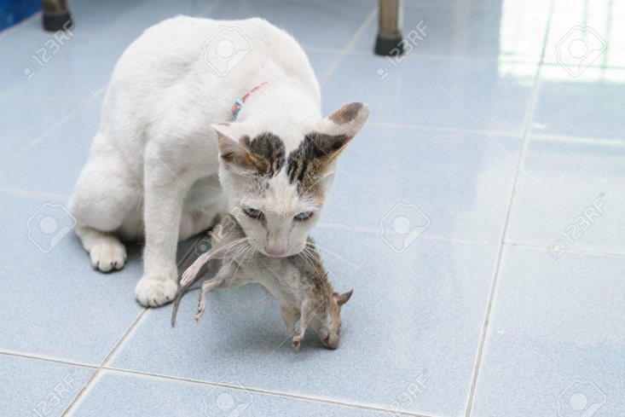
What do you see in the picture

Slide 6
Welcome everyone in today's lesson
What do they do?

Slide 7
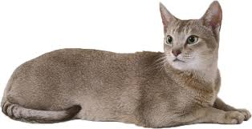
What do you see in the picture?
I’m a cat.

Slide 8
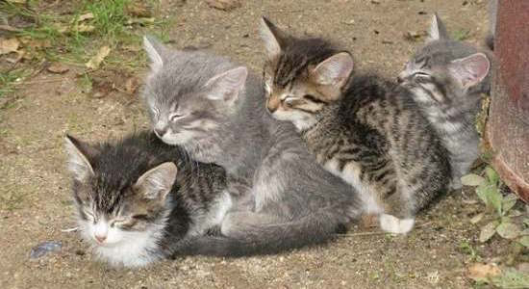
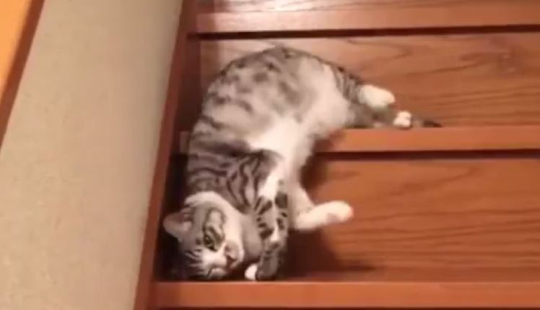
What do you see in the picture?
In the morning, I’m lazy and slow.

Slide 9
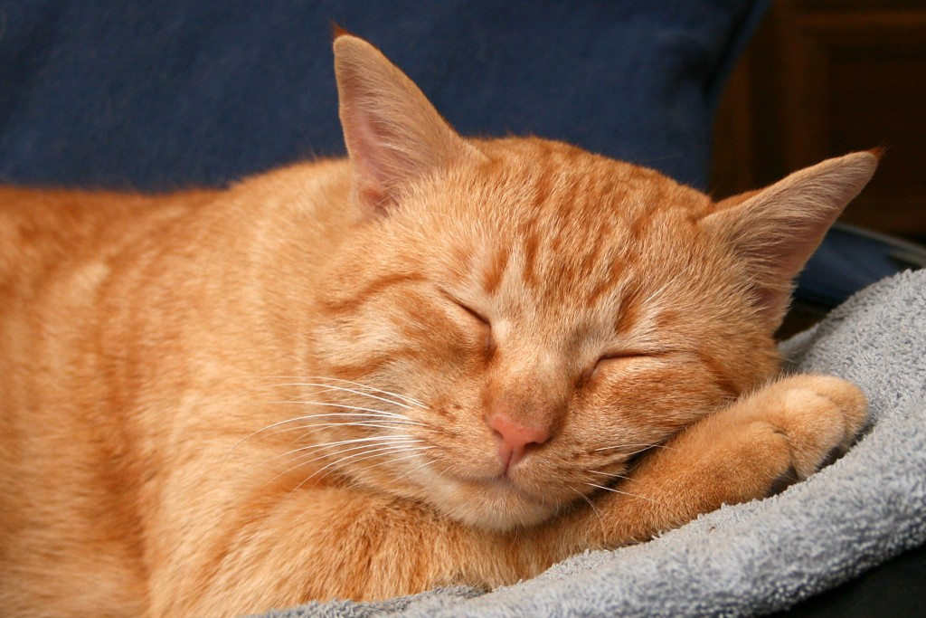
What do you see in the picture?
I get up late.

Slide 10
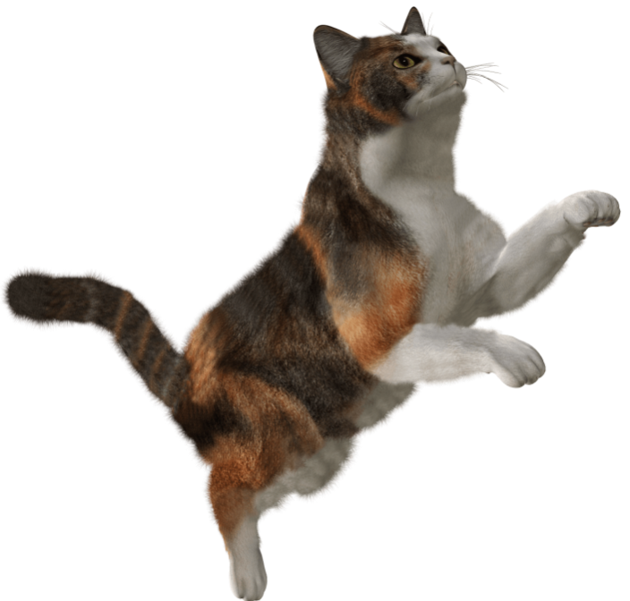
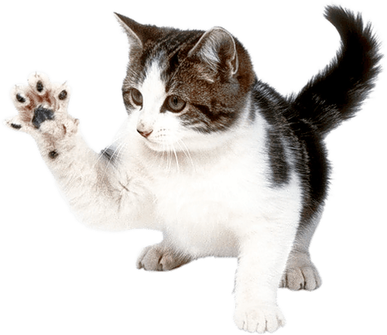
What do you see in the picture?
In the afternoon, I’m active.

Slide 11
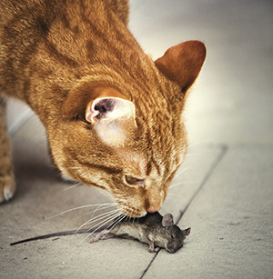
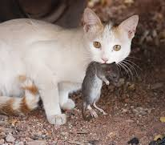
What do you see in the picture?
I catch rats.

Slide 12
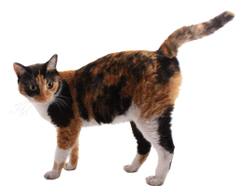
What do you see in the picture?
I’m quick!

Slide 13
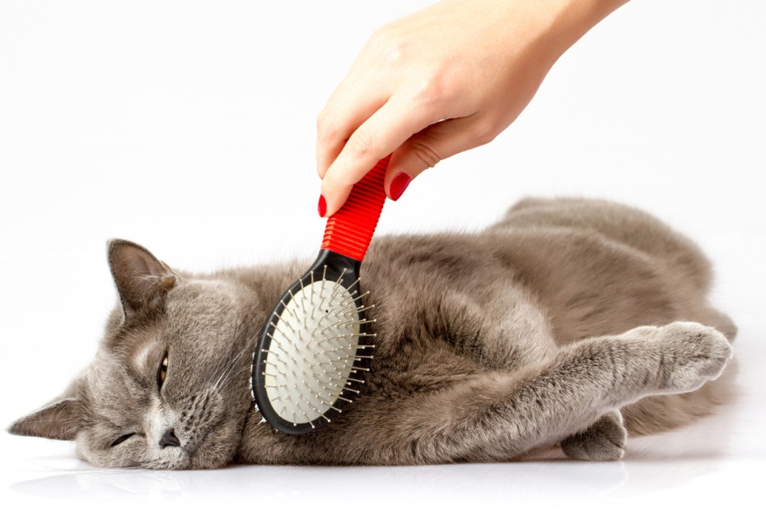
What do you see in the picture?
I’m a clean animal.

Slide 14
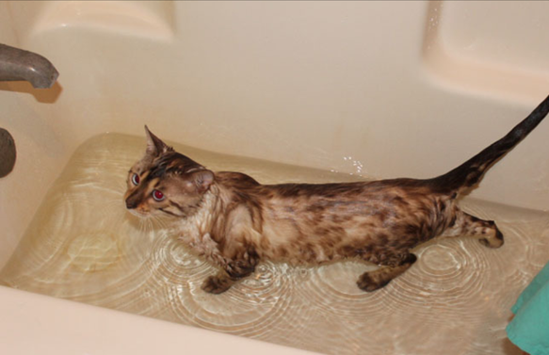
What do you see in the picture?
I wash myself everyday.

Slide 15

Open your book at page 46.

Slide 16
Everybody listen and say after me.
I’m a cat. In the morning, I’m lazy and slow. I get up late. In the afternoon, I’m active. I catch rats. I’m quick! I’m a clean animal. I wash myself everyday,

Slide 17
In the morning, I’m lazy and slow.
I wash myself everyday.
I get up late.
I’m a clean animal.
I’m a cat.
In the afternoon, I’m active.
I’m quick!
I catch rats.

Slide 18
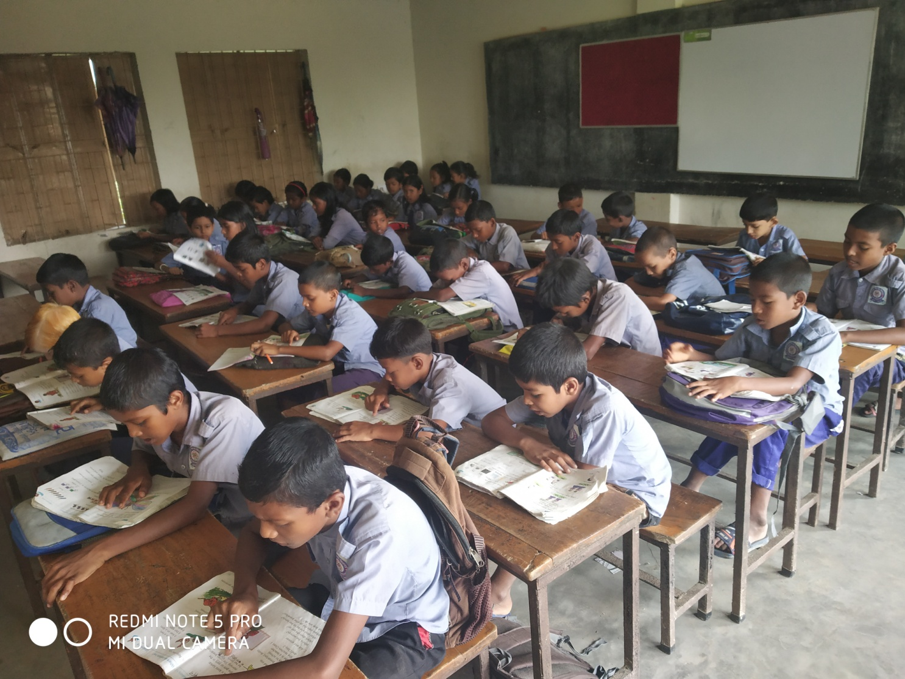
Student’s reading silently

Slide 19
Let us find out new words
Wash
Catch
Lazy
Slow
Clean
Late

Slide 20
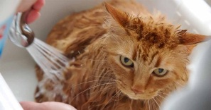
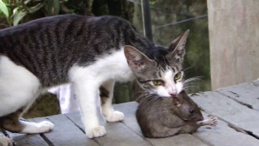
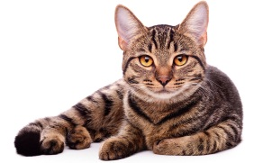
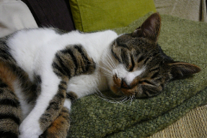
Make similar words
Wash
Bathe
Catch
Hold
Clean
Tidy
Lazy
Idle

Slide 21
make sentences with the given words
Wash=
The cat washes herself everyday.
Catch =
The cat catches rat.
Clean =
The cat is clean animal.
Lazy =
The cat is lazy animal.

Slide 22
Let’s work in group
C. Read again. Say true or False.
1. The cat gets up early in the morning.
Answer: False
2. The cat is lazy in the morning.
Answer: True
3. The cat is active in the afternoon.
Answer: True
4. The cat washes rats.
Answer: False
5. The cat is clean animal.
Answer: True
5. The cat doesn’t wash itself.
Answer: False

Slide 23
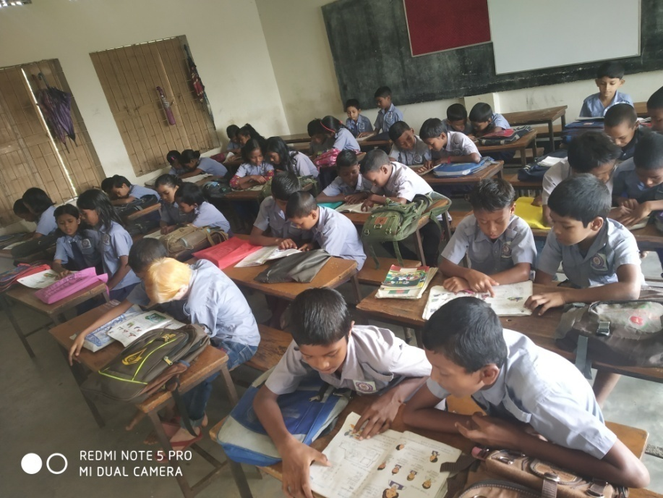
Let’s work in pair
I’m a cat. In the morning, I’m lazy and slow.
I get up late. In the afternoon, I’m active.
I catch rats. I’m quick! I’m a clean animal.
I wash myself everyday.

Slide 24
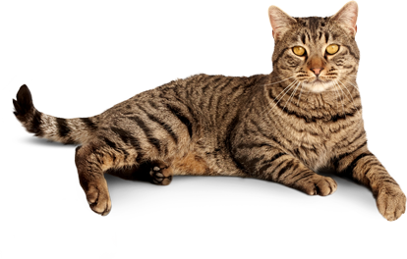
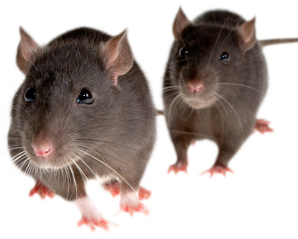
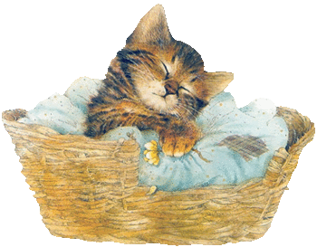

Evalution
What is this?
What is this?
When does it get up?
When does it active?

Slide 25


