Slide 1

Welcome

Slide 2
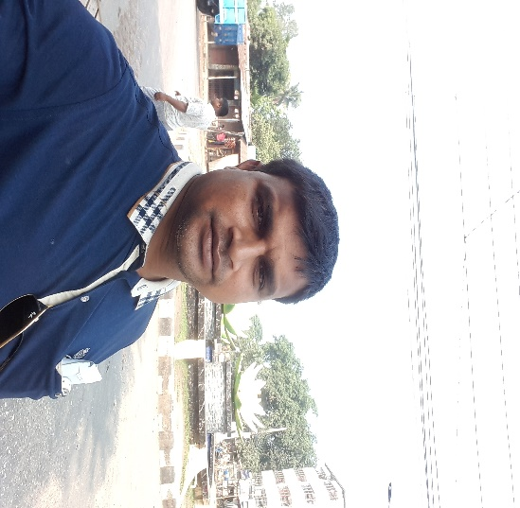
Teacher’s introduction
Md. Soriful Islam
Assistant Teacher
Chowrapara Fazil Madrasha
Niamatpur, Naogaon.
soriful03@gmail.com

Slide 3
Lesson’s introduction
Subject- English 2nd
^{Class- Six}
Time -45 Minuts
Date-07.10.2019

Slide 4
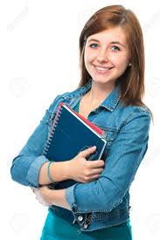
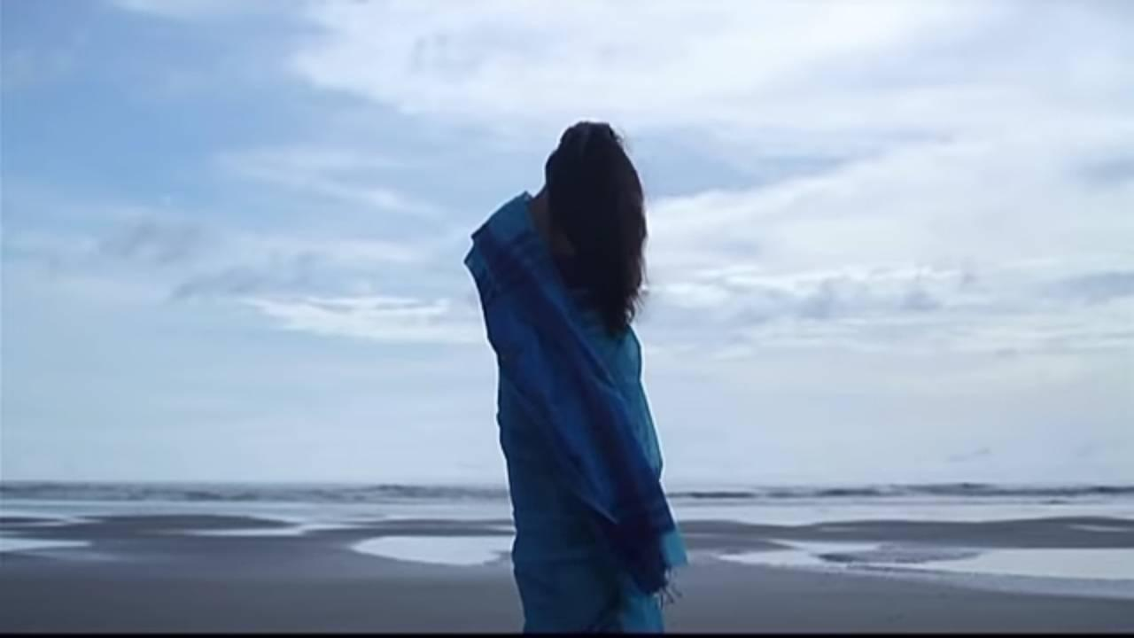
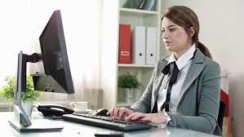

Look at the picture ;
Runa is student
She is enjoying the scenery
She works computer
The rose is very nice

Slide 5
Today’s lesson
Parts of speech

Slide 6
Learning outcome
By the end of the lesson,the students will be able –
To explain parts of speech.
To classify parts of speech.
To fill in the blank with parts of speech.

Slide 7
Look at the picture -
Runa is a good girl.
Runa
Name= Noun

Slide 8
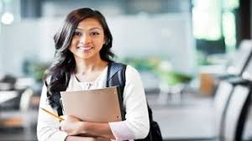
Look at the picture-
Who is She?
She/He = Pronoun

Slide 9
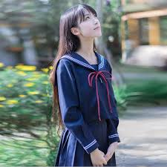
Look at the picture-
She is good girl
Good= adjective

Slide 10
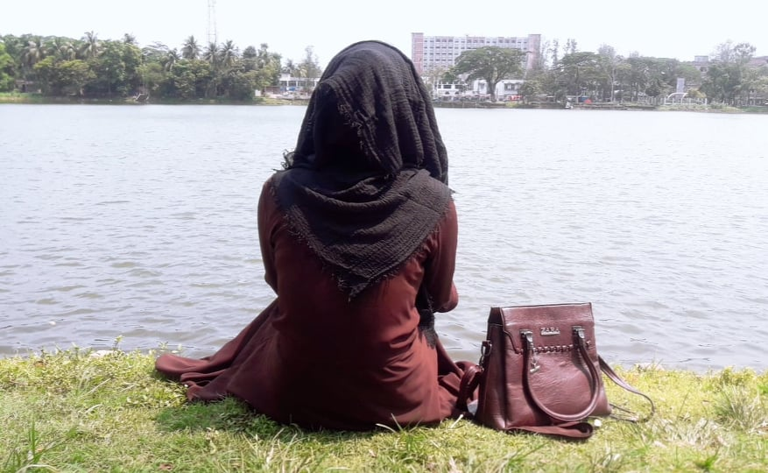
Look at the picture-
She is enjoying Scenery of river.
Enjoy= verb

Slide 11
Look at the picture-
She enjoy the scenery happily
She goes to regularly
Happily/ Regularly= Adverb

Slide 12
Look at the picture-
She is walking in sea beach
She looks at his father
She goes with his father
She wants to go their again
In/at/with/to= preposition

Slide 13
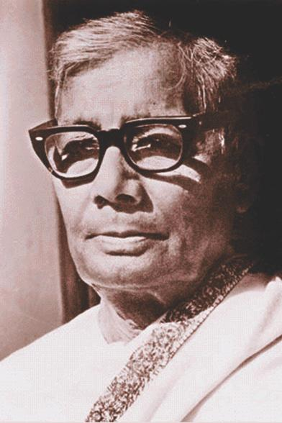
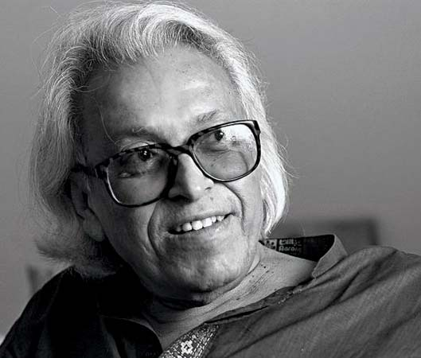
Look at the picture-
Jasimuddin
Shamsur Rahman
Jasimuddin and Shamsur Rahman are poet
And= conjunction

Slide 14
Look at the picture-
Hurrah! I have gone to Cox’s Bazar
Hurrah! = Interjection

Slide 15
Look at the picture-
1.Noun
2.Pronoun
3.Adjective
4.Verb
Parts of speech
5.Adverb
6. Preposetion
7.Conjunction
8.Interjection

Slide 16
Individual Work
How many kinds of parts of speech? with 3 example.

Slide 17
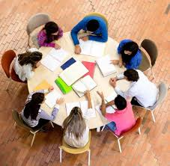
Group work
Write down the name of all kinds of parts of speech. With Example

Slide 18
Evaluation
Which parts of speech are the underlined word?
Every mother loves her child .
She is a good girl
He is good
Runa is visiting cox’s bazar
He teaches us very finely
The books is on the table.
Raju and Kajim are friend
Hurrah ! we have won the game.
1. Noun
2. Pronoun
3. Adjective
4. Verb
5. Adverb
6. Preposition
7. Conjunction
8. Interjunction

Slide 19
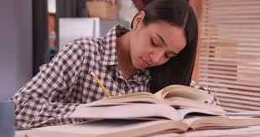
Home work
Write down the defination of all kinds of parts of speech with example.

Slide 20
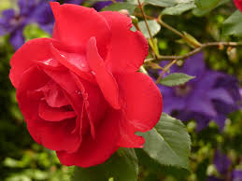
Thank you

