Slide 1
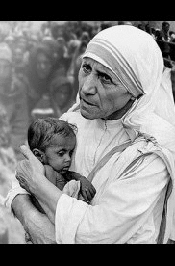
WELCOME

Slide 2
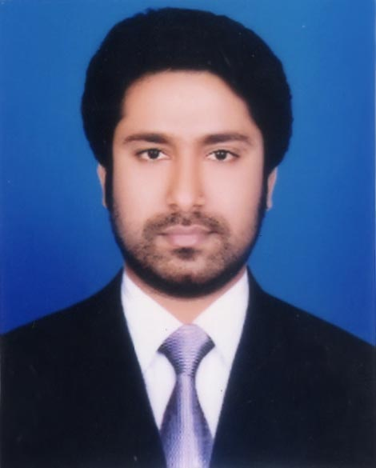
Presented by
M Humayun Kabir
English Teacher
Bhayeta Abdul Quddus Dakhil Madrasah, Tangail Sadar
Cell : 01727-425565 ; 01924-320532
E-mail : hkabir082009@gmail.com

Slide 3
Lesson Identity
People who stand out
Class Nine
Unit Seven
20 October 2019

Slide 4
TOPIC
The beginning
Subject : English 1st Paper
Lesson : 4
Period : 1st
Time : 40 minutes
Date : 20 October 2019

Slide 5
Learning outcomes
By the end of this lesson, the Ss will be able to
1. choose the specific information.
2. describe a person.
3. read and understand text throw silent reading.
4. ask and answer questions.

Slide 6
Lesson Presentation
According to
Learning outcomes-1 ; 2 :
choose the specific information.
describe a person.

Slide 7
Let’s Watch a Video

Slide 8
Part : A
Open your book…
Read the text and choose the best answer.

Slide 9
Let’s Listen to an Audio
&
Find out your problems to understand

Slide 10
What does ‘servant of humanity’ mean in the text ?
Evaluation
MCQ
d. to serve the needy
Why did Mother Teresa want be a missionary ?
c. Because she heard a voice within herself.

Slide 11
3. Mother Teresa set out to join the missionary of the Sisters of Loreto in the year-
b. 1928
4. Mother Teresa took her first vows at the age of -
c. 21

Slide 12
Part : B
Read the text in A again and answer the questions.

Slide 13
Where did Mother Teresa’s ancestors come
from ?
Mother Teresa’s ancestors came from Albania.
2. Where was her father’s home ?
Her father’s home was at Skopje in Macedonia.
Why did she want to become a missionary ?
She wanted to become a missionary to spread the love of Christ.

Slide 14
What made her different from other girls at such an early age ?
In her early age, Mother Teresa heard a voice from inside. It urged her to spread the love of Christ. So, she decided to be a missionary. All these made her different from other girls.

Slide 15
What words and expressions are used in the text to describe this difference ?
To describe this difference, some words and phrases like,
  a voice from within
  Urged
  love of Christ
  Missionary
  mother of humanity etc.
are used in the text.

Slide 16
5. What did Mother Teresa do in the first
seventeen years in India ?
In the first seventeen years in India, Mother Teresa taught geography and theology at St. Mary’s High School in Kolkata.

Slide 17
According to
Learning outcomes-3 ; 4 :
read and understand text throw silent reading.
ask and answer questions.

Slide 18
Part : C
Look at the picture and talk about her in pairs.

Slide 19
How old is she ? Why do you think so ?
Evaluation
She is over 80. Because her face says so. There are a lot of wrinkles.
What is she wearing ?
I think it is a share. It appears to be the uniform of a nun.
3. How has she worn it ?
As far as the picture shows, she has worn it by hiding her hair as a nun does.

Slide 20
Part : D
Write the description of Mother Teresa’s physical features in your exercise book .
Home Task

Slide 21
Thank you all
May Allaah swt donate us ability to work for humanity.

