Slide 1
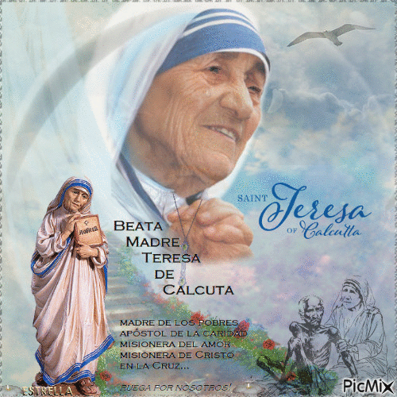
WELCOME

Slide 2
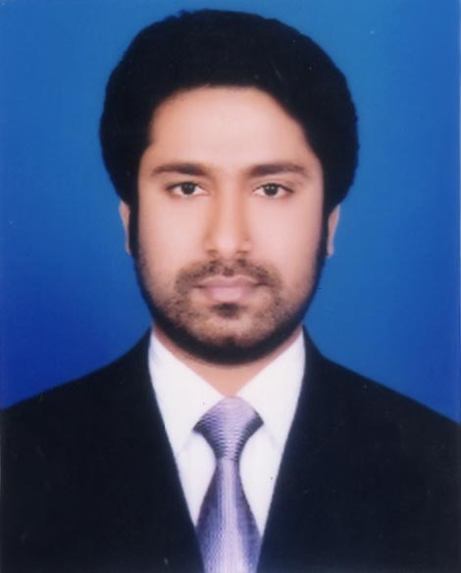
Presented by
M Humayun Kabir
English Teacher
Bhayeta Abdul Quddus Dakhil Madrasah, Tangail Sadar
Cell : 01727-425565 ; 01924-320532
E-mail : hkabir082009@gmail.com

Slide 3
Lesson Identity
People who stand out
Class Nine
Unit Seven
20 October 2019

Slide 4
TOPIC
Love of Humanity
Subject : English 1st Paper
Lesson : 5
Period : 1st
Time : 50 minutes
Date : 21 October 2019

Slide 5
Learning outcomes
By the end of this lesson, the Ss will be able to
1. talk each other about a person.
2. choose the specific information.
3. read and understand text throw silent reading.
4. ask and answer questions.

Slide 6
Let’s Watch a Video

Slide 7
Look at the picture & talk about it in pairs.
Part : A Open your book…

Slide 8
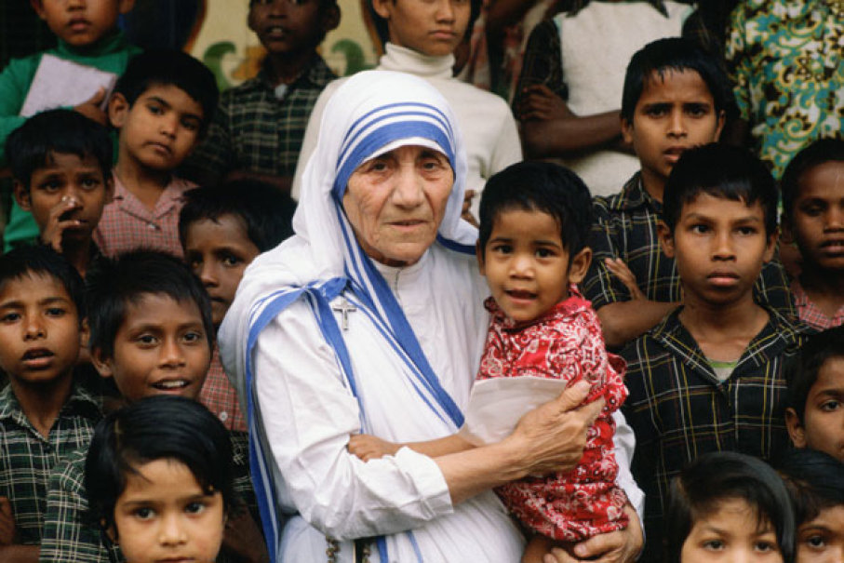

Slide 9
What do you see in the picture ?
I see Mother Teresa with some children.
2. What do you think about this picture ?
I think these children are rootless. There are no one to take care of them.
3. What does Mother Teresa do with them ?
Mother Teresa is giving them motherly love and affection.

Slide 10
Part : B Read more about Mother Teresa.

Slide 11
Part : C Check True or False. If false give the correct information.

Slide 12
Mother Teresa was moved to see the diseases that spread in the streets of Kolkata.
False. Corr. Inf. : Mother Teresa was
moved to see the sick and dying
people on the streets of Kolkata.
2. She opened a home for the orphans.
False. Corr. Inf. : She opened a home
for the dying destitute.

Slide 13
3. She and her group brought in the dying
people from the streets of Kolkata.
4. ‘Nirmol Hriday’ was founded so that the
poor peoplewho are dying can get love
and care before death.
5. Mother Teresa said that humanity passes
through charitable organizations.
False. Corr. Inf. : Mother Teresa said that
humanity passes through the family.

Slide 14
6. We have learnt from Mother Teresa how
to come forward to help only those who
belong to a special caste.
False. Corr. Inf. : We have learnt from Mother
Teresa how to come forward to help
people irrespective of creed, caste and
religion.

Slide 15
Part : D Answer the following questions.
Home Task

Slide 16
Why do think Mother Teresa won so many award ?
2. What does ‘Nirmal Hriday’ stand for ?
3. Why do think the home is named ‘Nirmal
Hriday’?
4. Why did Mother Teresa want the dying
people to feel that they too deserve care and
love ?
5. What are the things that we have learnt
from Mother Teresa ?

Slide 17
Thank you all

