Slide 1

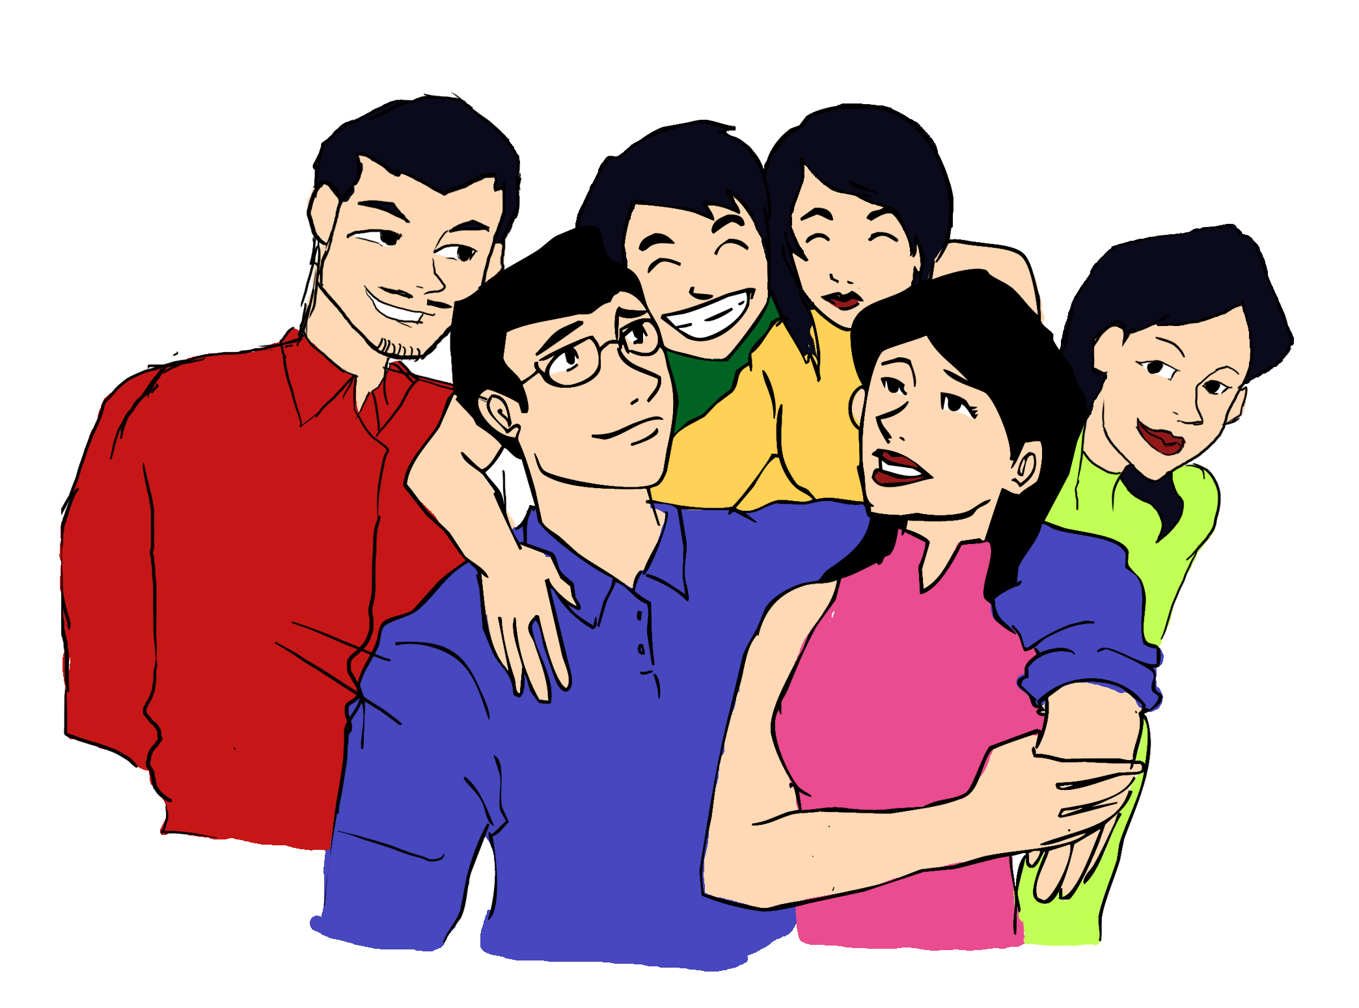

Slide 2

WELCOME

Slide 3


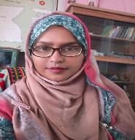


Presented by
Lesson Identity
Shahrina Bin Sweety
Assistant Teacher
Chormonai Madrasha Government Primary School
Barishal
Class : Four
Subject : English
Unit : 35
Lessons : 1-2
Page No. 7o

Slide 4
Learning Outcomes
By the end of the lesson the students will be able to----
Listening
3.2.1 understand questions about family and friends of students.
3.3.1 understand questions about objects around them.
Speaking
3.1.1 ask and answer simple WH questions.
Reading
5.1.1 read silently with understanding paragraphs, stories and other text materials.
Writing
3.1.1 Write words, phrases and sentences using non cursive capital and small letters.

Slide 5
Greeting
Good morning, students.
Good morning, teacher.
How are you today?
Fine. and you?
Fine, thank you.

Slide 6

Create Emotion
Link
Click
https://www.youtube.com/watch?v=cSw50Jw0H34
Discuss about the video
With the students
What are they doing ?
They are travelling.
Is it interesting ?
Of course.

Slide 7
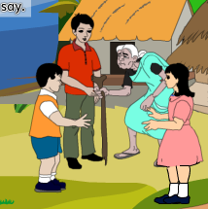
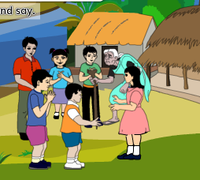
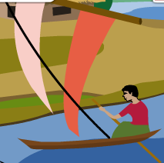
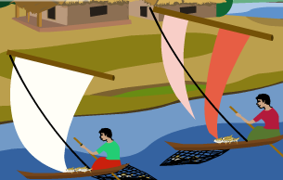
Look at the pictures and think alone
What do you see in the pictures ?
Some people.
Why do they go there ?
Yes, you are right.
To visit their relatives.

Slide 8
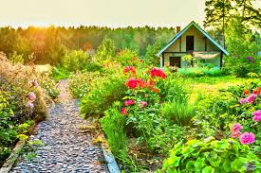
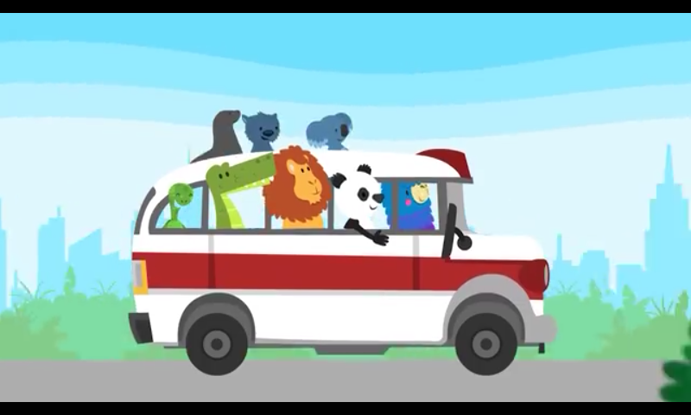
Dear students, Today’s Topic is
My Trip

Slide 9
Some Words
Family
Relatives
River
Fisherman
Delicious
Domestic
Family member
Stream
Who catches fish
Enjoyable
History
Special
Country
Times Past
Different
State

Slide 10
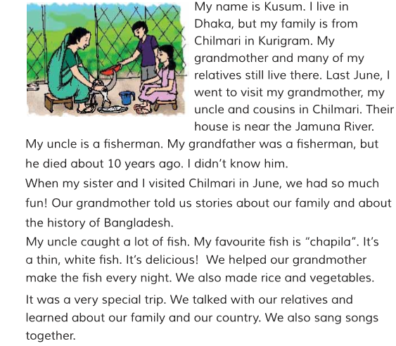

Teacher’s Reading

Slide 11
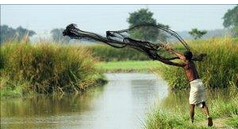
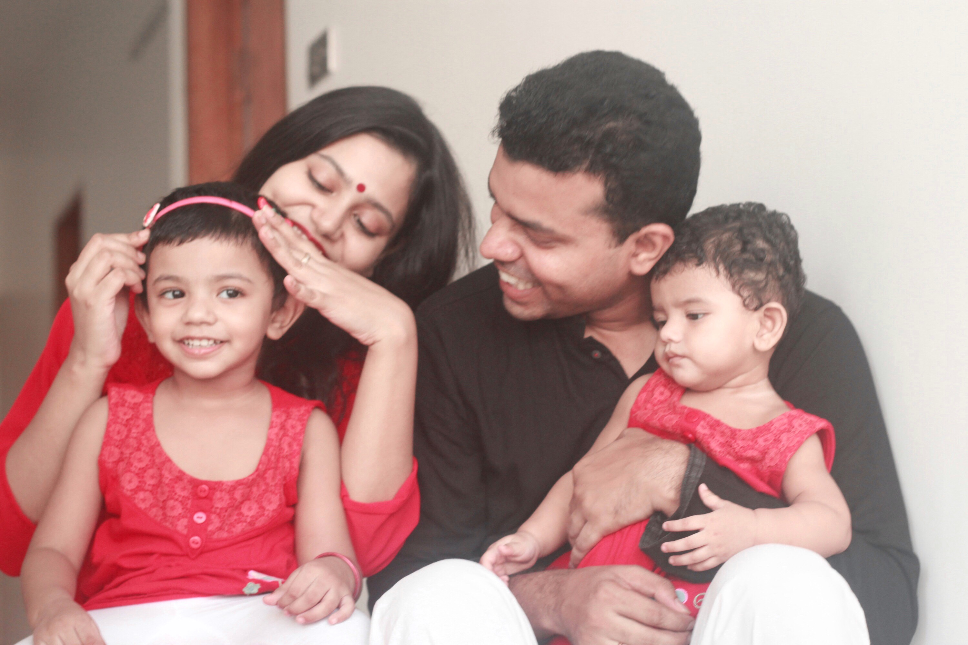
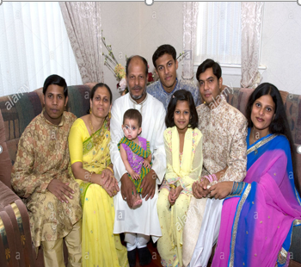
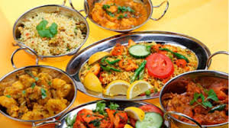
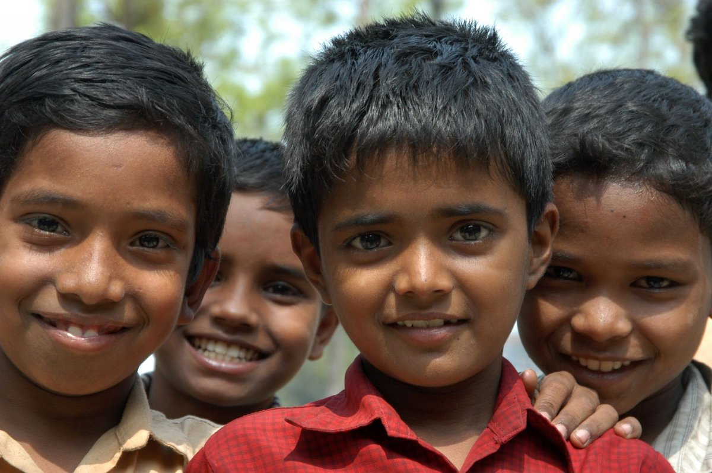
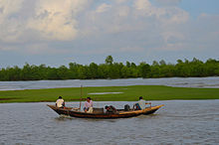
Whole Class Work
Now I’ll show 6 pictures. Write the name of the pictures and make sentences. You can see your text book.

Slide 12
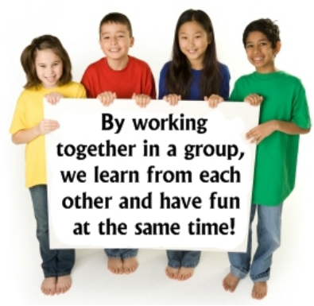



Group Work
Dear Students, Open your book at page no.70 and read the text in group.

Slide 13

Pair Work
Dear Students, Open your book at page no.70 .
Look Activity B
Ask and answer in pair.

Slide 14
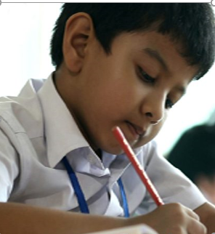

Individual Work
Fill in the gapes with the given words
special
delicious
Dhaka
Kurigram
fisherman
chapila
Jamuna
1. Alvi lives in ………..
2. Alvi’s uncle is a ……..
3. ……. is Alvi’s favourite fish.
4. Their house is near the ……. river.
5. The trip was very ………

Slide 15


Evaluation
Answer the following questions
1. Who told Alvi stories about the history of Bangladesh ?
2. Why was the trip special ?

Slide 16

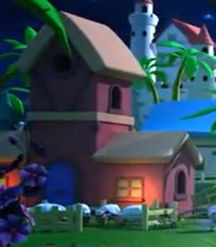
Homework
Write 5 sentences about Alvi’s trip to Chilmari.

Slide 17
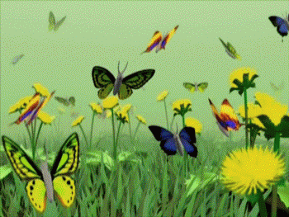
Thank you
That’s all for today.

