Slide 1

GOOD MORNING

Slide 2

Introducing:
Md. Saiful Islam
Assistant Teacher (English)
Bagbari Chowbaria High School,
Tangail Sadar, Tangail
E-mail: hridoy9555@gmail.com
Class: Nine-Ten
Subject: English for today
Unit: 03
Lesson: 02
Time: 50 Minutes
Date: 20-09-2019

Slide 3


Slide 4
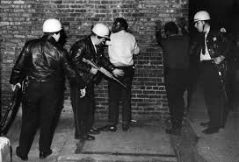
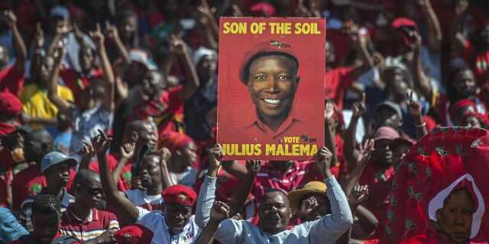
Look at the picture.

Slide 5

Lesson declaration
May Day

Slide 6
Learning out comes
After finishing the lesson learners will be able to-
1. Answer the questions.
2. Write a paragraph.
3. Say true or false
Choose the best answer from the alternative
say the meaning of the words
Make a dialogue about the importance of May Day.

Slide 7
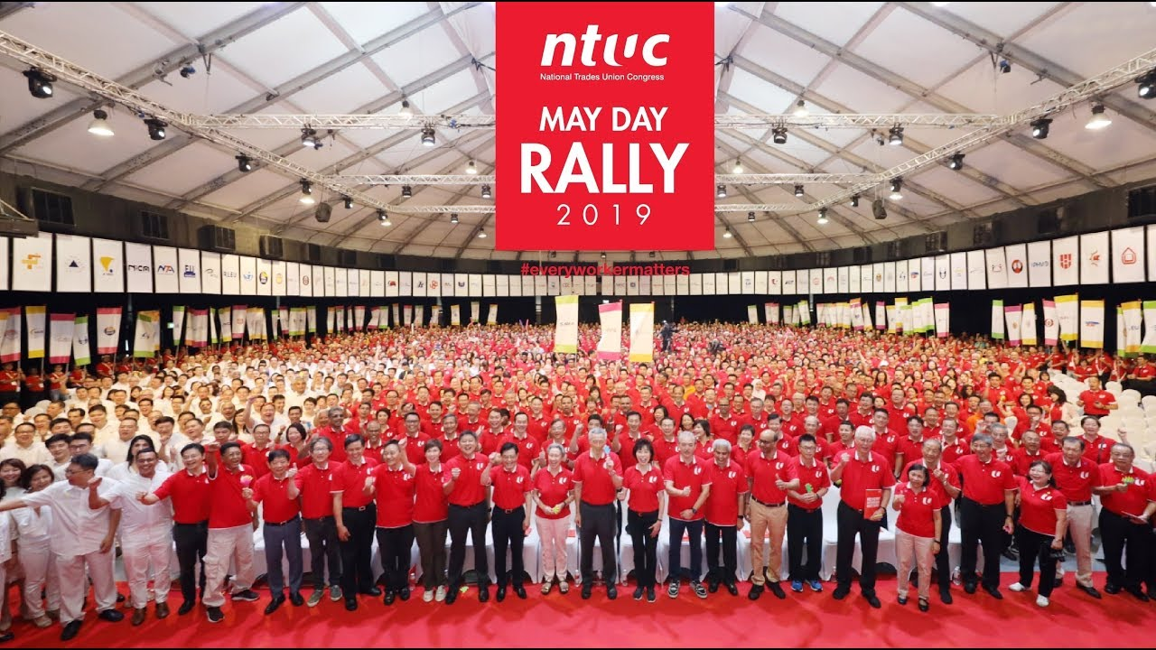
Look at the picture.

Slide 8

Standard reading

Slide 9
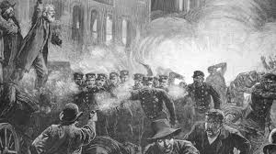
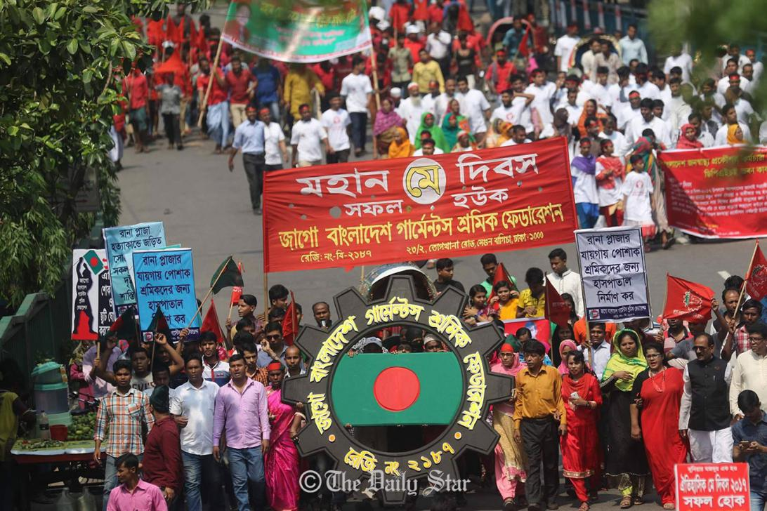
Look at the picture.

Slide 10
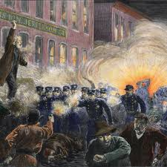
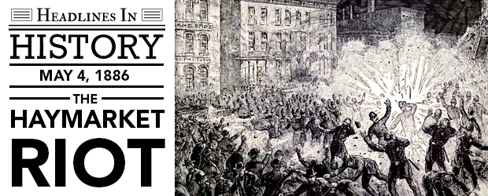
Look at the picture.

Slide 11
Individual work:
What is May Day?
What does May Day refer to?
Why did the workers in Chicago go on a strike?
What do you learn from the events of May Day?
Answers:
(1) The first day of May is called May Day.
(2) May Day refers to the International Workers Day.
(3) The workers went on a strike for demanding an eight hours workday.
(4) We learn from the events of May Day that worker will continuously be exploited until they stand up and speak out to gain better working condition, better pay and better lives.

Slide 12
Peer work
Make a dialogue between you and your friend about the importance of May Day

Slide 13
Group work:
Write the meaning of the following words:
Sacrifice, observed, exploited, strike, attacked
Sacrifice- উৎসর্গ slaughter
Observed -অনুষ্ঠিত celebrated
Exploited- শোষিত take advantage of
Strike- ধর্মঘট walkout
Attacked- আক্রান্ত invaded

Slide 14
Evaluation
Choose the best answer from the alternatives:
May Day is recognized as International ---- (i) Mother’s Day (ii) Father’s Day (iii) Worker’s Day (iv) all
Workers were inspired by ----- union. (i) Trade (ii) Labour (iii) cultural (iv) Political
Suddenly – policemen attacked the workers (i) 100 (ii) 200 (iii) 300 (iv) 400
Before 1886 workers had to work more than (i) 7 hours (ii) 8 hours (iii) 14 hours (iv) 12 hours.
Now the workers enjoy --- hours workday (i) 8 (ii) 9 (iii) 10 (iv) 11

Slide 15
Say whether the following sentences are true or false. If false give the right answer.
May Day is celebrated Internationally.
Now May Day is a public holiday.
The workers went on a strike in 1886.
(d) About 500 workers had joined to the rally near the McCormic Hervester Company.
(e)Now the workers are enjoying 7 hours works day.
True
True
True
False. About 600
False. 8 hours.

Slide 16
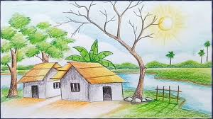
Home work
Write a paragraph about May Day

Slide 17

Thank you very much

