Slide 1
WELCOME

Slide 2
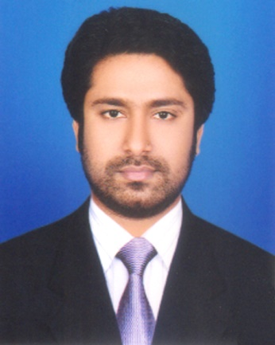
Presented by
M Humayun Kabir
English Teacher
Bhayeta Abdul Quddus Dakhil Madrasah, Tangail Sadar
Cell : 01727-425565 ; 01924-320532
E-mail : hkabir082009@gmail.com

Slide 3
Lesson Identity
Roots
Class Ten
Unit Ten
06 March 2019

Slide 4
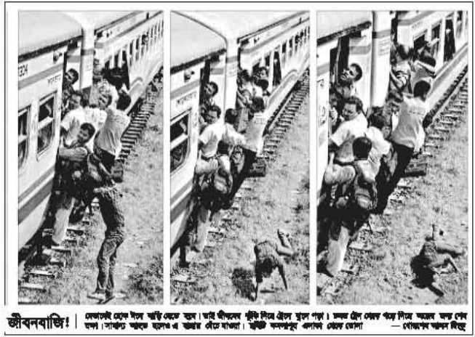

Slide 5
Let’s Watch a Video

Slide 6
TOPIC
My roots
Subject : English 1st Paper
Lesson : 1
Period : 1st
Time : 50 minutes
Date : 06 March 2019

Slide 7
Learning outcomes
After we have studied this lesson, we will be able to
participate in conversations and debates
exchange personal information
present own ideas, give and ask for information
present information in a chart.

Slide 8
According to
Learning outcomes-1 :
participate in conversations and debates

Slide 9
Part - A
Now open your books and look at the caption again and try to share your idea with following question-
How do you feel looking at the photo ?
Why do you think people take such risks to go home to celebrate Eid ?

Slide 10
Answer the questions
Oh my God ! Heavy unexpected loaded train with passengers. They are hanging with the handle of the train and trying so hardly to enter into the train. Because, they are taking such a risk of life to go back to their roots, to meet their kith and kin and spend a quality time with them.
2. Yes, I think so.

Slide 11
Part : B Read the following text silently

Slide 12
Part : C
Eid is the main religious festival of the Muslims in Bangladesh.
What is the main religious festival of the Muslims in Bangladesh ?
Eid means happiness.
What does Eid mean ?

Slide 13
In the sense our families, our land of birth, relatives, our culture, traditions, or surroundings are our roots.
It’s our roots that develop our identity making us what we are.
What do our roots do to us ?
What are our roots ?

Slide 14
According to
Learning outcomes-3 :
present own ideas, give and ask for information

Slide 15
Part : D
That makes
our roots
The problems of
a rootless person
Family bondage
No entity
Love to friends
Devoid of values
Love to in-laws
Devoid of humanity
Love to neighbours
No destiny
Our birth and growing land
Feeling of emptiness

Slide 16
According to
Learning outcomes-2 :
exchange personal information

Slide 17
Part : E
1.
Do you have any root other than the place where you are living now ? If yes, where is it and who live there ? If not, why not ?
Yes, I have. It’s in Madhupur. My father and brother live there.
2.
How do you label your roots ?
Yes, it is actually the bonding of love, isn’t it ?
I label my native place as a remote rural village. I love this beautiful village very much as it’s my birth place.

Slide 18
3.
Do you feel any attraction for your roots ? Any pull in your heart ?
Yes, I obviously feel a great attraction for my roots. I also feel a continuous pull in my heart.
4.
How do you nourish your roots?
I nourish my roots by keeping communication with my beloved persons living in my village. I also celebrate different festivals with them.

Slide 19
5.
What, according to you, are the reasons why people become rootless ?
I think, people become rootless for not keeping proper communication with their family members and kith and kin living in their native places. Besides, disintegration of joint families, people’s tendency to come to city for job and their self-centered outlook are some of the reasons of rootless. In some cases, poverty is responsible for our alienation.

Slide 20
What are our roots ?
Assessment
Our families, our land of birth, relatives, our culture, traditions, or surroundings are our roots.
What are the main religious festivals in Bangladesh ?
Eid-ul-Fitre, Eid-ul-Azha, Durgapuja, Cristmas Day etc.

Slide 21
According to
Learning outcomes-4 :
present information in a chart.

Slide 22
Survey Report
Part : F
There are 60 students in our class. They are from different roots. We have made a classroom survey and found out the roots of all the students of our class. Now, the types of roots our classmates are presented in a chart below.
Total Students | City | Small Town | Semi-Urban | Village | Remote Rural Village
60 | 25 | 10 | 5 | 15 | 5

Slide 23
A Class Survey on the Types of Roots
The Chart

Slide 24
Write a paragraph on “Your Roots”
Home Task

Slide 25
Thank you all
May Allaah swt save and develop our roots.

