Slide 1

Welcome everyone

Slide 2

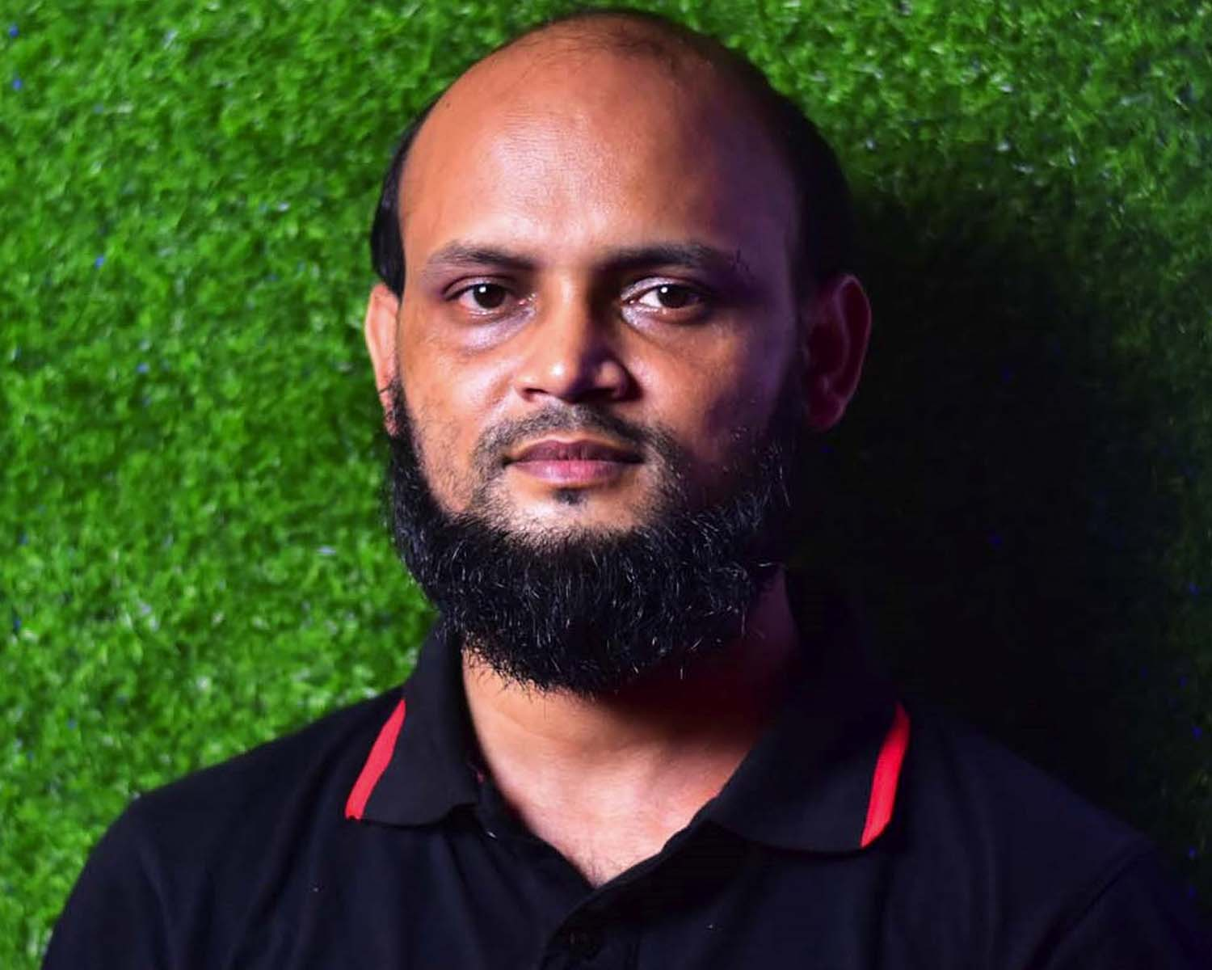

Identity
Nurul Aziz
Assistant Teacher (English)
Krishnakumari City Corp. Girls’ High School,
Nandankanan,Chittagong
E-mail : naziz13.na@gmail.com
Mobile : 01843773924
English For Today
Class : 9
Time : 45 Minutes
Date : 24/07/2019

Slide 3
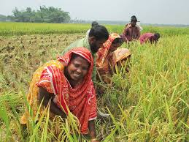
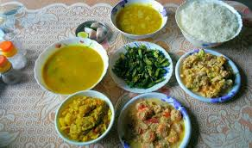
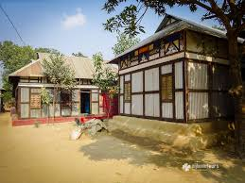
What do you see in the pictures below?
Harvesting
Ready food
home/ shelter

Slide 4

Our Today’s lesson is on……
Our food and shelter
Unit : 4, Lesson: 3
English For Today (Page: 43)

Slide 5
Objectives
After the end of the lesson students will be able to
Learn new words
comprehend the text after reading
talk about population problem
discuss the possible impacts of over population
write composition

Slide 6
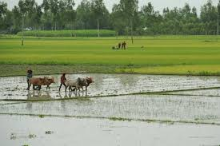
Vocabulary Presentation
Arable (adj.)
Syn.
Cultivable
We need arable field to grow crops.

Slide 7
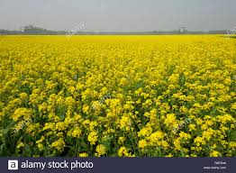
Vocabulary Presentation
Mustard (N)
Syn.
rapeseed
Rapeseed is one of the most important cash crops in Bangladesh.

Slide 8
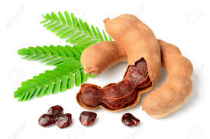
Vocabulary Presentation
a chocolate-colored fruit with acidic pulp.
Tamarind (N)
There was a huge tamarind tree in our village.

Slide 9
Silent Reading
C. Read what Ms. Choudhury and her students are talking about.
The class comes with different problems. One group leader says,” The scarcity of food will be a serious problem. (The full text is not given here but the keys sentences are mentioned below.)
Increase in food production can not keep pace with the rate of population growth.
Families are growing larger in size and breaking into smaller families.
The arable fields are being divided by these smaller families among themselves.
Mills and factories are being set up , which occupy a considerable portion of our land.
Trees are being cut, hills are being cleared and water bodies are being filled up.
The beauty of the crop fields is spoiled by the unplanned houses built here and there.
Notes:
Note : The full text is not given here but the keys sentences are mentioned below.

Slide 10
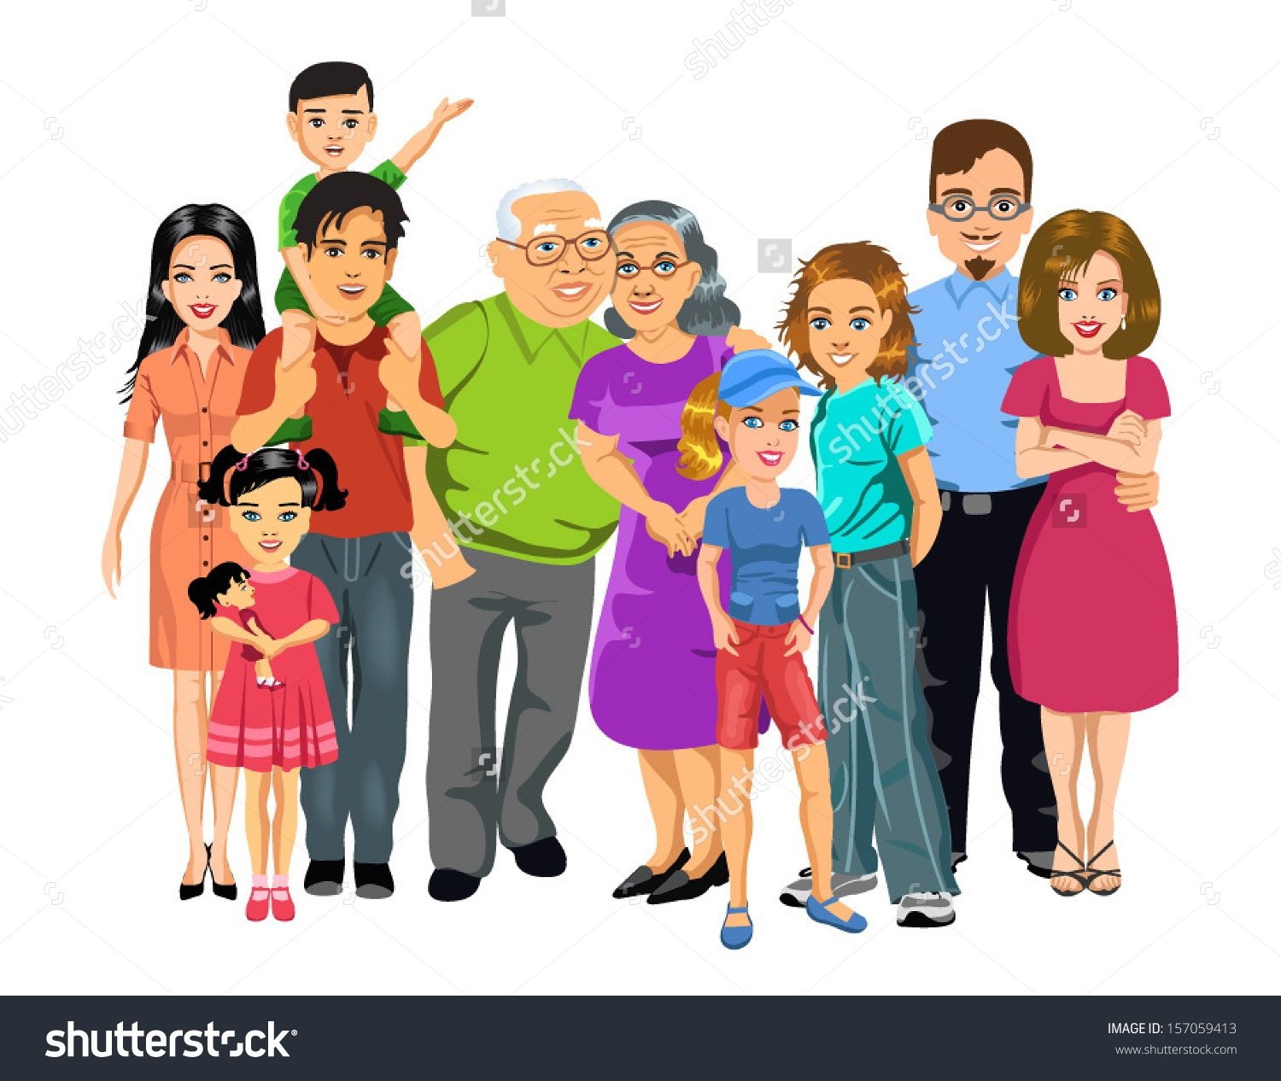
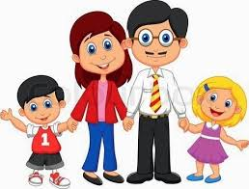
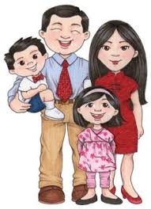
Silent Reading
“Families are growing larger in size and breaking into smaller families.”
Larger family
Smaller families

Slide 11
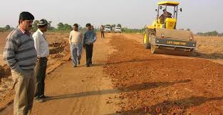
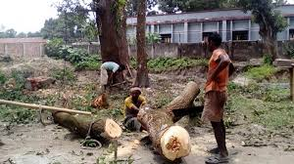
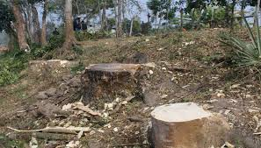
Silent Reading
“Trees are being cut, hills are being cleared and water bodies are being filled up ---all to meet the needs of too many people.”

Slide 12
Individual work
The word ‘scarcity’ means?
shortage
People are cutting trees to ?
To grow crops
The second group leader talks about?
The housing problem
The first group leader talks about?
The scarcity of food
Tamarind is?
One kind of fruit.

Slide 13
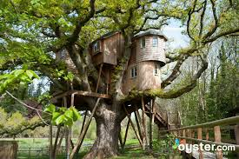
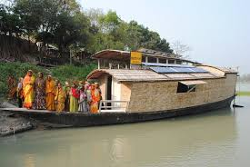
Group Work
Discuss what will be our problems if our population becomes double the number we have now.
Possible answers: Many of the people might live on trees or on the floating boats in the rivers.

Slide 14

Pair Work
E. Make a list of things Ms. Choudhury saw as a child in the village. How do you know from the text that she liked them?

Slide 15
Evaluation
D. Tik the best answer.
1. The rate if increase in food production cannot keep pace with the rate of population growth.
The sentence means that the food production
is as much as needed
is more than what is needed
is sufficient for the population
2. People are cutting trees to
Plant more trees
Keep the environment clean
make articles of furniture
is less than what is needed
d) Grow crops or make houses

Slide 16
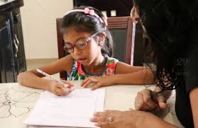
Home Work
Write a composition about your village or locality. Describe any change in the things you have noticed over the years, such as houses, fields, trees, plants etc.

Slide 17

Thank you and Good bye.

