Slide 1

Good morning

Slide 2
Presented by
Shahrina Bin Sweety
Assistant Teacher
Chormonai Madrasha Govt.Primary school.
Barishal.

Slide 3
Lesson Identity
Class:two
Subject: English
Lesson:4-6
Unit:Three

Slide 4

Creat Emotion
Let’s listen a song.

Slide 5





Let’s see some letter
Our lesson is to know about this letter

Slide 6
Today’s Lesson
Alphabet
(Kk-Oo)
Page: 7

Slide 7
Learning Outcomes
* By the end of the lesson the students will be able to------.
Speaking
1.1.1: Repeat after the teacher simple word and phrases with proper stress and intonation.
Reading
1.4.1: Read word and phrases with help of visual clues(about 30 new words) and simple sentences.
Writing
1.2.1: Write non-cursive small letters.

Slide 8

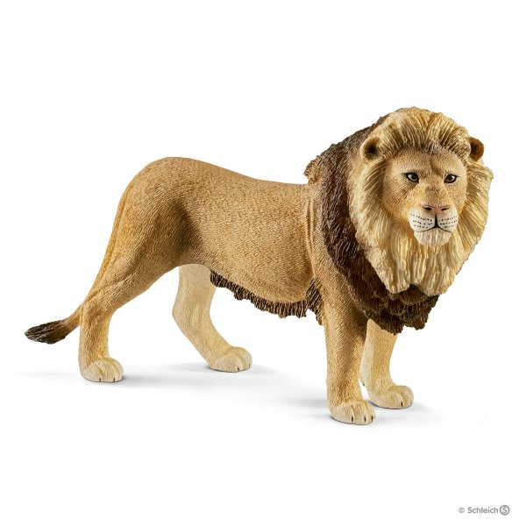
Now look at the picture’s and repeat after the teacher.
Kite
Lion

Slide 9
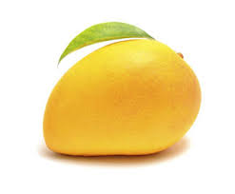
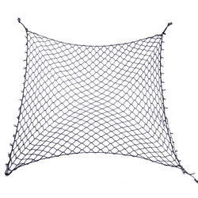
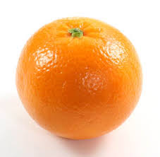
Now look at the picture and repeat after the teacher.
Mango
Net
Orange

Slide 10
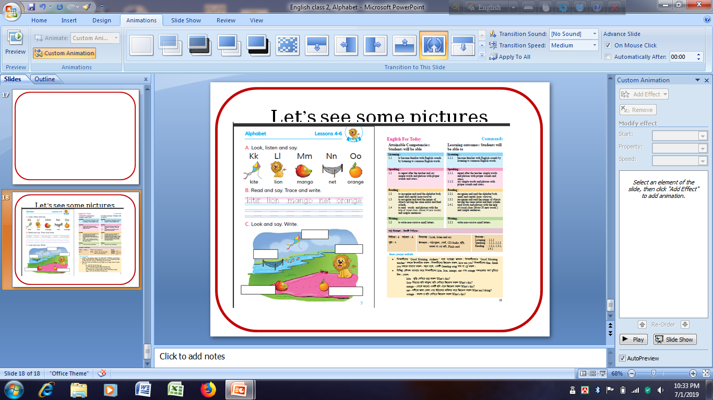
Now open your book, page no 7 and look at activity c.

Slide 11

Fill in the gaps by the names of the picture.
Kite
Lion
Orange
WCW
Net
Mango

Slide 12

Read loudly with your teacher
K
Kite
N
Net
O
L
Lion
Orange
M
Mango
PW

Slide 13

Match the words with the letter
Net
Orange
Kite
Lion
Mango
IW

Slide 14
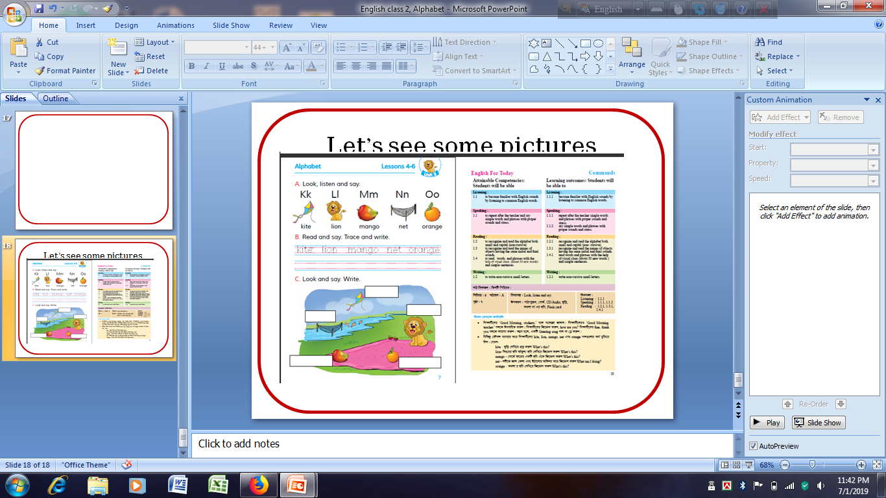
Evaluation
Fill in the blanks from your text
Kite
Lion
Net
Mango
Orange

Slide 15

Evaluation
Say name’s of the pictures
Orange
Lion
Kite

Slide 16
Evaluation
Write the non-cursive small letter
K
L
M
k
l
m
O
N
o
n

Slide 17
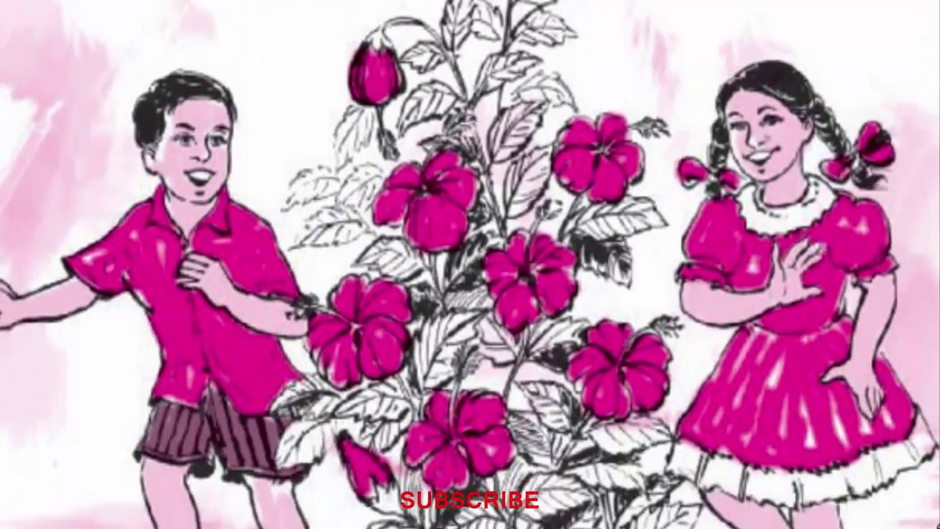
Good bye

