Slide 1
Welcome

Slide 2
Sultan Ahmed Miazi (MA.Bed)
Asst. Teacher
Balia K. B. D. N. Dakhil Madrasah,
Chandpur Sadar, Chandpur.
Mobile: 01817106106
Email: sultanshapdi@gmail.com

Slide 3
Class—9,Unit-3, Lesson-3
Subject—English 1st paper
Time-50 mins
Total SS—60, Presences-40
Date—17-05-2019

Slide 4
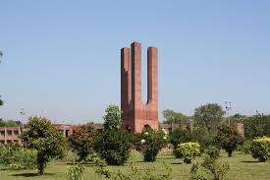
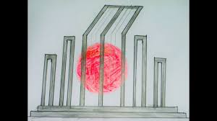
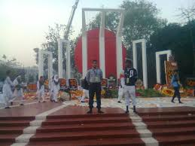
Let’s some pictures

Slide 5
International Mother Language Day

Slide 6
Learning Outcome : By the end of the lesson SS will be able to----- 1.Speak about the pictures; 2.Read and understand the text;
3.Complete a chart;
4. Match words with their meaning;
5. Answer some questions;
6. Write a paragraph “How you observed last 21 February”;

Slide 7
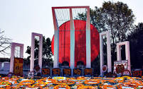
Ask SS to discuss the picture in pair;3 mins
1.What is the picture about ?
Answer: It Is Shaheed Minar.

Slide 8
Vocabulary—5 m.
Who Know the pronunciation and meaning of this words;
tribute
outlawled
procession
enkindled
verb
noun
noun
verb
ban
respect
parade
inflame

Slide 9
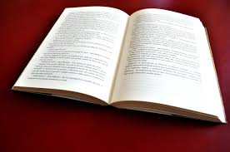
Read the text silently and try to understand;

Slide 10
See the video

Slide 11
Complete the chart carefully in pair-5 mins
Time | What happened
1947
Pakistan and india became independent.
1948
Mohammad Ali Zinnah declared that Urdu would be the only official of language of Pakistan.
1952
The students of Dhaka University brought out a procession on 21st February.

Slide 12
Match the words with their meaning;-4 m.
Words | Meaning
tribute
To have a particular effect
climax
To repuse to obey
outlaw
To give in
momentum
To ban

Slide 13
Evaluation-10 mins
1.Who Is Mohammad Ali Zinnah?
2.When the sad of the language movement was sown ?
3.Who brought out a peaceful protest procession ?

Slide 14
Home work;
Write a paragrapath about International Mother Language Day.

Slide 15
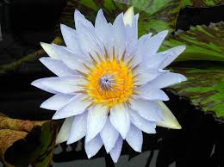
Thanks to all.
Thahjghgh

