Slide 1
Welcome to the students

Slide 2
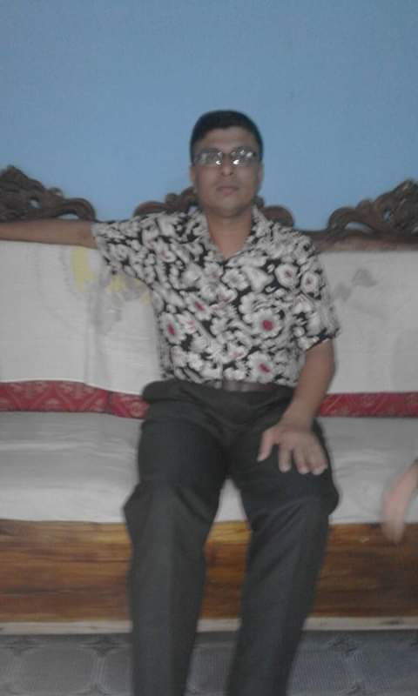
Identity Teacher
Sultan Ahmed Miazi(MA.Bed)
Astt. Teacher
Balia K.B.D.N.Dakhil Madrasah
Chandpur Sadar, Chandpur.
Mobile: 01817106106
Email: sultanshapdi@gmail.com

Slide 3
English First Paper
Class: Nine
Unit: Eight
Lesson: Four
Total ss: 60
P. ss: 45
Time: 50

Slide 4
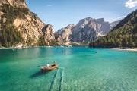
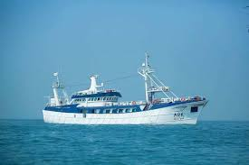
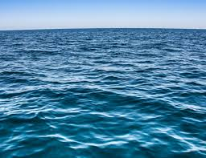
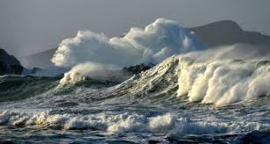
Let’s some pictures

Slide 5
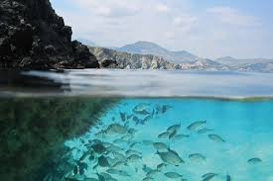
Lake Baikal
Let’s some vedio

Slide 6
So today’s lesson: Lake Baikal.

Slide 7
Learning outcomes:
By the end of lesson students will be able to-
Speak about the pictures;
Read and understand the text;
Match the words with the meaning;
Complete the chart by the information;
Describe a place;

Slide 8
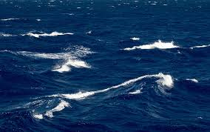
Where is this situated ?

Slide 9
It is situated in the center of Asia.

Slide 10
Do you think the beauty of Lake Baikal is exceptional ?
Yes, the beauty of Lake Baikal is exceptional.

Slide 11
Vocabulary:Pronunciation and meaning
Gigantic
Extremly large
adj
enormous
Very big in size
adj
occupy
To fill a particular amount of space
verb
average
Usual standard
noun

Slide 12
Read the passage silently and indevisualy-----8 mins

Slide 13
Match the words with the meaning;
Words | Meanings
miracle
An act believed to be caused by God
basin
Bowl shaped depression filled with water
brook
Small stream
crest
top
exceptional
outstanding

Slide 14
Complete the chart by the information (group work-10 mins)
Location-------------
Setting---------------
Length---------------
Width----------------
Maximum----------
Highest depth-----
Area------------------
Amount of water--

Slide 15
Home work-
Make a list of attractive features of Lake Baikal

Slide 16
Thanks to all

