Slide 1



WELCOME

Slide 2

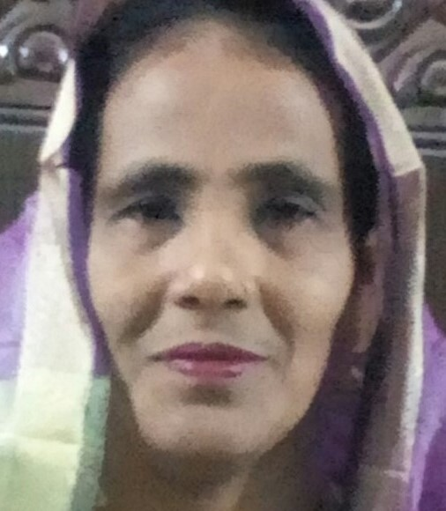
Introduction of Teacher
Mst.Rokeya Begum,
Assistant teacher,
Amanotpur Govt.Primary School,
Begumgonj,Noakhali.

Slide 3

Lesson’s Identity
Class :Two
Sub:English.
Unit—29 (4-6)
Title-Story:The Golden Goose.
Time-40 mn.

Slide 4
Learning Outcomes
After this lesson students will be able to-
Listening-1.1.1- became familiar with English sound by listening to common English words.
4.2,1-Enjoy simple stories.
Speaking-1.1.1-repeat after teacher simple words and phrases with proper
Sound and stress.

Slide 5
Let’s See A Video.

Slide 6
Today’s Lesson
The Golden Goose

Slide 7
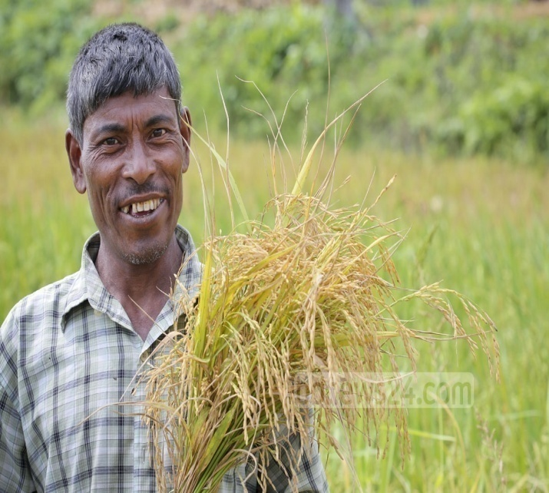


Look at the picture below
What can you see in the picture? Think yourself
And discuss with your partner.
Farmer
Magic Goose
Golden egg

Slide 8
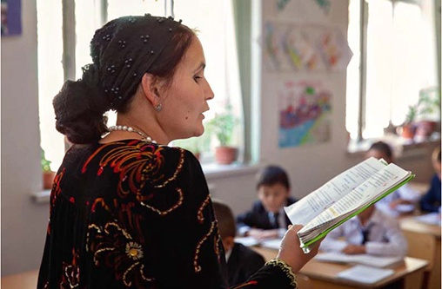
Teacher’s loud reading
Look and listen

Slide 9
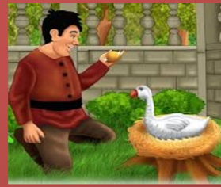
A poor farmer has a goose

Slide 10
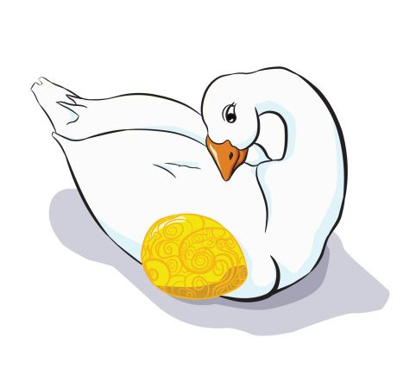
Everyday ,the goose lays an egg . It’s a golden egg.

Slide 11
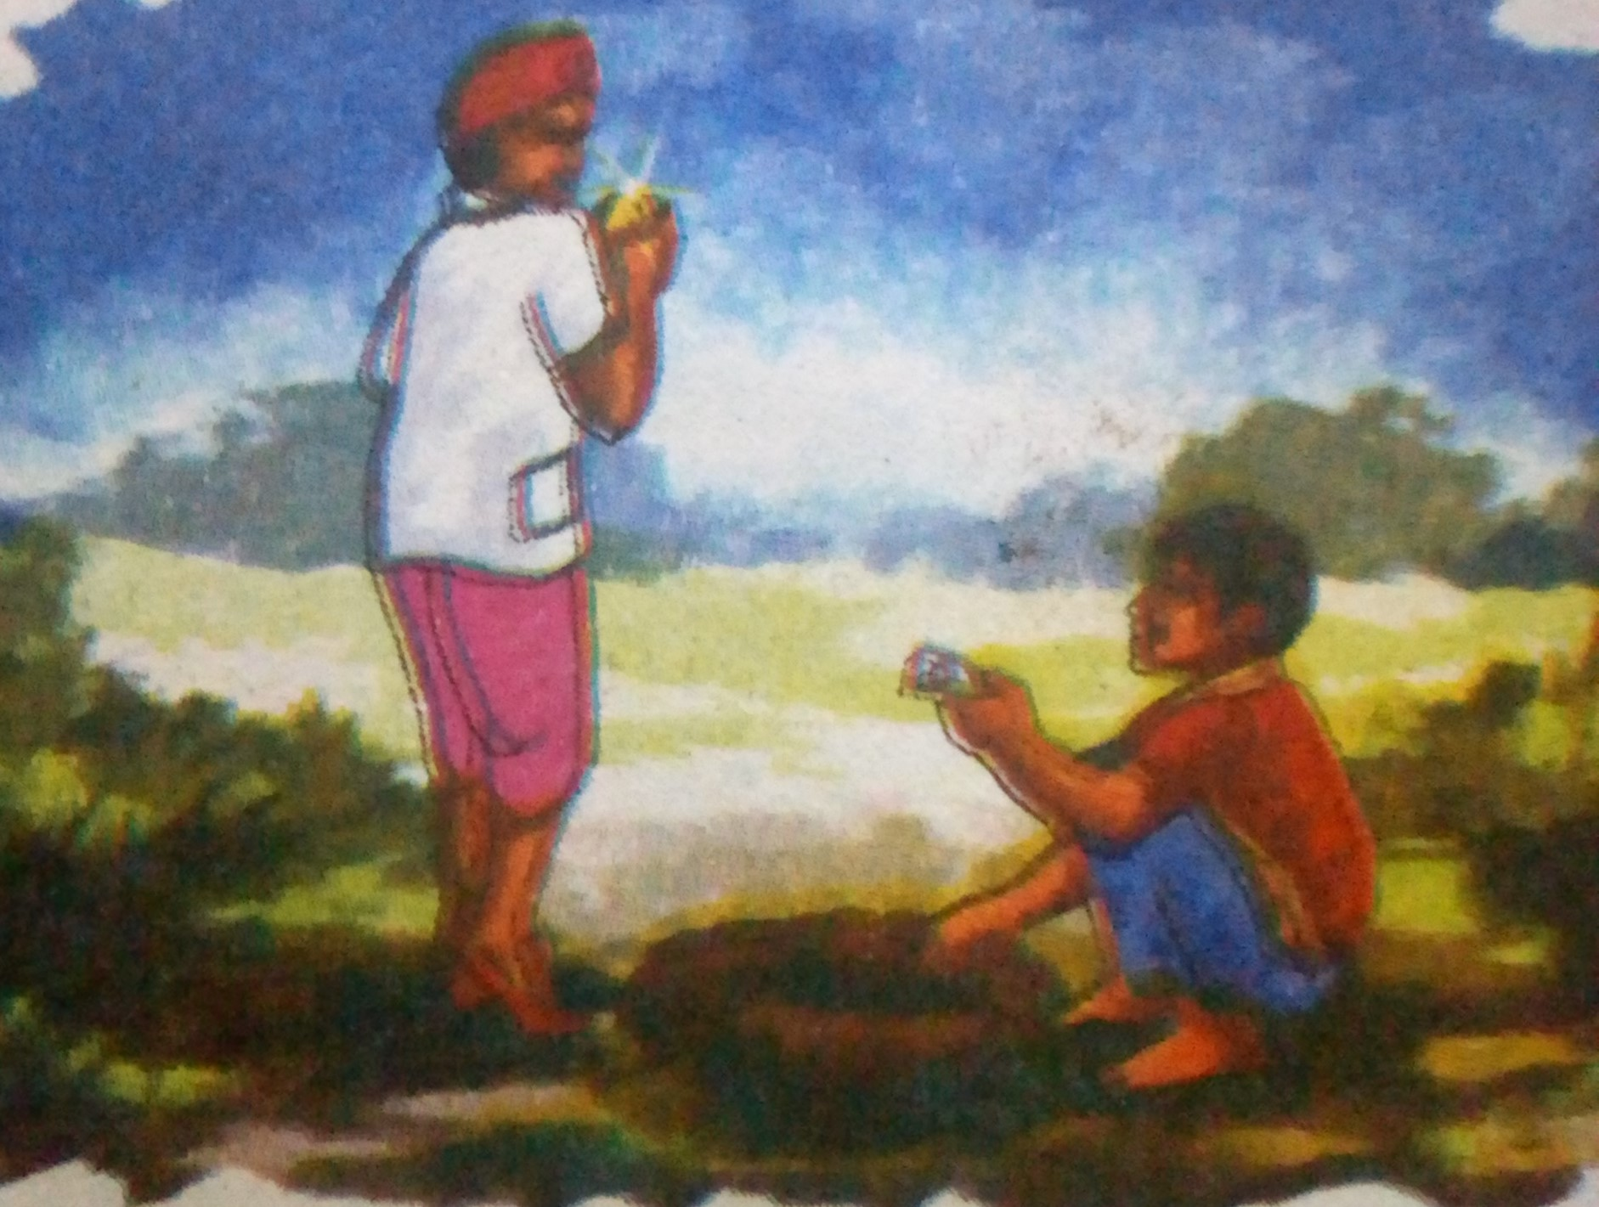
Everyday the farmer sells the egg.

Slide 12
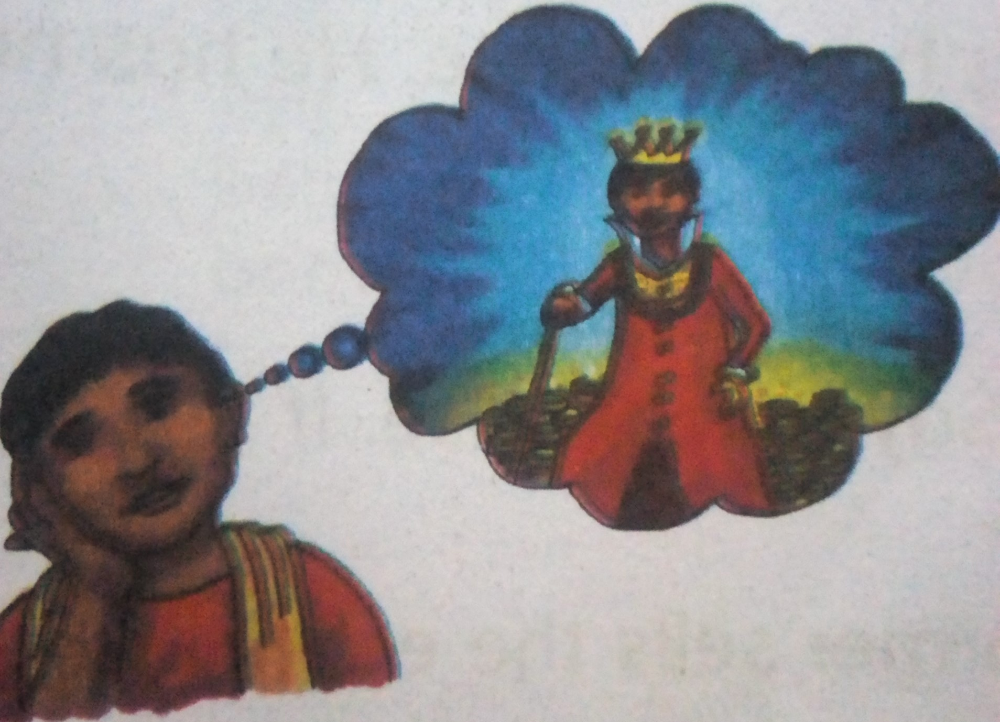
The farmer thinks, I want to be rich. I have an idea!”
The farmer thinks all the eggs are inside the goose.

Slide 13
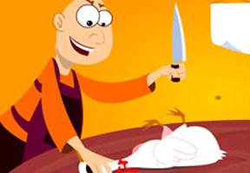
He kills the goose . He open its belly , but there are no eggs!

Slide 14
Word meaning
Poor
গরিব
Farmer
কৃষক
Golden
সোনালী
Sell
বিক্রয় করা
  Kill
হত্যা করা

Slide 15
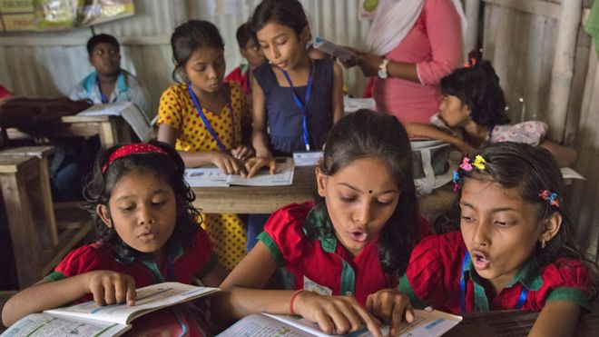
Students loud read reading

Slide 16
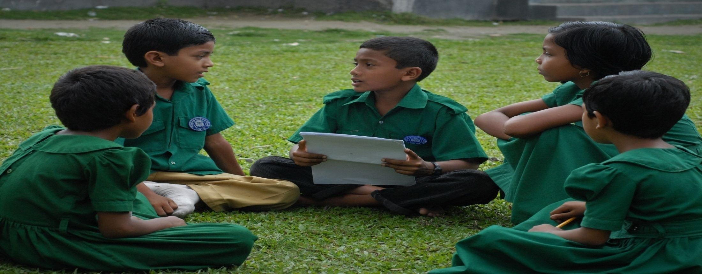
Group work
Make sentences with the following words.
(poor, goose , sell, want , kill)

Slide 17
Pair work
Rearrange the following letters and make meaningful words .
osoge
Goose
gcmia
Magic
dngoel
Golden
refram
Farmer
yeadrvea
Everyday

Slide 18
Evaluation
Say true or false . If false , say the true
1)The farmer sells the egg everyday
2)The farmer buys eggs everyday.
3)The farmer is rich.
4)The egg is white.
True
false:
false:
false:
True

Slide 19
Homework
Everybody will write 5 sentences about the Farmer at Home

Slide 20

THANKS TO ALL, GOOD BYE!

