Slide 1

Welcome To My English Grammar Class

Slide 2
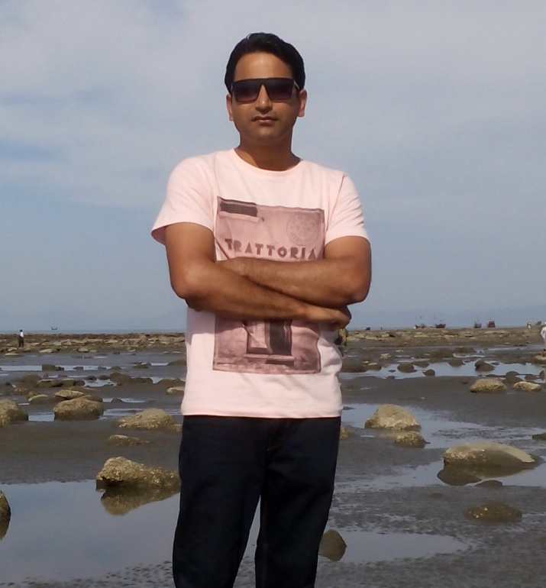
Teacher’s Identity
Md. Sharif Azam
Assistant Teacher ( English)
Jangalia High School
Kaligonj, Gazipur

Slide 3
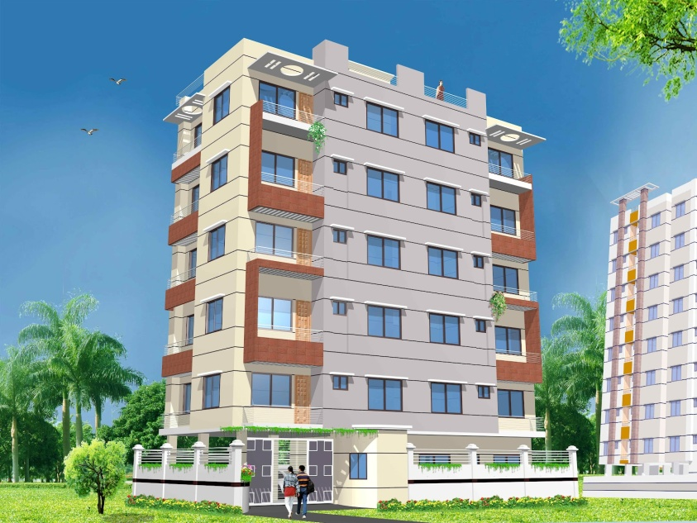
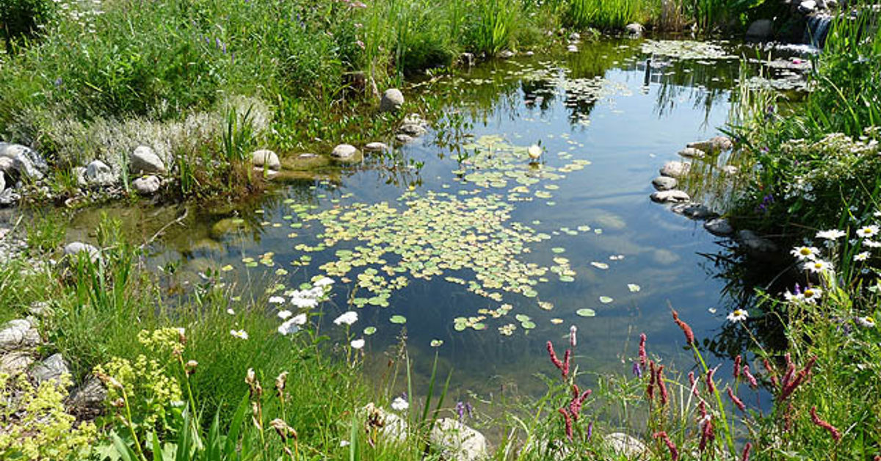
Look at the following images and read the sentences
The building is tall.
The building is not short.
The water is clean.
The water is not dirty.

Slide 4
What type of sentences are they ?
Affirmative
Negative

Slide 5
Our Today’s topic is
Transformation of sentence
Affirmative
Negative

Slide 6
Learning outcomes
By the end of the lesson students will have to-
1. Identify affirmative and negative sentences .
2. Utilize the basic rules of transformation .
3. Change the sentences from affirmative to negative.

Slide 7
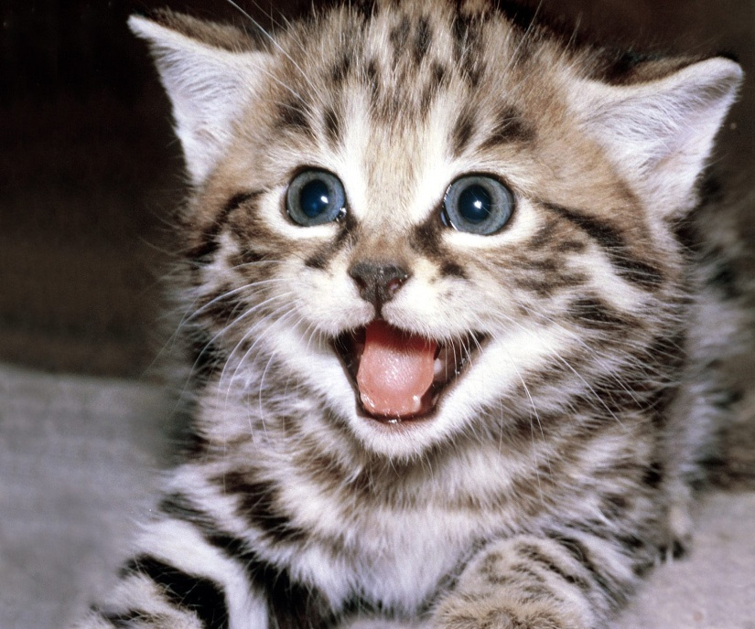
Look at the following picture and read the sentence
The cat is beautiful
The cat is not ugly.
Rule : Auxiliary verb এর সাথে not / no বসে এবং adjective এর বিপরীত অর্থবোধক শব্দ বসে ।
Examples : Affirmative : Messi is a good player.
Negative : Messi is not a bad player.

Slide 8

Look at the following picture and read the sentence
A man is always kind to the others.
A man is never unkind to the others.
Rule : Always এর স্থলে never + adjective এর antonym + extension .
Example : Shahrukh always remembers me.
Shahrukh never forgets me.

Slide 9
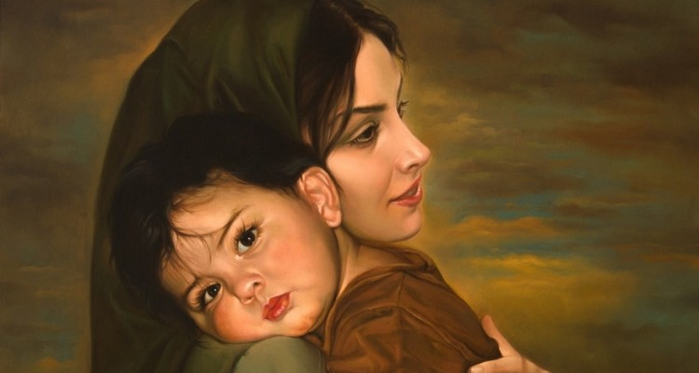
Look at the following picture and read the sentence
Every mother loves her child.
There is no mother but loves her child.
Rule : Every এর স্থলে there is no + Every এর পরের word
+ but + verb + extension.
Example : Every action has an equal re-action.
There is no action but has an equal re-action.

Slide 10

Look at the following picture and read the sentence
Only the bird can fly.
Nothing but the bird can fly.
Rule : only ব্যক্তির পূর্বে হলে None but , বস্তুর পূর্বে হলে nothing but এবং সংখ্যার / বয়সের পূর্বে not more than / not less than হয়।
Example : Allah only can help us.
None but Allah can help us.

Slide 11
Rule : Sentence এ Must/have to/has to/can থাকলে Must/have to/has to/can এর
স্হলে can not but/can not help + verb + ing হবে।
Example : # We must obey our creator.
» We can not but obey our creator.
Or, We cannot help obeying our creator.
তবে Had to থাকলে Had to এর স্হলে could not but হবে।
Example : # I had to solve the problem.
» I could not but solve the problem.
Rule : Everybody/Somebody/Every+noun/Some+noun + auxiliary verb
হলে
Nobody/No one/None + adjective এর opposite word হবে।
Example : # Everybody is liable to error
» Nobody is free from error.
Or, There is nobody but liable to error. (Auxiliary verb বাদ যাবে)
# Everybody is depend on others.
» Nobody is self reliant.

Slide 12
Rule : A+noun হলে There is no + subject + but + বাকী অংশ হবে।
Example : # A patriot loves his country.
»There is no patriot but loves his country.
Or, No patriot hates his country.
Or, There is no patriot who does not love his country.
Rule : All থাকলে No/None + singular noun + verb এর singular form + adjective এর
opposite word হবে।
Example : # All men are mortal. # All the pens are good.
» No man is immortal. » No pen is bad.
# All love a flower. # All Bangladeshi are honest.
» None hates a flower. » No Bangladeshi is dishonest.
সাধারনত All এরপর Noun থাকলে No হয় তবে All এরপর verb থাকলে None হয়।
Rule : Sentence এ very / very much থাকলে at all হয়।
Example : # They like Messi very much.
» They do not hate Messi at all.

Slide 13
Rule : Both + noun + and +noun থাকলে Not only + noun + but also +
noun হবে।
Example : # Both he and his brother are responsible for this.
» Not only he but also his brother are responsible for this.
তবে শুধু And দ্বারা দুইটি noun যুক্ত হলেও Not only + noun + but also + noun হবে।
Example : # He ate eggs and vegetables.
» He ate not only eggs but also vegetables.
# Karim and Rahim had done the work.
» Not only Karim but also Rahim had done the work.

Slide 14
Rule: Many থাকলে not a few হবে ; a few থাকলে not many হবে এবং Much থাকলে not a little হবে ; a little থাকলে not much হবে।
Example : # There are many men on the road.
» There are not a few men on the road.
# I have a few pens.
» I do not have many pens.
# They need much money.
» They do not need a little money.
# They have a little food.
» They do not have a little food.

Slide 15
Rule : Universal truth Sentence এ adjective এর Opposite word পাওয়া না গেলে Negative-Interrogative করতে হয় তবে auxiliary verb না থাকলে Nothing but ব্যবহার করেও করা যায়।
Example : # Knowledge is power.
» Isn’t knowledge power?
Or, Knowledge is nothing but power.
# The sun sets in the west.
» Doesn’t the sun set in the west?
তবে Opposite word পাওয়া গেলে Negative-Interrogative করতে হবে না।
Example : # Man is mortal
» Man is not immortal.

Slide 16
Group Work
Change the following sentences into negative form
I need a book only.
He failed to keep his promise.
3. I need ten taka only.
4 . Every cloud has a silver lining.
5 . Only money can save me now.
6. Every effect has cause.
7. I eat only one thing.
8. He refused the money.
9. All men must die.
10. Every lighting has a thunder.
1. I need nothing but a book.
2. He did not keep his promise.
3. I do not need more than ten taka.
4. There is no cloud without a silver lining.
5. Nothing but money can save me now.
6. There is no effect without cause.
7. I do not eat more than one thing.
8. He did not accept the money.
9. None can avoid death.
10. There is no lighting without a thunder.

Slide 17
Evaluation
Transform the following sentences into Affirmative
1. I could not catch the train.
2. There is no rose but has a thorn.
3. I am never against him.
4. None will deny this.
5. He did not act wisely.
1. I missed the train.
2. Every rose has a thorn.
3. I always support him.
4. Everyone will admit this.
5. He acted foolishly.

Slide 18
Home Work
Make ten meaningful affirmative
sentences by using your imagination and transform them into negative form .

Slide 19
Thank you all for watching my class
Allah Hafiz

