Slide 1









It’s a presentation of Bibek Biswas
Narail Sadar, Narail
Bibek Biswas, Assistant Teacher, Rameshworpur Government Primary School, Narail Sadar, Narail. Email: bibekmitna@gmail.com, fbook: bibekbiswas, contact: 01914244847

Slide 2

Welcome to our classes
Bibek Biswas, Assistant Teacher, Rameshworpur Government Primary School, Narail Sadar, Narail. Email: bibekmitna@gmail.com, fbook: bibekbiswas, contact: 01914244847

Slide 3
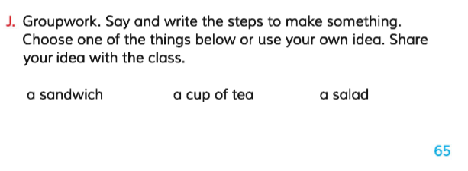

Teacher’s Information
Bibek Biswsa
Assistant Teacher
Rameshworpur Government Primary School
Narail Sadar, Narail.
Email: bibekmitna@gmail.com
fbook: bibekbiswas
Contact: 01914244847
Lesson’s Information
Class: Five
Questions No: 10
Unit: 16
Lessons 6-7
Page No: 65
Making a sandwich
Bibek Biswas, Assistant Teacher, Rameshworpur Government Primary School, Narail Sadar, Narail. Email: bibekmitna@gmail.com, fbook: bibekbiswas, contact: 01914244847

Slide 4
Dear students, Let’s sing an action song together
I can see left
I can see right
Hello to you
Hello to you
I look at the ground
I look at the sky
Fly away little birds
Good bye, good bye.
Bibek Biswas, Assistant Teacher, Rameshworpur Government Primary School, Narail Sadar, Narail. Email: bibekmitna@gmail.com, fbook: bibekbiswas, contact: 01914244847

Slide 5
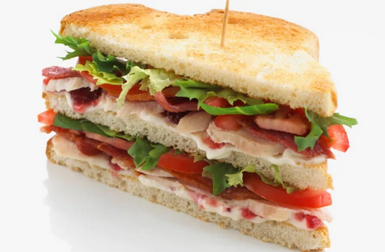
Dear students, do you know what is this?
It’s a sandwich.
Bibek Biswas, Assistant Teacher, Rameshworpur Government Primary School, Narail Sadar, Narail. Email: bibekmitna@gmail.com, fbook: bibekbiswas, contact: 01914244847

Slide 6
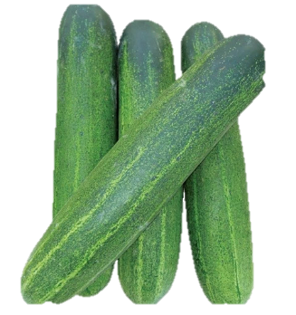

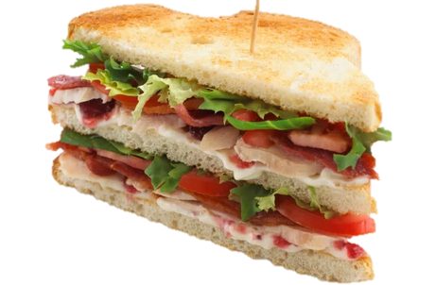
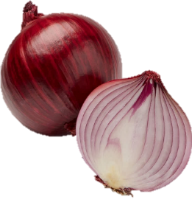

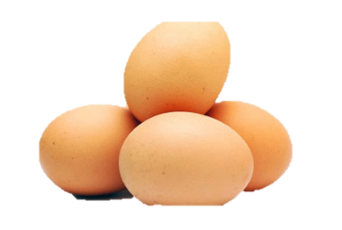
Dear students, what do you need to make sandwich?
Chili
Cucumber
Onion
sandwich
Slice bread
Egg
Bibek Biswas, Assistant Teacher, Rameshworpur Government Primary School, Narail Sadar, Narail. Email: bibekmitna@gmail.com, fbook: bibekbiswas, contact: 01914244847

Slide 7
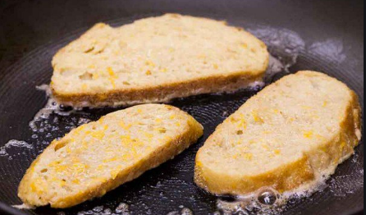
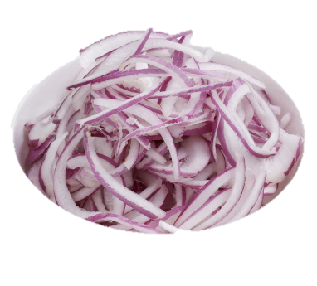
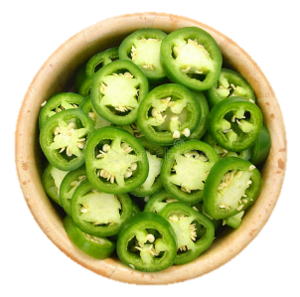

Dear students, what is the procedure to make a sandwich?
          Apply egg both side of slice bread and fry until it become brown color.
Onion slice
          Slice the onion, cucumber and chili.
Cucumber slice
Chili slice
Bibek Biswas, Assistant Teacher, Rameshworpur Government Primary School, Narail Sadar, Narail. Email: bibekmitna@gmail.com, fbook: bibekbiswas, contact: 01914244847

Slide 8
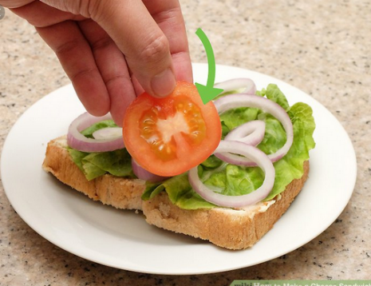
Dear students, what is the procedure to make a sandwich?
          Take the sliced onion, cucumber and chili inside two pieces of fried bread and served in a plate.
          Eat and enjoy your sandwich.
Bibek Biswas, Assistant Teacher, Rameshworpur Government Primary School, Narail Sadar, Narail. Email: bibekmitna@gmail.com, fbook: bibekbiswas, contact: 01914244847

Slide 9
Today we will practice 10 no. questions according to NAPE questions guideline.
10. Read the instructions about how to make sandwich and then answer the following questions..
          Take some slice bread, egg, onion, cucumber and chili.
          Apply egg both side of slice bread and fry until it become brown color.
          Slice the onion, cucumber and chili.
          Take the sliced onion, cucumber and chili inside two pieces of fried bread and served in a plate.
          Eat and enjoy your sandwich.
          Questions:
          What do you need to make sandwich?
          Why do you eat sandwich?
          How do you make sandwich?
Bibek Biswas, Assistant Teacher, Rameshworpur Government Primary School, Narail Sadar, Narail. Email: bibekmitna@gmail.com, fbook: bibekbiswas, contact: 01914244847

Slide 10
10. Read the instructions about how to make sandwich and then answer the following questions..
          Take some slice bread, egg, onion, cucumber and chili.
          Apply egg both side of slice bread and fry until it become brown color.
          Slice the onion, cucumber and chili.
          Take the sliced onion, cucumber and chili inside two pieces of fried bread and served in a plate.
          Eat and enjoy your sandwich.
          Questions:
          What do you need to make a sandwich?
          Why do you eat a sandwich?
          How do you make a sandwich?
Bibek Biswas, Assistant Teacher, Rameshworpur Government Primary School, Narail Sadar, Narail. Email: bibekmitna@gmail.com, fbook: bibekbiswas, contact: 01914244847

Slide 11
10. Read the instructions about how to make sandwich and then answer the following questions..
          Take some slice bread, egg, onion, cucumber and chili.
          Apply egg both side of slice bread and fry until it become brown color.
          Slice the onion, cucumber and chili.
          Take the sliced onion, cucumber and chili inside two pieces of fried bread and served in a plate.
          Eat and enjoy your sandwich.
          Questions:
          Answer: I need some slice bread, egg, onion, cucumber and chili to make a sandwich.
          Why do you eat a sandwich?
          How do you make a sandwich?
Bibek Biswas, Assistant Teacher, Rameshworpur Government Primary School, Narail Sadar, Narail. Email: bibekmitna@gmail.com, fbook: bibekbiswas, contact: 01914244847

Slide 12
10. Read the instructions about how to make sandwich and then answer the following questions..
          Take some slice bread, egg, onion, cucumber and chili.
          Apply egg both side of slice bread and fry until it become brown color.
          Slice the onion, cucumber and chili.
          Take the sliced onion, cucumber and chili inside two pieces of fried bread and served in a plate.
          Eat and enjoy your sandwich.
          Questions:
          Answer: I need some slice bread, egg, onion, cucumber and chili to make a sandwich.
          Why do you eat a sandwich?
          How do you make a sandwich?
Bibek Biswas, Assistant Teacher, Rameshworpur Government Primary School, Narail Sadar, Narail. Email: bibekmitna@gmail.com, fbook: bibekbiswas, contact: 01914244847

Slide 13
10. Read the instructions about how to make sandwich and then answer the following questions..
          Take some slice bread, egg, onion, cucumber and chili.
          Apply egg both side of slice bread and fry until it become brown color.
          Slice the onion, cucumber and chili.
          Take the sliced onion, cucumber and chili inside two pieces of fried bread and served in a plate.
          Eat and enjoy your sandwich.
          Questions:
          Answer: I need some slice bread, egg, onion, cucumber and chili to make a sandwich.
          Answer: I like to eat and enjoy a sandwich.
          How do you make a sandwich?
Bibek Biswas, Assistant Teacher, Rameshworpur Government Primary School, Narail Sadar, Narail. Email: bibekmitna@gmail.com, fbook: bibekbiswas, contact: 01914244847

Slide 14
10. Read the instructions about how to make sandwich and then answer the following questions..
          Take some slice bread, egg, onion, cucumber and chili.
          Apply egg both side of slice bread and fry until it become brown color.
          Slice the onion, cucumber and chili.
          Take the sliced onion, cucumber and chili inside two pieces of fried bread and served in a plate.
          Eat and enjoy your sandwich.
          Questions:
          Answer: I need some slice bread, egg, onion, cucumber and chili to make a sandwich.
          Answer: I like to eat and enjoy a sandwich.
          How do you make a sandwich?
Bibek Biswas, Assistant Teacher, Rameshworpur Government Primary School, Narail Sadar, Narail. Email: bibekmitna@gmail.com, fbook: bibekbiswas, contact: 01914244847

Slide 15
10. Read the instructions about how to make sandwich and then answer the following questions..
          Take some slice bread, egg, onion, cucumber and chili.
          Apply egg both side of slice bread and fry until it become brown color.
          Slice the onion, cucumber and chili.
          Take the sliced onion, cucumber and chili inside two pieces of fried bread and served in a plate.
          Eat and enjoy your sandwich.
          Questions:
          Answer: I need some slice bread, egg, onion, cucumber and chili to make a sandwich.
          Answer: I drink tea because it refresh myself.
          Answer: I make a sandwich in following ways:
            At first, I take some slice bread, egg, onion, cucumber, and chili. Then I apply both sides of bread and fry until it become brown color. I slice the onion, cucumber and chili. Then I take sliced onion, cucumber and chili inside two pieces of fried bread and served it in a plate. Thus I eat and enjoy my sandwich.
Bibek Biswas, Assistant Teacher, Rameshworpur Government Primary School, Narail Sadar, Narail. Email: bibekmitna@gmail.com, fbook: bibekbiswas, contact: 01914244847

Slide 16

Practice more and more...............
No more today
Thank you students for your keen attention and active participation
Bibek Biswas, Assistant Teacher, Rameshworpur Government Primary School, Narail Sadar, Narail. Email: bibekmitna@gmail.com, fbook: bibekbiswas, contact: 01914244847

Slide 17
* প্রয়োজন হলে নিশ্চিন্তে নামিয়ে নিন, এডিট করুন ও ব্যবহার করুন।
* ছাত্রছাত্রীদের উপকারে ব্যবহৃত হলেই আমি খুশি।
* উন্নয়নের জন্য কমেন্ট করুন।
* ধন্যবাদ সবাইকে।
Bibek Biswas, Assistant Teacher, Rameshworpur Government Primary School, Narail Sadar, Narail. Email: bibekmitna@gmail.com, fbook: bibekbiswas, contact: 01914244847

Slide 18
* প্রয়োজন হলে নিশ্চিন্তে নামিয়ে নিন, এডিট করুন ও ব্যবহার করুন।
* ছাত্রছাত্রীদের উপকারে ব্যবহৃত হলেই আমি খুশি।
* উন্নয়নের জন্য কমেন্ট করুন।
* ধন্যবাদ সবাইকে।
Bibek Biswas, Assistant Teacher, Rameshworpur Government Primary School, Narail Sadar, Narail. Email: bibekmitna@gmail.com, fbook: bibekbiswas, contact: 01914244847

