Slide 1
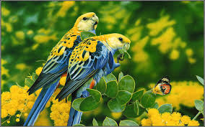
WELCOME

Slide 2

Teacher ‘s Identity
CHANDAN BISWAS
ASSISTANT TEACHER
ANDHA HIGH SCHOOL
E-mail: chandanb13@gmail.com

Slide 3
Class Identity
English-1st Paper
Class-Six
Lesson-22
Wonders of the world

Slide 4
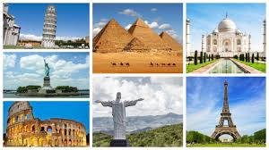
Look at the picture

Slide 5
Learning outcomes
After completing the lesson students will be able to-
*Read and understand the texts.
*Understand and enjoy stories .
*Answer the questions.

Slide 6
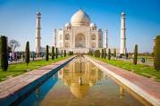
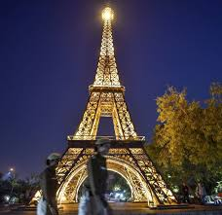
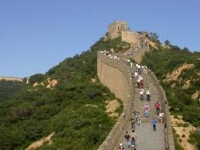
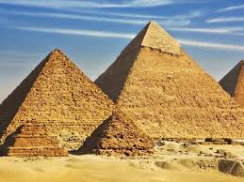
Look at the pictures

Slide 7
Vocabulary
Located
Emperor
Shocked
Architecture
Combine
Universally
Wonders
বিস্মিত
স্থাপত্য
সার্বজনীন
মেশা, মিলিত করা
অবস্থিত
আশ্চর্য, বিস্ময়
সম্রাট

Slide 8
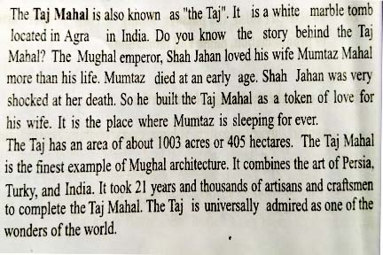
Read the following text.

Slide 9
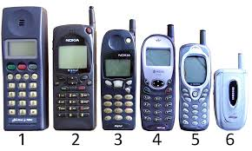

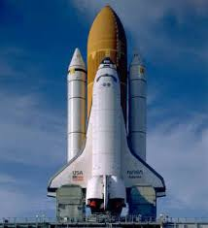
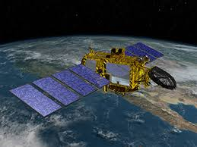
Look at the pictures
These are Wonders of the modern world.

Slide 10
Group work
* Complete the following table with the information given in the passage.
Shah Jahan | Built
Taj Mahal | is
Its area | is
Mumtaj | died
To complete the Taj | it look

Slide 11
EVALUATION
1* Where is located the Taj Mahal ?
Ans: The The Taj Mahal is located in Agra in India .
2* What is the area of the Taj ?
Ans: The Taj has an area of about 1003 acres or 405 hectares .
3* How many artisans and craftsmen to complete the Taj Mahal?
Ans : Thousands of artisans and craftsmen to complete the Taj Mahal.

Slide 12

Home work
* Write a short paragraph about the Taj Mahal.

Slide 13

Thank you
everybody

