Slide 1

welcome

Slide 2
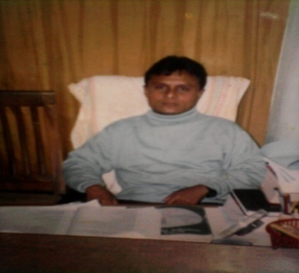
ITRODUCTION
Name:k.m. abdul bari
Amoin GPS
Sherpur,Bogra
Sub:English
Class: Five
Lesson:9
Page: 36

Slide 3
Learning outcomes
Listening:3.3.1student will able to understand question about objects around them.
Speaking:1.1.1 student will able to say words,phrases and sentences with proper sounds and stress.
Reading:1.5.1 student will able to read words,phrases and sentences in the text with proper pronunciation,stress and intonations.
Writing:9.1.1 student will able to take dictation of simple paragraph.

Slide 4
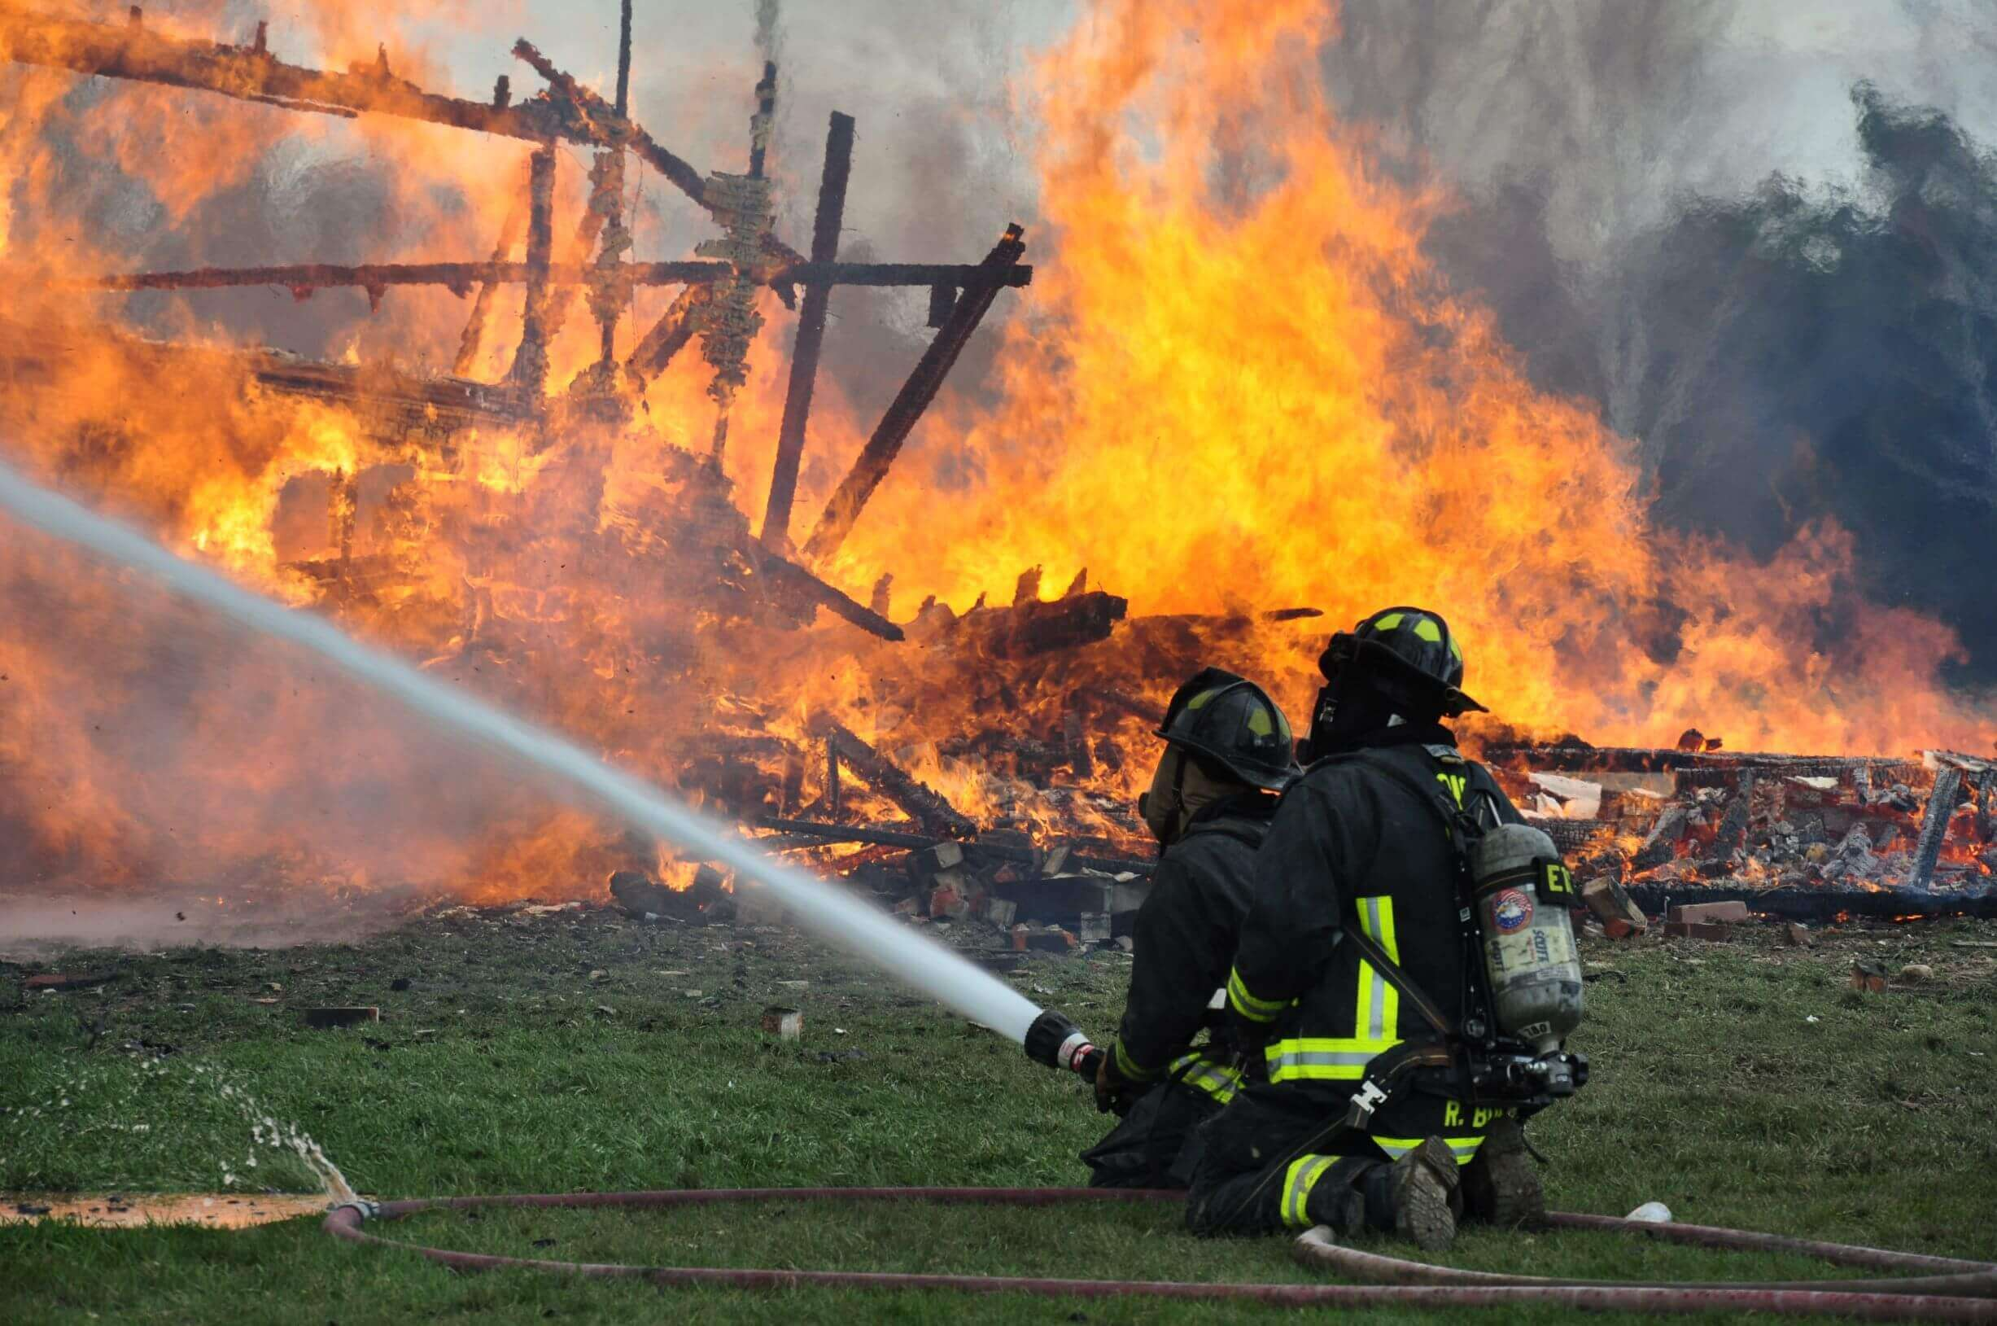
Creates emotion

Slide 5
Title of the lesson
Title:A Firefighter
Part of the lesson: Raju is-----become firefighter.

Slide 6
Pronunciation drill
Firefighter
Forget
Building
Joined
Panicked
Volunteer
Department
Brigade

Slide 7
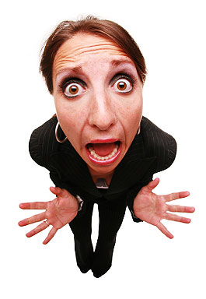
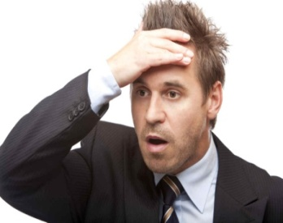
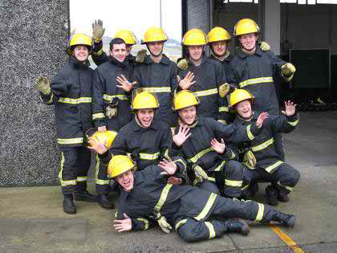

words meaning(WCW)
Panicked
Sudden anxiety.
Fail to remember.
Forget
A group of people who
have something
in common.
Brigade
Put out
To stop a fire.

Slide 8
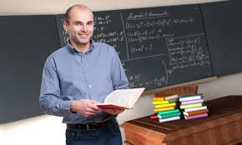
Teacher’s model reading
Put your finger under the lines and words look and listen carefully,the word I missed, you shout for that at page 36

Slide 9

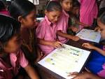

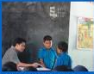
Group work(SGW)
Group 1
Group 2
Group 3
Group 4
One student will read by turn and others will listen.I’ll demonstrate by the ss if require.

Slide 10

Student reading(WCW)
One student will read in front others will listen.I and others studends will help.

Slide 11

Individual work(IW)
Students will read the text silently.

Slide 12
Task(IW-WCW)
Now ss ,write a short paragraph by answering the following question.
Where does the firefighter work?
What is his main job ?
What is the activity of a firefighter?
Whom does he train?
How is the profession?

Slide 13
Possible answer to the task.
A firefighter is a person who works at fire department.The main job of a firefighter is to putting out fire.He save people and protects their houses and property from fire related accident. A firefighter also trains young people to become firefighter. It is nobel profession.

Slide 14

A title
Nice
Avoid Overwriting

Slide 15
Evaluation
Read the following lines(reading skill).
Firefighter is a Raju. Got panicked every one.A fire brigade soon came and the fire put out.

Slide 16
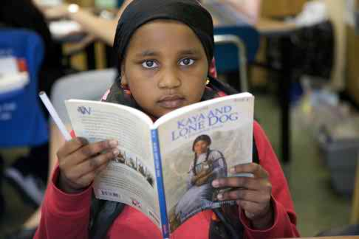
Better understand
I will tell(1/2) the text in Bangla to check whether they understand or not.

Slide 17

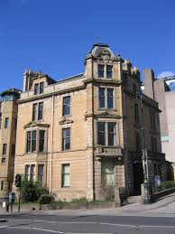

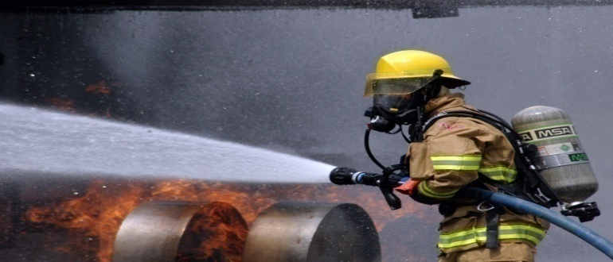
Say the following words and phrases.
Put out
Building
Fire
Firefighter

Slide 18
Creative Work(home task)
Think of a person who works in your area to help you live well. Write a paragraph on this person by answering the following question.
a) What does he/she do? b)What time does he/she start his/her work?
c) How does he/she do the work? d) Does he/she like the job? Why / Why not? e) What do you think about his/her job?

Slide 19

The end
TANKS

