Slide 1


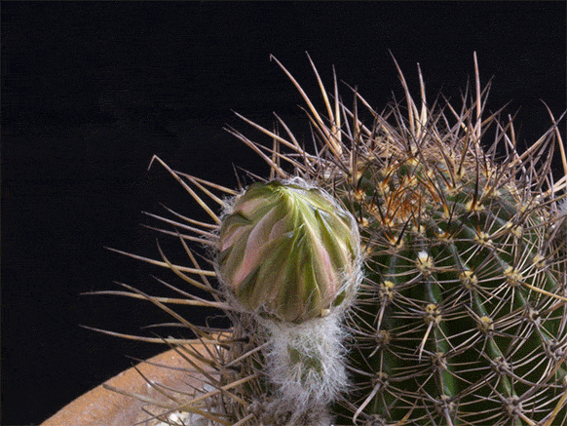
Welcome to my class

Slide 2
Introduction
Shahrina Bin Sweety
Assistant Teacher
Chormonai Madrasha Govt. Primary school
Barishal

Slide 3

Class : Two
Subject : English
Time : 40 minute

Slide 4
Learning outcomes
At the end of the lesson students will be able to-
1.1.1 become familiar with English sounds by listening to common English words.
1.1.1. repeat after the teacher simple words and phrases with proper sounds and stress.
1.1.2 say simple words and phrases with proper sounds and stress.
1.3.1 recognize and read the names of objects having the same initial and final sounds.
1.4.1 read word and phrases with the help of visual clues (about 30 new words) and simple sentences.

Slide 5
Let’s recite a poem.
Head and shoulders,
Knees and toes………

Slide 6
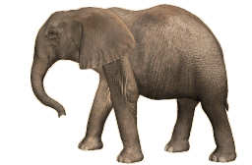
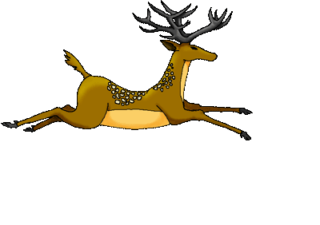
What can you see the picture?
Do you find out any difference between them ?
Their difference between sizes.

Slide 7
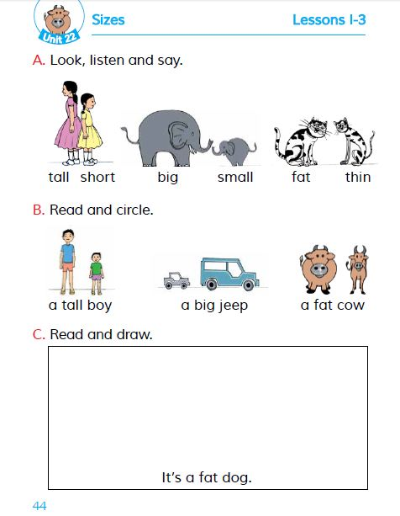
Today’s lesson
Size
Unit : 22
Lessons : 1-3
Page : 44

Slide 8
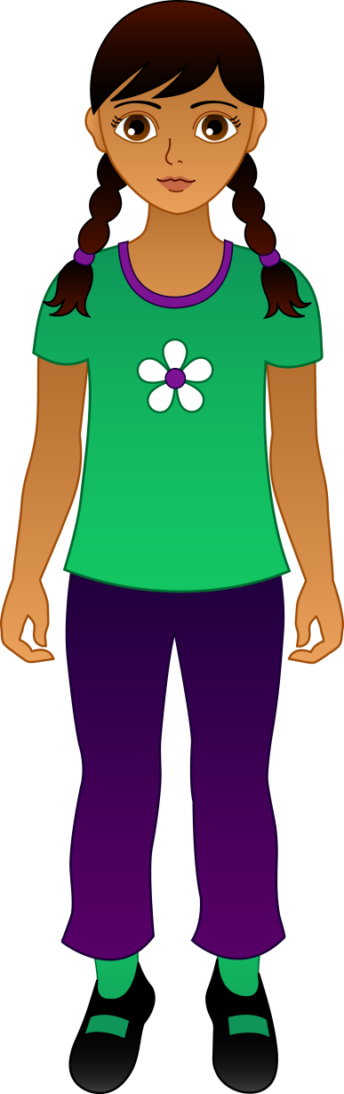

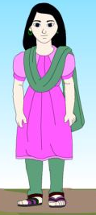
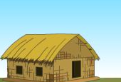
Look, listen and say
WCW
Tall
Short
Short
Tall

Slide 9

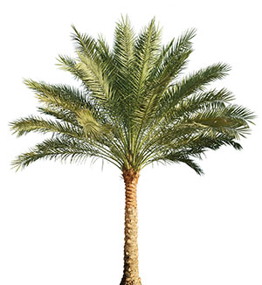
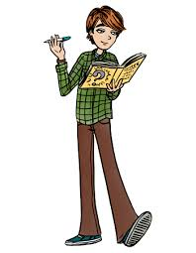
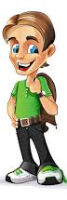

Look, listen and say
WCW
Tall
Short
Tall
Short

Slide 10
Look, listen and say
WCW
Small
Big

Slide 11

Look, listen and say
WCW
Small.
Big

Slide 12

Look, listen and say
WCW
Big
Small

Slide 13
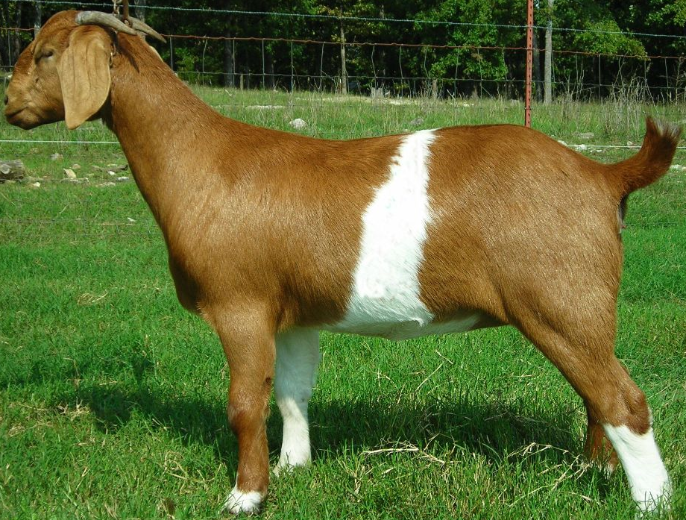
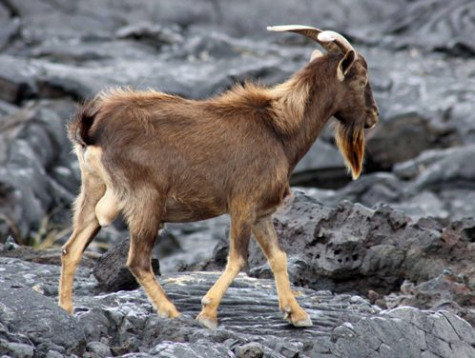
Look, listen and say
WCW
Fat
Thin

Slide 14
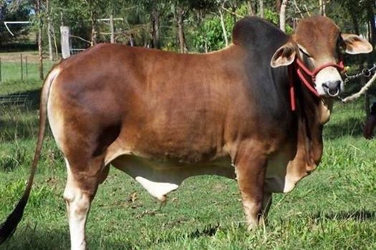
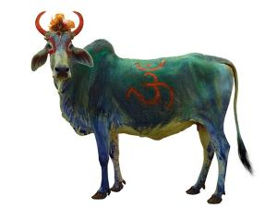
Look, listen and say
WCW
Fat
Thin

Slide 15
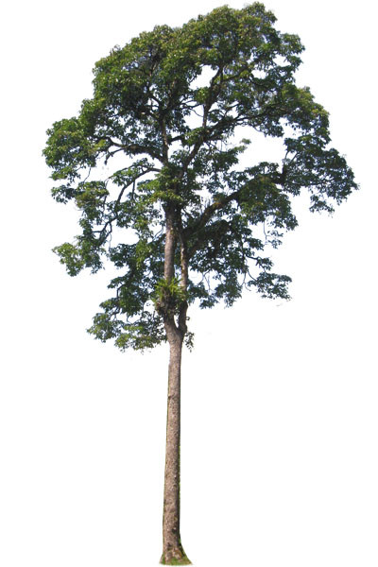
Look, listen and say
WCW
Short
Long

Slide 16
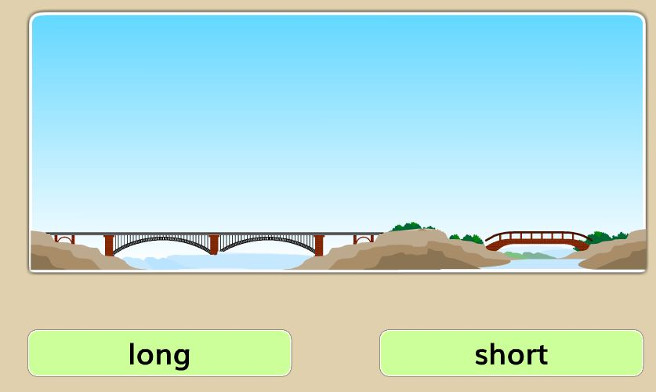
Look, listen and say
WCW
Long
Short

Slide 17
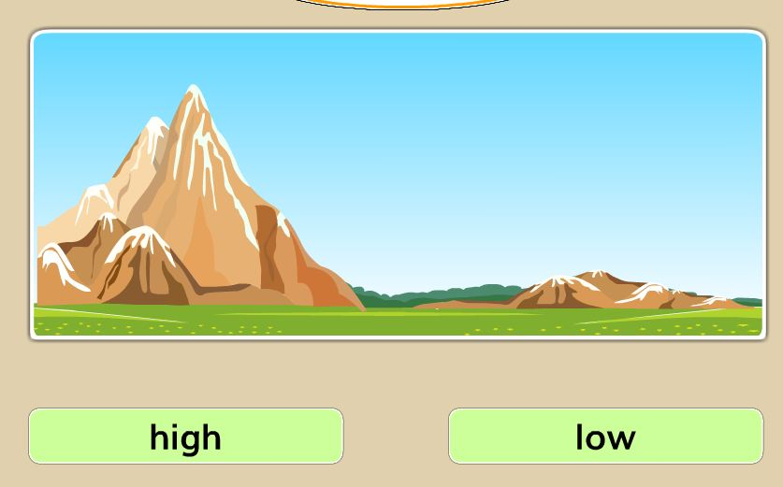
Look, listen and say
WCW
High
Low

Slide 18
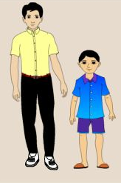
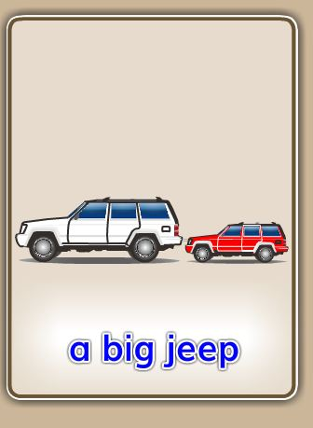
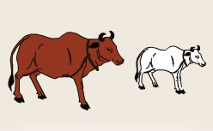
Group work
Read and circle
A big jeep
A fat cow
A tall boy

Slide 19
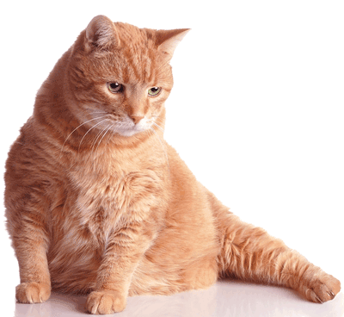
Look, listen and Say
WCW
Click on the picture
It’s a fat cat.

Slide 20
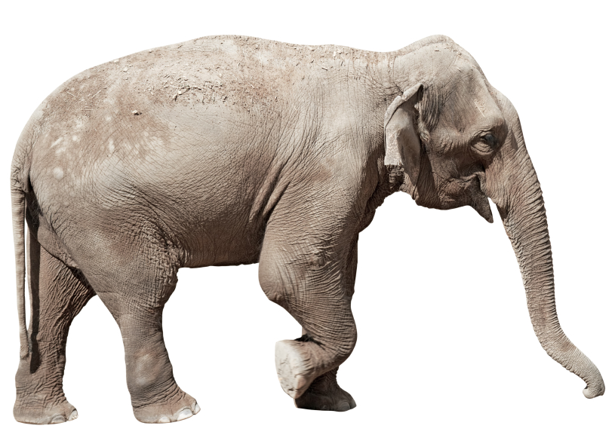
Look, listen and Say
WCW
Click on the picture
It’s a fat elephant.

Slide 21
Look, listen and Say
WCW
Click on the picture
It’s a fat cow.

Slide 22
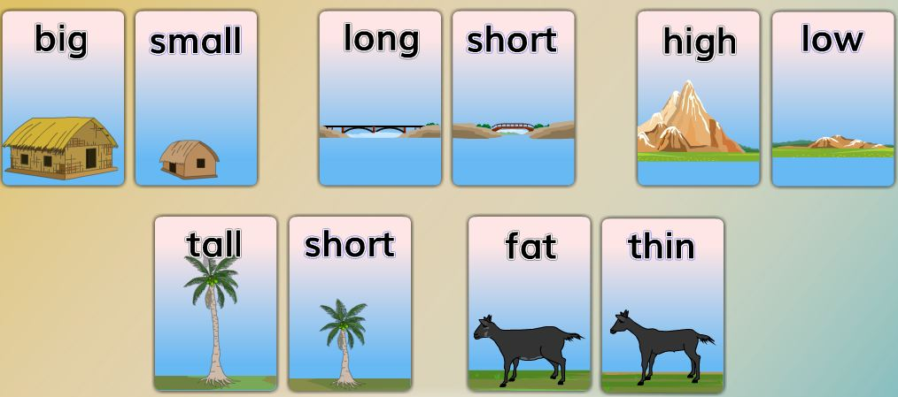
Pair Work
Write the words in your exercise books

Slide 23

Evaluation
It’s a ……………tree.
tall
small
It is a ………….. house .
It’s a ………… goat .
fat

Slide 24
Matching
Big
Short
Tall
Low
High
Thin
Fat
Small

Slide 25
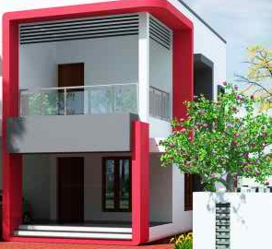
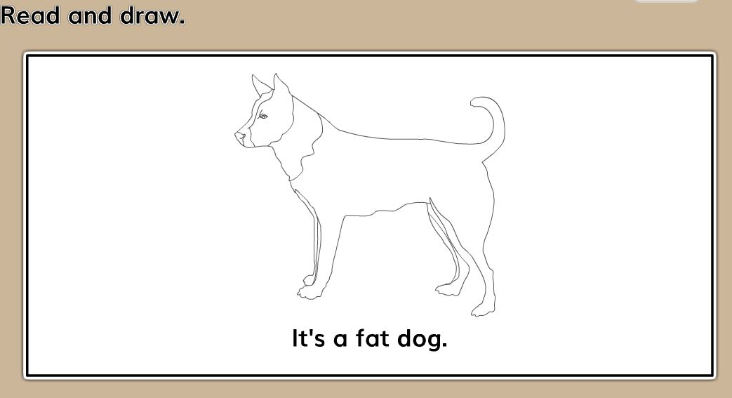
Home work
Read and draw
It is a fat dog.

Slide 26
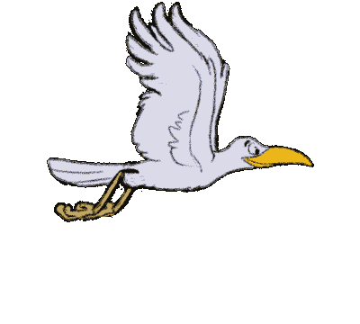
Thank you everybody.
See you again.
Bye Bye

