Slide 1
Dear students, welcome to my class

Slide 2
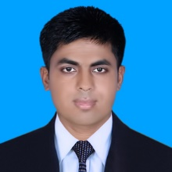
Introduction
Lesson`s Identity
Class Nine
Subject: English 2nd Paper
Lesson: Grammar(Completing)
Time : 40 minutes
Teacher`s Identity
Abul Kashem Miah
Assistant Teacher(English)
Shaheed Alauddin High School
Mirjapur,Pakundia, Kishoreganj

Slide 3
Evaluation Of previous Class

Slide 5
Too……. To :
Subject+ verb + too+ adj/adv+ to+ Verb (base form)+ extension
Example:
The man is too weak to walk.
He is too dishonest to speak the truth.
He is too old to work.
He is too silly to solve the math.

Slide 6
Too……….. To:
Subject+ verb + too + adj/adv + for + personal object+ to + verb(base form) + extension.
Example:
The load is too heavy for him to carry.
There was too much snow for us to go walking.
The problem was too hard for them to sovle.
It is too interesting a matter for us to overlook.

Slide 7
Unless(If not):
Unless + subject + verb + obj+ , Sub+ verb+ obj.
Sub+ verb+ obj+ unless+ sub+ verb+ obj.
Unless you read attentively , you will fail.
He will not shine unless he works hard.
Unless you have good health, you cannot be happy.
Unless he practices English, he can`t learn it well.
Unless you are united, you will not be able to face any crisis boldly.

Slide 8
Though /although :
Though /although + subject + verb+ object,………………………………….
…………………………….. though /although + subject + verb+ object.
Though /although + subject + verb+ object, sub+ verb(according to tense of first clause) + object+ extension.
Or, Subject + verb+ object + extension+ though/although + Subject + verb+ object
Example:
Though the man is poor, he is large hearted.
He could not catch the bus although he ran fast.
Though cricket is a costly game, it is widely played in our country.
He could not get a job although he had a good educational qualification.

Slide 9
Exercise
Unless you have good health ,………………………………………
The boy is too weak in mathematics ……………………………..
Unless we stand ,…………………………………………….
--------------------- unless you work hard.
Unless you united ,…………………………………..
Unless he starts at once,……………………………………..
Though Bangladesh has limited natural resources,…………..
Although the slum dwellers do hard lobour from dawn to dusk,…….
Though lost wealth can be regained by hard work, lost time………….
…………though he did not do hard labour.

Slide 10
Home work
Revision of the above rules.
Practice of the given examples

Slide 11
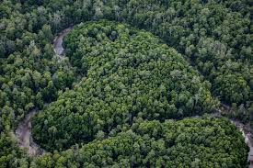
See you again. Good by.
Thanks all.

