Slide 1
Welcome

Slide 2
Identity
Teacher’s Identity
Lesson Identity
Md Harisur Rahman
Asst.Teacher (English)
Lamkain wahedia Dakhil Madrasha
Gafargaon,Mymensing
Class : Ten
Subject : English For Today
Unit : Eight, World heritage
Lesson : The Shat Gambuj Mosque
Time : 50 minutes

Slide 3
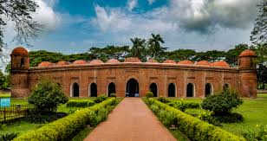
Shat Gombuj Mosque in Bagerhat

Slide 4
Learning Outcomes:
At the end of the lesson, students will be able to:
know about UNESCO
know about Shat Gombuj Mosque
read and understand texts
ask and answer questions

Slide 5
*The UNESCO is an agency of the United Nations.
*UNESCO means United Nations Educational, scientific and Cultural Organization.
*The Shaṭ Gambuj Mosque is situated at the outskirts of Bagerhat town.
^{*Ulugh} Khan Jahan founded the mosque in the 15 ^{th} century.
^{*The} mosque has 60 pillars and 77 domes.
* It has 4 towers at 4 corner and 11 mihrabs.

Slide 6
Home work
Shat Gambuj Mosque | Information
Founded by
When
Number of domes
Number of pillars
Number of Mihrabs
Number of towers

