Slide 1

WELCOME

Slide 2
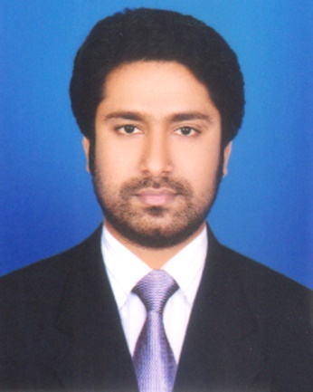
Presented by
M Humayun Kabir
English Teacher
Bhayeta Abdul Quddus Dakhil Madrasah, Tangail Sadar
Cell : 01727-425565 ; 01924-320532
E-mail : hkabir082009@gmail.com

Slide 3
Lesson Identity
Tense - English (Part-1 Primary)
Class Six
Unit Six
16 October 2019

Slide 4
Learning outcomes
After we have studied this lesson, we will be able to
learn about the tenses.
know the kind of tenses and
find out the tenses.

Slide 5
Let’s Enjoy a Video

Slide 6
Tense (সময়)
Present (বর্তমান)
Past
(অতীত)
Future
(ভবিষ্যত)
1. Simple / Indefinite (সাধারণ)
2. Continuous / Progressive (চলমান)
3. Perfect (ঘটমান)
4. Perfect Continuous (পুরাঘটিত ঘটমান)

Slide 7
Simple
Present (বর্তমান)
Past
(অতীত)
Future
(ভবিষ্যত)
1. Present Simple
2. Past Simple
3. Future Simple

Slide 8
Continuous
Present (বর্তমান)
Past
(অতীত)
Future
(ভবিষ্যত)
1. Present Continuous
2. Past Continuous
3. Future Continuous

Slide 9
Perfect
Present (বর্তমান)
Past
(অতীত)
Future
(ভবিষ্যত)
1. Present Perfect e
2. Past Perfect
3. Future Perfect

Slide 10
Perfect Continuous
Present (বর্তমান)
Past
(অতীত)
Future
(ভবিষ্যত)
1. Present Perfect Continuous
2. Past Perfect Continuous
3. Future Perfect Continuous

Slide 11
Assessment-1
How many Tenses are totally in number ? Who are they ?

Slide 12
Let’s Learn 12 Tenses in a Sentence
Step-1
Simple
Present Simple : I recite a poem.
Past Simple : I recited a poem.
Future Simple : I shall recite a poem.
V1 (s/es)
V2
Shall / will V1

Slide 13
Simple
s/es
Present Simple : He recites a poem.
Past Simple : He recited a poem.
Future Simple : He will recite a poem.
V1 (s/es)
V2
Shall / will V1

Slide 14
Continuous
Present Continuous : I am reciting a poem.
Past Continuous : I was reciting a poem.
Future Continuous : I shall be reciting a poem.
am; is; are Ving
was ; were Ving
shall; will be Ving

Slide 15
Perfect Continuous
P. P. Continuous : I have been reciting a poem for 10 minutes.
P. P. Continuous : I had been reciting a poem for 10 minutes.
F.P. Continuous : I shall have been reciting a poem for 10 mn.
have / has been Ving Time
had been Ving Time
shall / will have been Ving Time
For = যাবৎ / ধরে (for 3 hours/days)
Since = হতে / থেকে (since morning/2000 years)

Slide 16
Perfect
Present Perfect : I have recited a poem.
Past Perfect : I had recitied a poem.
Future Perfect : I shall have recitited a poem.
have / has V3
Had V3
shall / will have V3

Slide 17
Step-2
Simple
Present Simple : I am a student.
Past Simple : I was a student.
Future Simple : I shall be a student.
Am; is; are non-verb
Was; were non-verb
shall / will be non-verb

Slide 18
Simple
Present Simple : It am easy.
Past Simple : It was easy.
Future Simple : It will be easy.
Am; is; are non-verb
Was; were non-verb
shall / will be non-verb

Slide 19
Simple
Present Simple : There is a ball in the field.
Past Simple : There was a ball in the field.
Future Simple : There shall be a ball in the field.
Am; is; are non-verb
Was; were non-verb
shall / will be non-verb

Slide 20
Assessment-2
Open your Text Book
Remember our class at a glance
and try to find out
The Tenses

Slide 21
Home Task
Remember our class at glance
and try to find out
The Tenses
in your text books and journals
And make a list.
1. Text Book (English for Today)
Newspaper (The Daily Star)

Slide 22

Thank You All
May Allaah swt learn and expert us in The Tenses (our roots).

