Slide 1

WELCOME

Slide 2

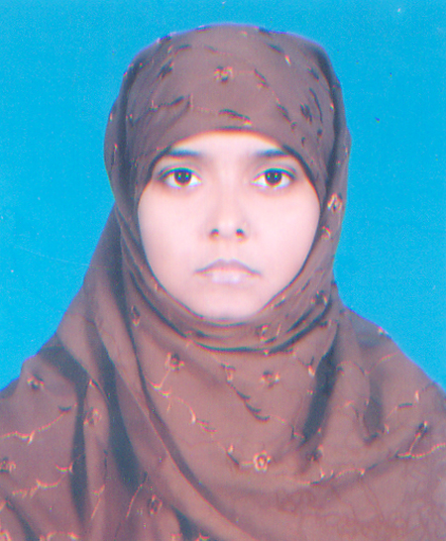
TEACHER INTRODUCTION
Farhana Akter
Assistant teacher(ICT)
Jaria Islamia S. D Madrasah
Post : Town-nawapara
Upazilla : Fakirhat
Dist : Bagerhat

Slide 3
ENGLISH 2nd paper
Parts of Speech
Class : Six
Time : 40Minute
LESSON

Slide 4
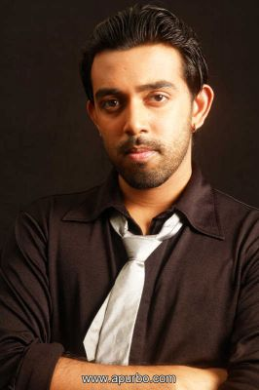
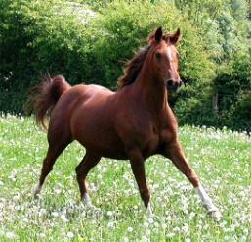
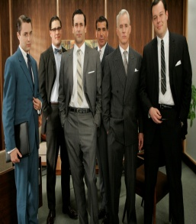
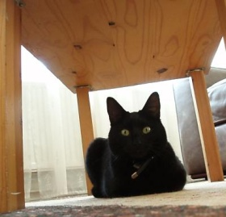
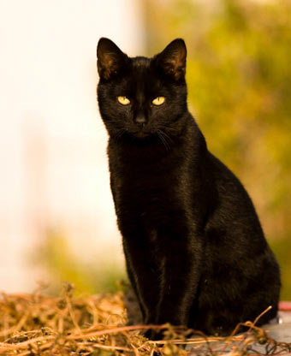
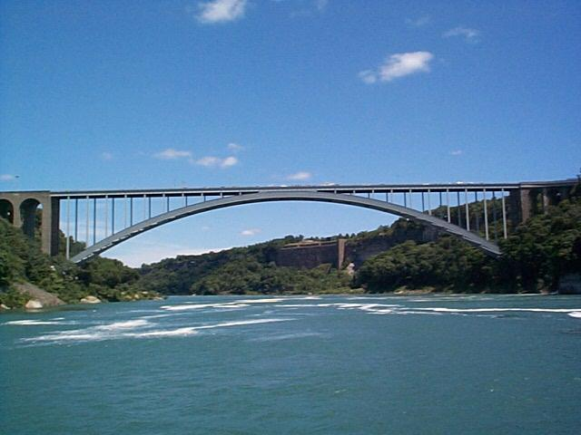
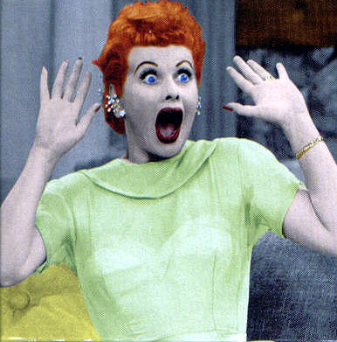
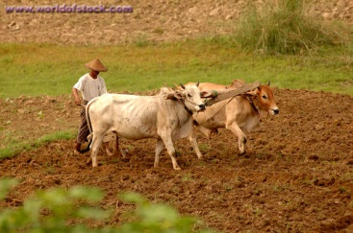
Noun
Adverb
Pronoun
Preposition
Adjective
Conjunction
Verb
Interjection

Slide 5
OBJECTIVES
After enjoying the picture can understand the subject matter.

Slide 6
1. I have many…….
2. It is my ……….
3. This cow is ………
4. Birds ………. in the sky.
5. The old man walks …….

Slide 7
Now students I am making you in group. Find out the words and make a list of parts of speech, Fan, he, bad, dig, fast, under, but, hurra.
GROUP WORK

Slide 8
EVALUATION
Match the following words with the pictures.

Slide 9
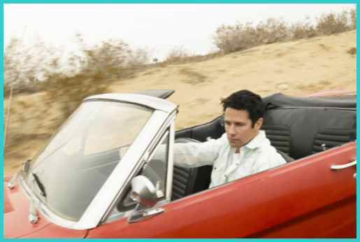

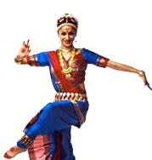


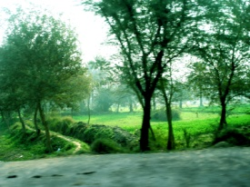

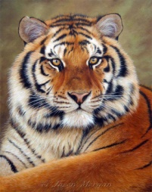
NOUN
PRONOUN
ADJECTIVE
VERB
ADVERB
PREPOSITION
CONJUNCTION
INTERJECTION

Slide 10
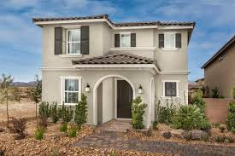
Home Work
You wii write eight sentences and underline
Parts of speech

Slide 11

THANKS TO ALL

