Slide 1

WELCOME

Slide 2
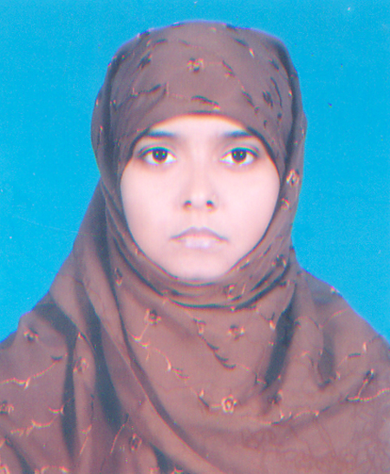
PRESENTATION BY
Farhana Akter
ASSISTANT TEACHER (ICT)
Jaria Islamia s.d. madrasah
CLASS –VI
SUBJECT-ENGLISH
LESSON-26(Our wage earners)
Time40Minute)

Slide 3


Slide 4
Learning outcome -1.Do you know how many Bangladeshis work abroad?
2.Do you know what countries they work in ?
3. Can you guess how hard they work ?

Slide 5
Group work
Group-----------1.
Group-----------2
Group----------- 3
Group-----------4
Colum -A
Colum –B-(Find out Answer)
Number of jobseekers going abroad in May
Skilled professionals migrate to.
Countries preferring Bangladeshi manpower.
Total remittance /foreign exchange earned in May,2012.

Slide 6
Evaluation
1. How many number of person going to abroad For job ?
2. Which country they were go?
3. Why they are hard work do ?

Slide 7

HOME WORK
You read the passage -----Find out the (U A E)
Country name.

Slide 8


THANK YOU

