Slide 1
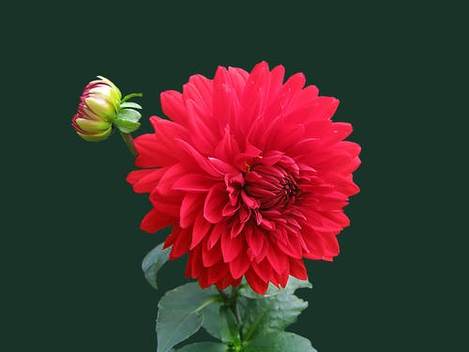
Welcome

Slide 2
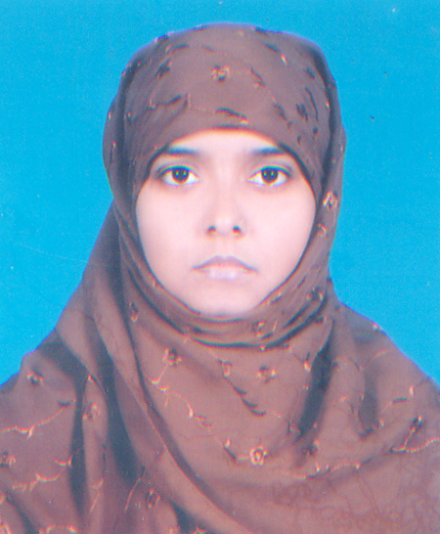
Identity
Farhana Akter
Asst. Teacher(ICT)
Jaria I.S.D Madrasah
Fakirhat, Bagerht
English For Today
Class : Six.
Lesson-13
Time-40Minutes

Slide 3
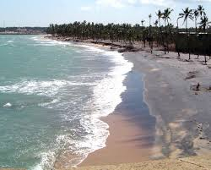
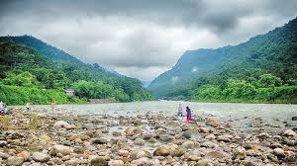
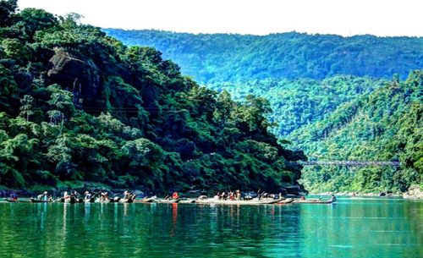
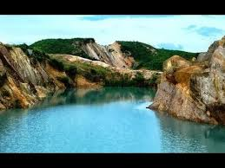
Look at the pictures
Do you know what about these pictures ?
These are beauties of Bangladesh.

Slide 4
Today’s topic
beauties of Bangladesh

Slide 5
Learning outcomes
After completing the lesson students will be
able to –
1. ask and answer the questions
2. read and understand text
3. write short paragraphs

Slide 6
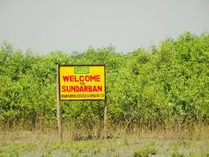
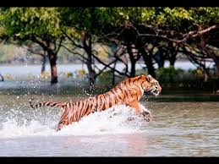
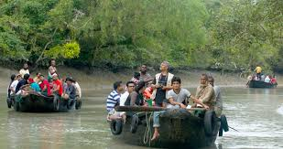
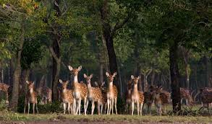
Look at the pictures

Slide 7
Write a passage on a place of tourist attraction that you see in the picture.

Slide 8
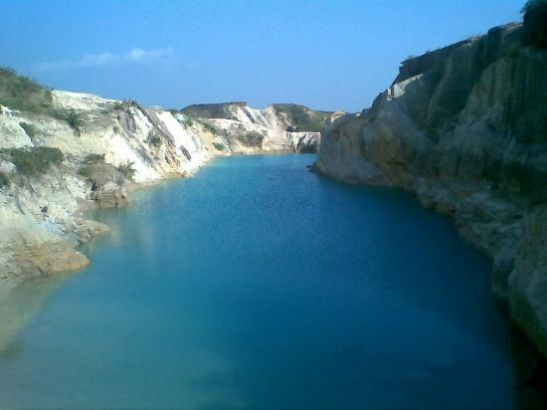
Birishiri is an attractive tourist spot in Netrakona district.

Slide 9
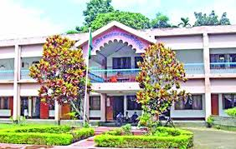
Birishiri
Cultural Academy

Slide 10

Home work
Write a paragraph about the beauties of Bangladesh.

Slide 11

Goodbye

