Slide 1
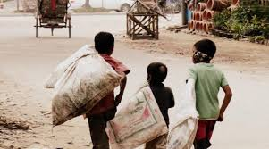
Welcome
Notes:
I use this picture to make thankful the students about the topic.

Slide 2
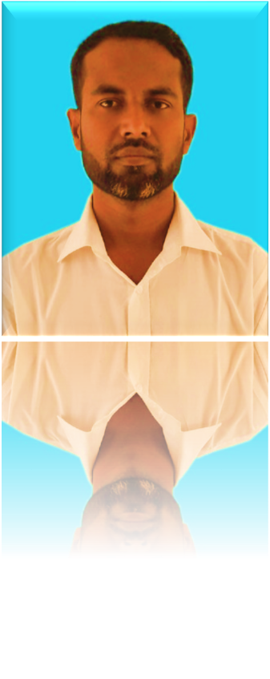

Introduction
Zakir Hossen
Lecturer in English
Bhulkara Islamia Alim Madrasah
Chouddagram,Cumilla
Mobile-01818713909
English for today
Class _ XI-XII
Notes:
Teacher can hide the slide, if he wants.

Slide 3
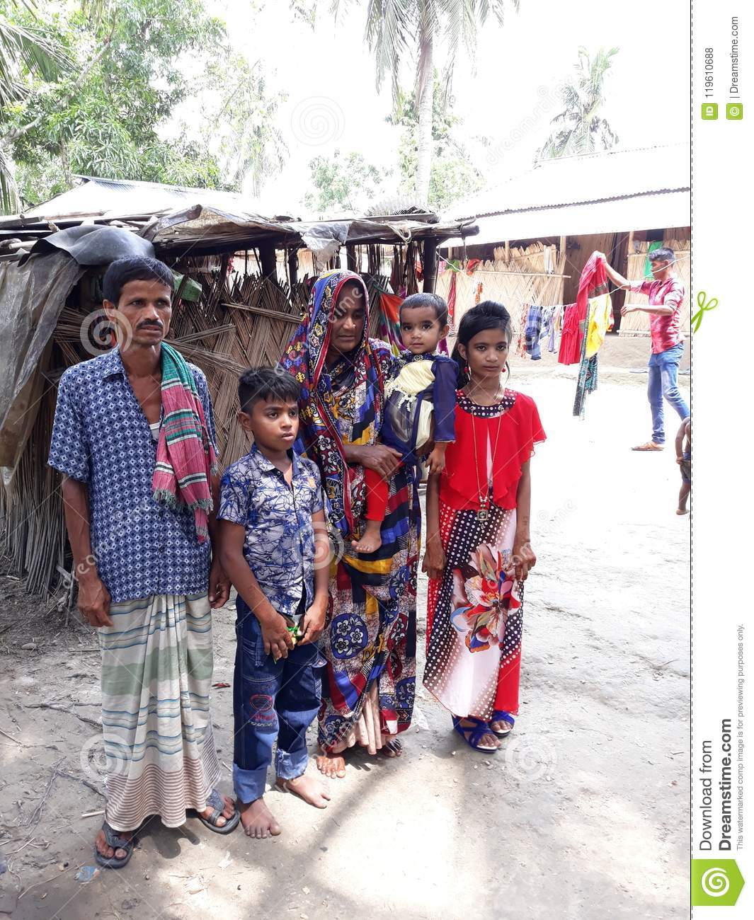
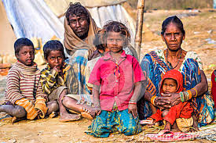
What do you see in the pictures?
Children living with their parents
Notes:
Correct Answer will be provided after the students answer.

Slide 4
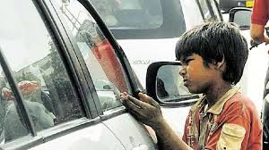
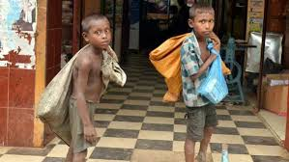
Why are they doing these?
They have no parents
Notes:
Caption will be given after the picture.

Slide 5
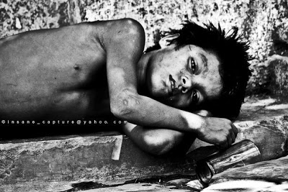
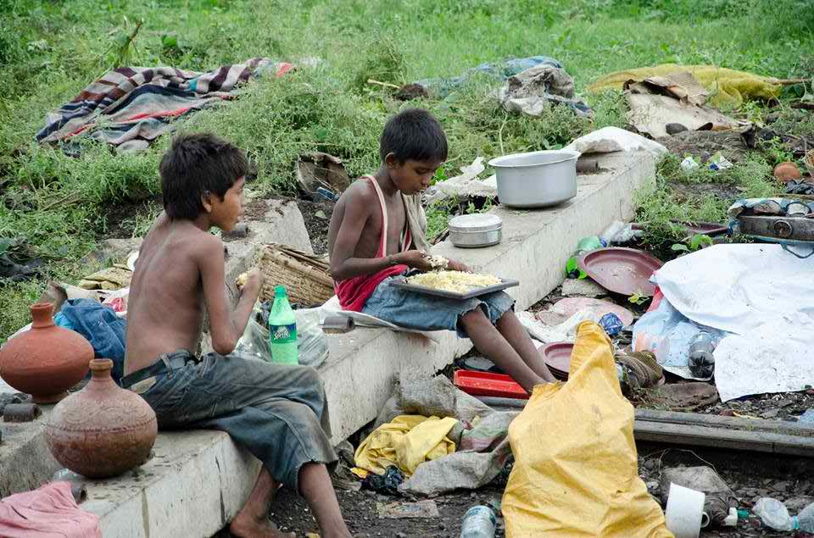
Who are they?
Street children
Notes:
Ss will give different kind of answer. Teacher will write their answer and then give the correct answer.

Slide 6
Our today’s topic is-
Amerigo,a street children
Notes:
Teacher will write the topic name on the board.

Slide 7
Learning outcomes
By the end of the lesson SS will be able to-
Read and understand the text through silent reading;
Read aloud make sounds with stress;
Read text silently for comprehension.
Notes:
Learning outcomes should be read out by the students. Teacher can hide this slide, if he wants.

Slide 8


existing or happening independently
or in a different physical space.
separate
adjective
/ˈsep.ɚ.ət/
The art department and the music department are in two separate buildings
Notes:
Students will be able to pronounce the word correctly and make sentence. Caption will be provide later

Slide 9
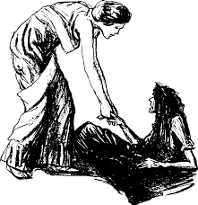
beg
to make a very strong and urgent request:
verb
/beɡ/
They begged for mercy.
Notes:
Students will be able to pronounce the word correctly and make sentence. Caption will be provide later

Slide 10
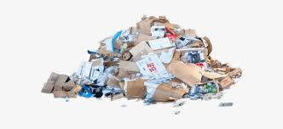
something that is of low quality.
Trash
noun
I can't believe that someone of his intelligence can read such trash!
/træʃ/
Notes:
Students will be able to pronounce the word correctly and make sentence. Caption will be provide later

Slide 11
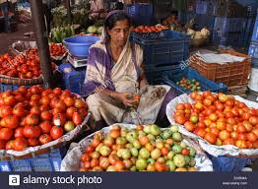
someone who is selling something.
vendor
noun
/ˈven.dɚ/
The vendor of the house wants to exchange contracts this week
Notes:
Students will be able to pronounce the word correctly and make sentence. Caption will be provide later

Slide 12
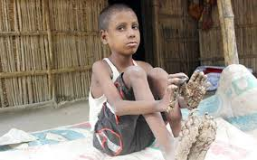
a disease in a part of your body that is caused by bacteria or a virus.
infection
noun
/ɪnˈfek.ʃən/
Bandage the wound to reduce the risk of infection.
Notes:
Students will be able to pronounce the word correctly and make sentence. Caption will be provide later

Slide 13
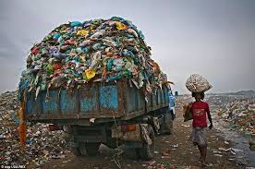
rubbish
waste material or things that are no longer wanted or needed.
noun
/ˈrʌb.ɪʃ/
I forgot to put the rubbish out this morning.
Notes:
Students will be able to pronounce the word correctly and make sentence.

Slide 14
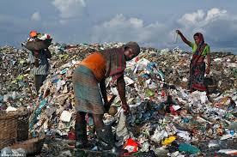
sorting
Searching same type of things
noun
We both like the same sort of music.
/sɔːt/
Notes:
Students will be able to pronounce the word correctly and make sentence.

Slide 15
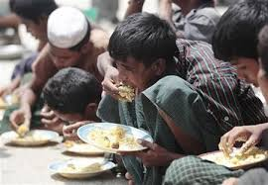
hungry
wanting or needing food:
adjective
/ˈhʌŋ.ɡri/
By four o'clock I felt / was really hungry
Notes:
Students will be able to pronounce the word correctly and make sentence.

Slide 16
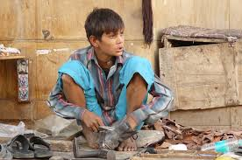
Shoe shining
Shoe shining
Amerigo worked shoe shining.
Notes:
Students will be able to pronounce the word correctly and make sentence.

Slide 17
Pre-reading
Dear students, you will read the first Para and
try to find out the answer of the question silently.
Who is Amerigo?
How old is he?
Where are Amerigo’s parents?
Notes:
Students will read the passage individually and try to find this questions answer.

Slide 18
While reading
Dear students, Now read the whole passage and try to write down the answer the question given below..
What was Amerigo’s first job?
How is Amerigo’s experience of selling ice cream?
What is your impression about Amerigo’s parents?
What does Amerigo desire now?
Notes:
Students will do the work in pair and write down the answer in their notebook. Teacher will help them to find the answer of the questions.

Slide 19
Post reading
Read the following text again. Make a list of the difference between yours,
and Amerigo’s lives:
Amerigo’s life | My life (Similarities) | My life (Dissimilarities)
1.He is 13. | 1. I am 17 | 1. -----------
2. He lives on the street alone. | 2. ------------- | 2. I live in house with my parents.
3. He is deprived of his parental care. | 3. ------- | 3. I am nourished with my parental care.
4. He is male in gender. | 4. I am male in gender | 4. ----------
5. | 5. | 5.
6. | 6. | 6.
7. | 7. | 7.
Notes:
Students will do the work in group and try to solve the question from their understanding.
Teacher will play the role of a monitor.

Slide 20
Evaluation
Answer the following questions:
What is your impression about Amerigo’s parents?
What was Amerigo’s first job?
What made him stop doing that job?
How is Amerigo’s experience of selling ice cream?
How does Amerigo evaluate his life now?
Notes:
Teacher will write the students answer on the board and then provide the correct answer.

Slide 21
Thank you dear students
Notes:
This picture is given to remind the students about the topic again.

